Slide 1
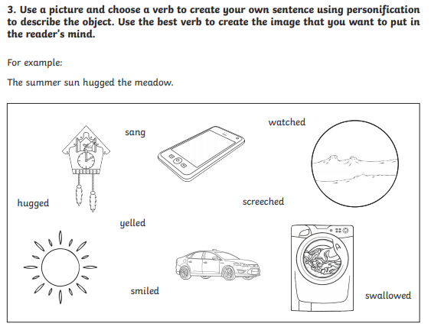
Let’s get started!

Slide 2
L.O. I am learning to write a poem.
Context: The Great Storm Cat

Slide 3
Today we are going to use everything that we have learned this week to write a poem that uses personification.

Slide 4
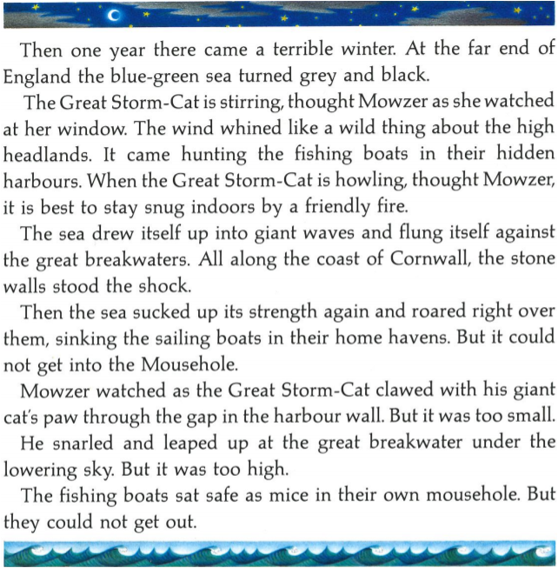
We are going to use the storm on Page 9 to help us write our poems.

Slide 5
Use your ideas from yesterday and some from below to help you.
A beast ready to be unleashed
The greatest stalker of all
The Great Storm Cat
A protector of the sea
A predator ready to strike
Destructive
Cunning
Vicious
Sly
Devious
Claws as swords
Attacking paws
Roars
Howls
Hunting hands
Striking the angry waves
Clawing at it’s victims

Slide 6
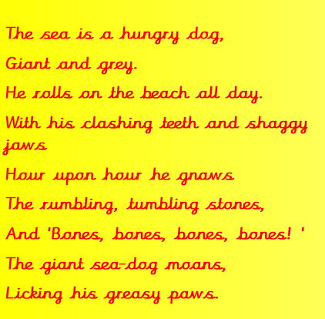
We can use The Sea by James Reeves to help us!
Have a look at my example.
The Great Storm Cat is the Queen of the sky,
Furious and menacing.
She hunts the seas fishermen.
With her razor sharp claws and wild ways
Hour upon hour she strikes again
The rumbling, tumbling waves
And ‘Crash, crash, crash!’
The Great Storm Cat moans.
Seeking out her prey.

Slide 7
Can you change the parts in red to make your own poem?
The Great Storm Cat is the Queen of the sky,
Furious and menacing.
She hunts the seas fishermen.
With her razor sharp claws and wild ways
Hour upon hour she strikes again
The rumbling, tumbling waves
And ‘Crash, crash, crash!’
The Great Storm Cat moans.
Seeking out her prey.
Challenge –
To write another stanza, describing the Great Storm Cat.
If you do not want to follow this structure, that is absolutely fine. You can write in your own style describing the Great Storm Cat.

