Slide 1
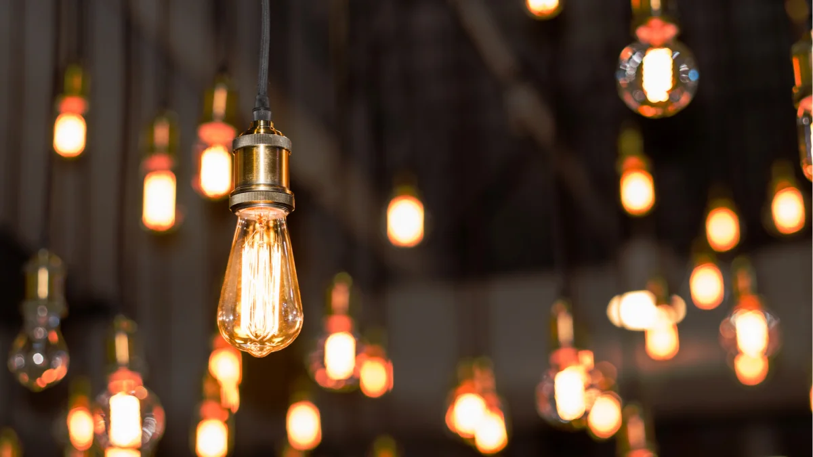
Year 3
Light

Slide 2
Think back to last lesson. What do a mirror and the moon have in common?

Slide 3
Light reflects off both a mirror and the moon. The light comes from a light source and is bounced back off the surface of the mirror or the moon.
Can you think of anything else that reflects light?

Slide 4
Actually, almost every surface reflects light. Different surfaces reflect different amounts of lights. For example, a high visibility jacket reflects a lot of light but a blackboard does not reflect much light.

Slide 5
Watch this short BBC Bitesize clip. https://www.bbc.co.uk/bitesize/clips/zs3ygk7

Slide 6
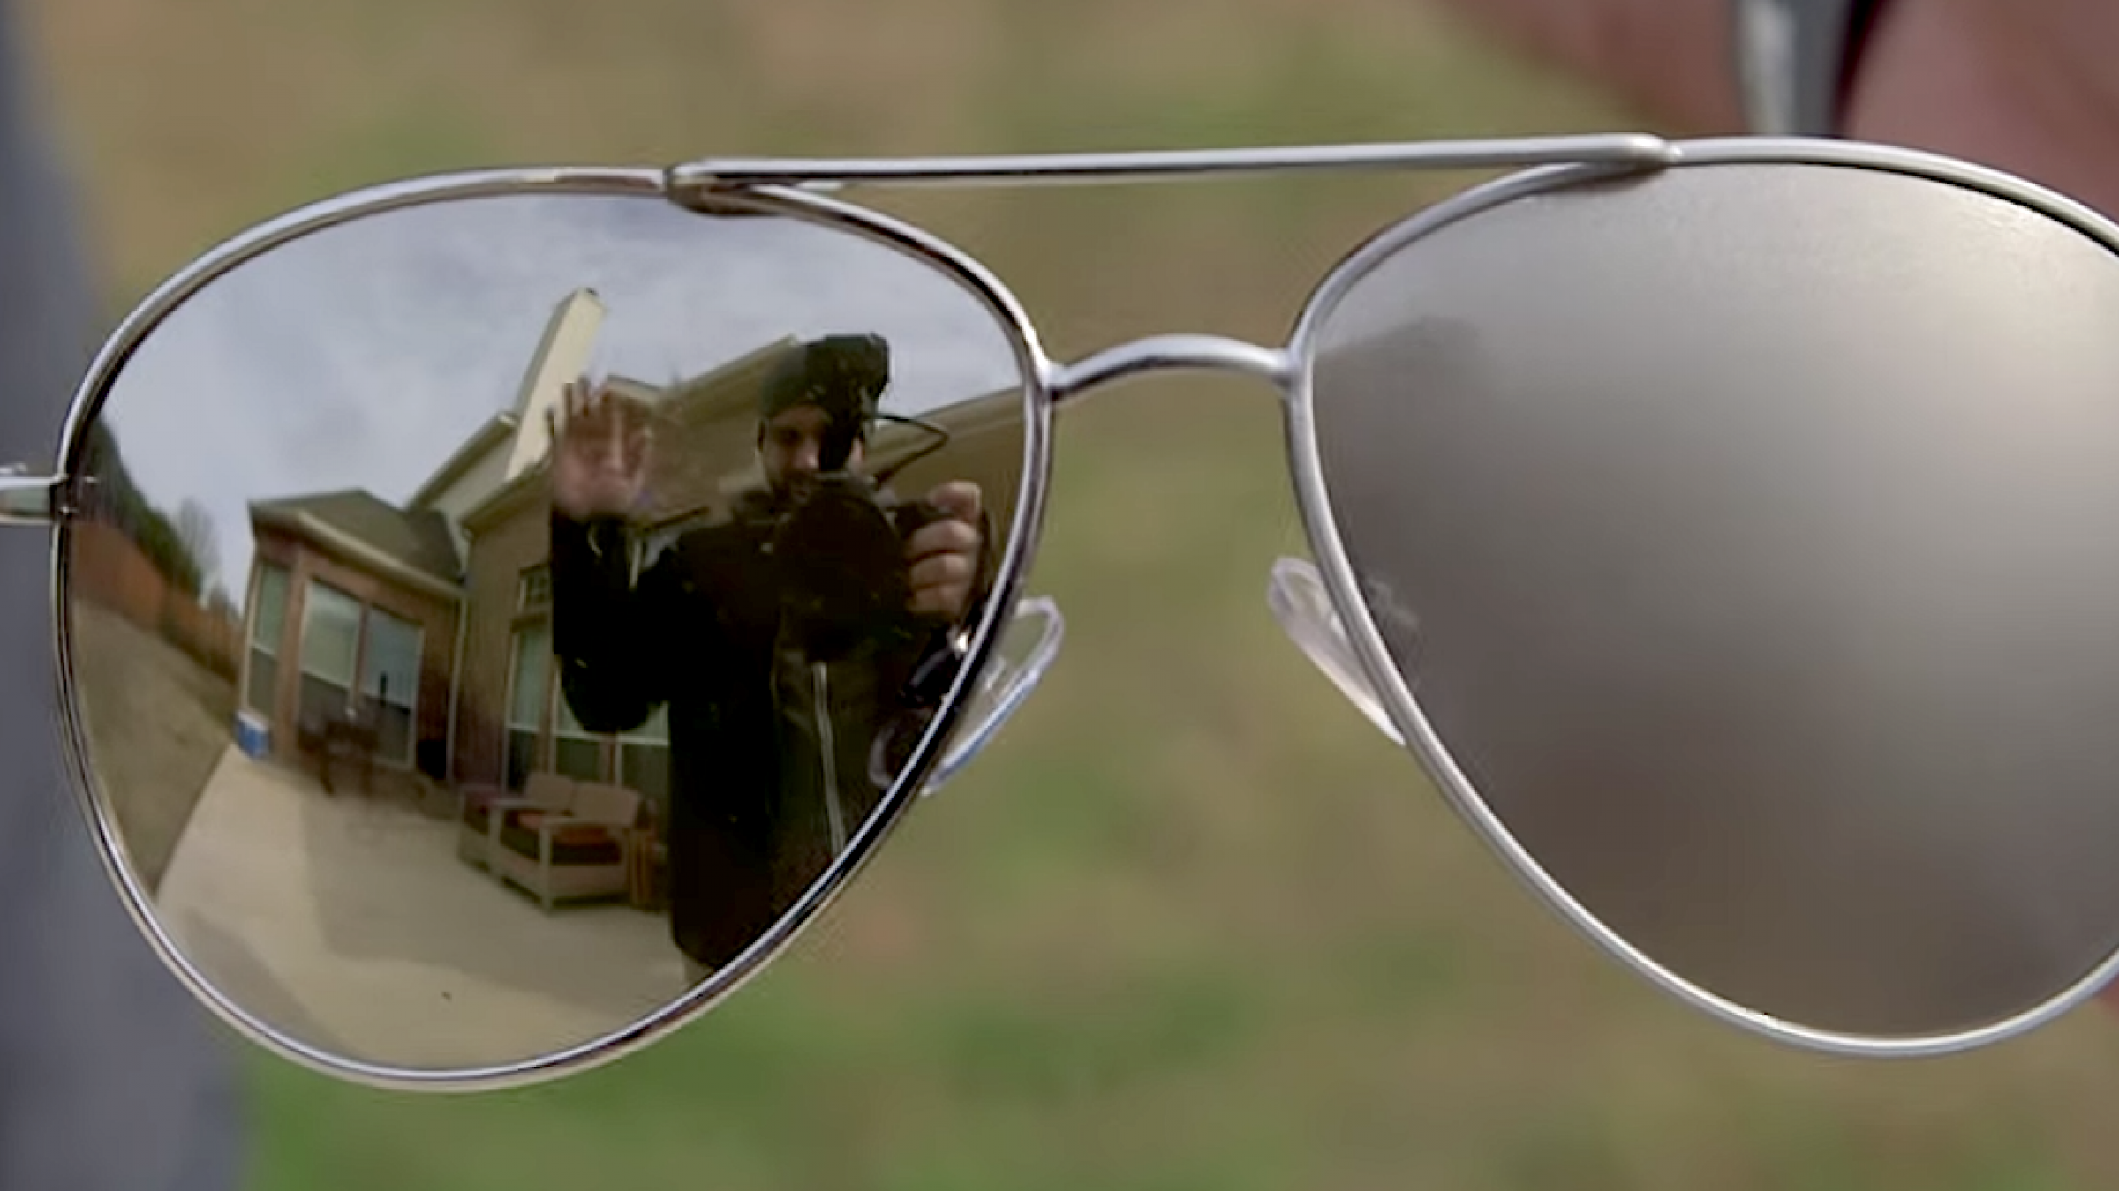
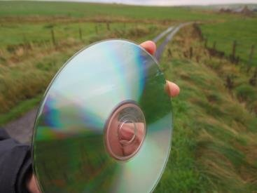
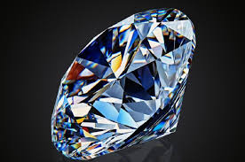
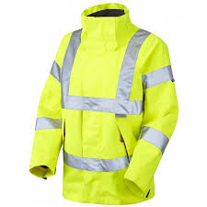
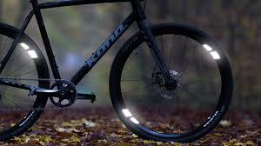
These are some examples of surfaces that reflect a lot of light.
Can you think of any more?

Slide 7
Your task today is to look around your home and find surfaces that reflect a lot of light. Use a torch or ask your grown up if you can use the torch on their mobile phone.
Before you start, make a prediction about what types of materials will reflect the most light.
(Tip: a lot of coats and trainers have a small reflective section on them; do yours?)

Slide 8
Write down what you found out and email it to your teacher.
What types of surfaces are the most reflective?
What types of surfaces are the least reflective?

