Slide 1

Let’s get started!
Look at the poems, can
you spot any personification?
Which is your favourite and why?
How does the poet make you feel?

Slide 2
L.O. I am learning to write a poem.
Text: The Mousehole Cat

Slide 3
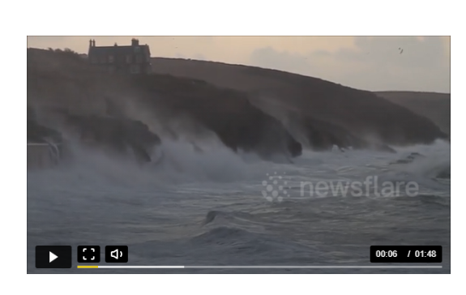
Mousehole
https://www.newsflare.com/video/25098/weather-nature/huge-waves-in-cornwall-as-storms-batter-the-uk

Slide 4
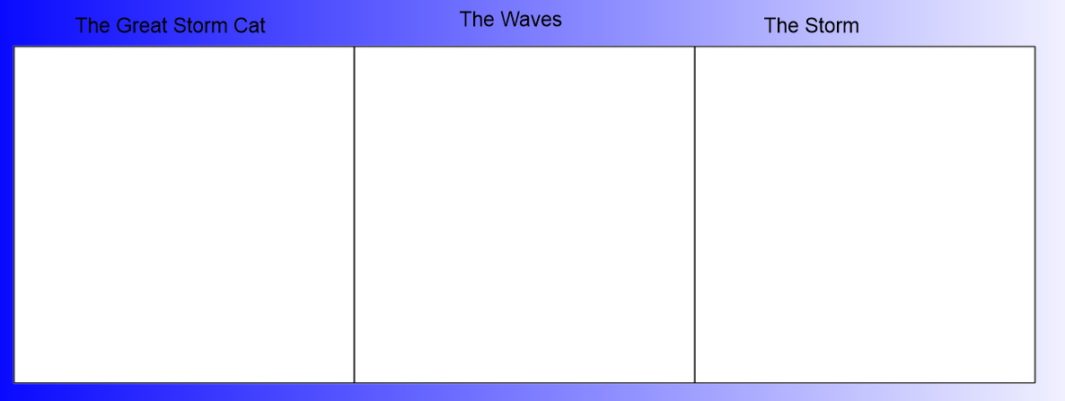
Listen to me reading you page 9. Draw pictures to show!

Slide 5
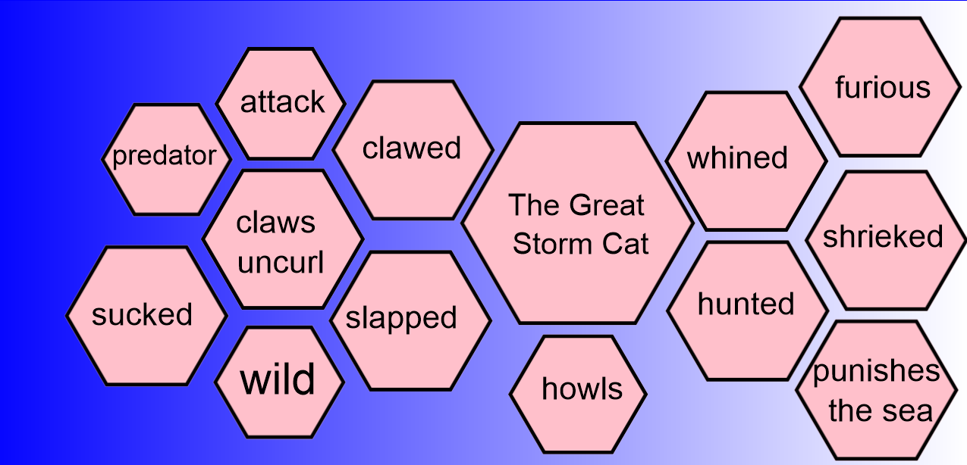
Now label your pictures!
Can you add any of your own words or phrases?

Slide 6
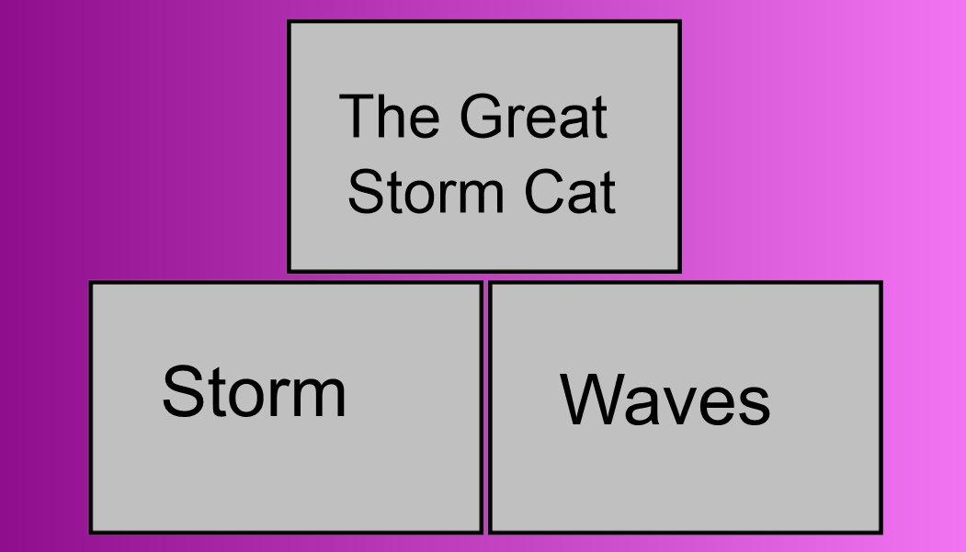
Now write 3 or 4 sentences to match your pictures.
Examples:
The Great Storm Cat hunted it’s prey.
Furiously, the storm made it’s way to the small fishing village.
Loud shrieks filled the sky as the wind attacked the cove.
Challenge:
Can you use personification for some of your sentences?

Slide 7
Which is your favourite sentence and why?

