Slide 1
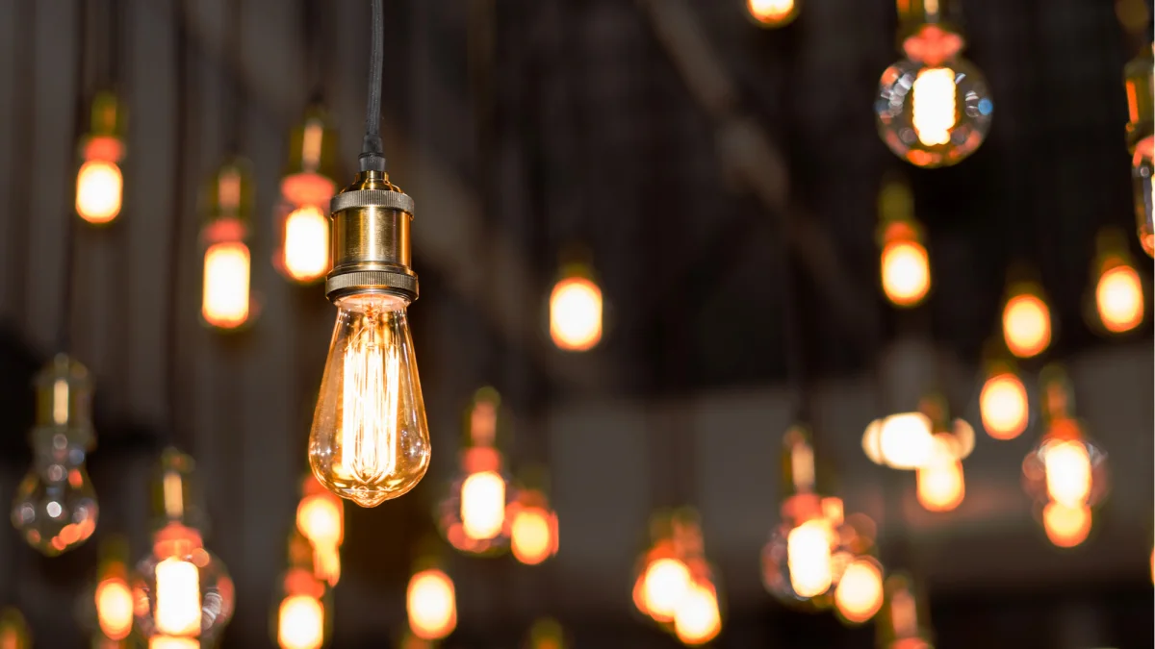
Year 3
Light

Slide 2
What is light?
What do you already know about it?
Share your ideas with your grown up or siblings.

Slide 3
Task 1: What is your darkest room in your home?
Can you make it as dark as possible?

Slide 4
What did you have to do to make the room dark?
Could you get it completely dark?

Slide 5
A light source is something that produces its own light. Can you think of any examples?

Slide 6

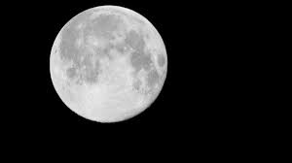
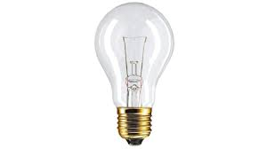
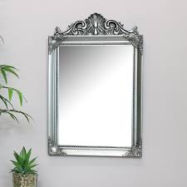
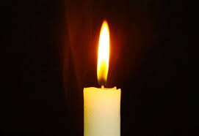
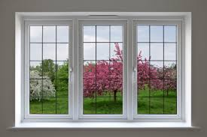
Can you sort these objects into light sources and not light sources?

Slide 7
Light source Not a light source

Slide 8
A mirror is not a light source because it does not make its own light. It reflects the light from other sources.
A window is not a light source. It is an opening that lets the light from the sun and other light sources into the room.
The moon is NOT a light source because it does not make its own light. We can see the moon because light from the sun reflects
off it (bounces off it) back to the Earth.

Slide 9
If you can, create a tube by rolling up some card of paper (dark colour is best but use what you can). Cover one end with another piece of card or paper.
Hold your tube tight up to your eye. What can you see?

Slide 10
Now ask a grown up to pierce a small hole in the side of your tube.
Now what can you see?

Slide 11
Dark occurs only when there is no light. For total darkness to happen, you need absolutely no light. You might have struggled to make your room totally dark earlier because it is very difficult to block all light.

Slide 12
Challenge: Can you use you tube again but this time draw a small picture on the card that covers the end. See if your grown up or a sibling can see the picture before a hole is made. (You can use the same tube, just put your finger over the hole until you need it).

Slide 13
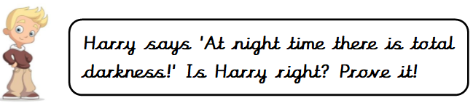
Super challenge:

