Slide 1
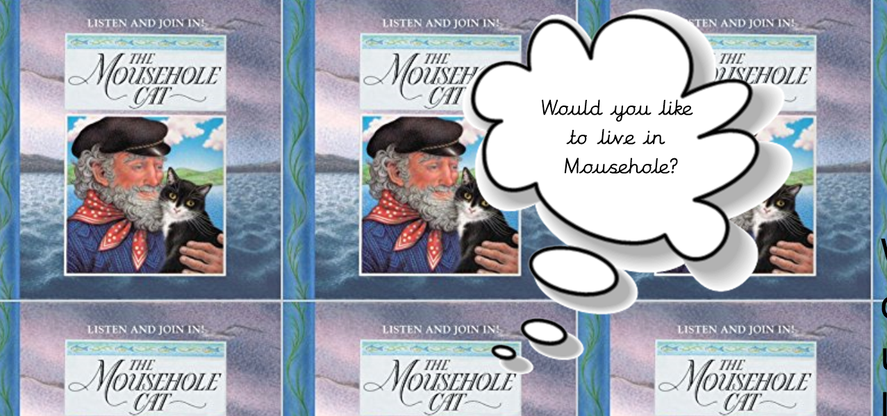


Slide 2
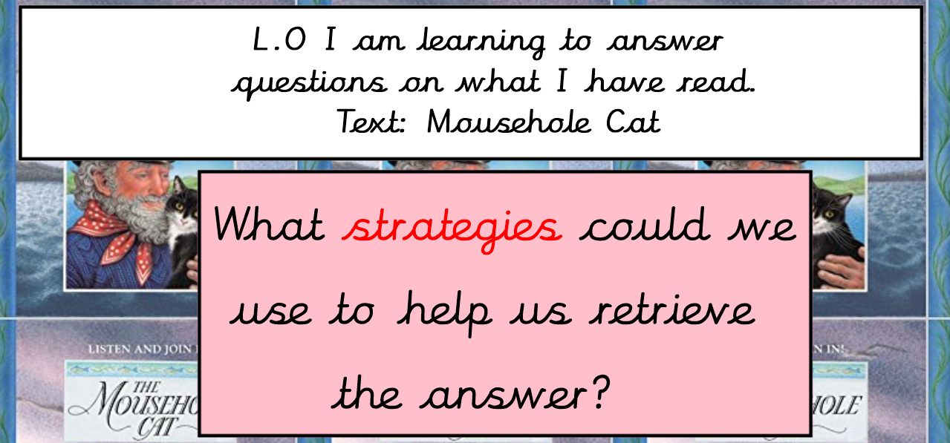

Slide 3
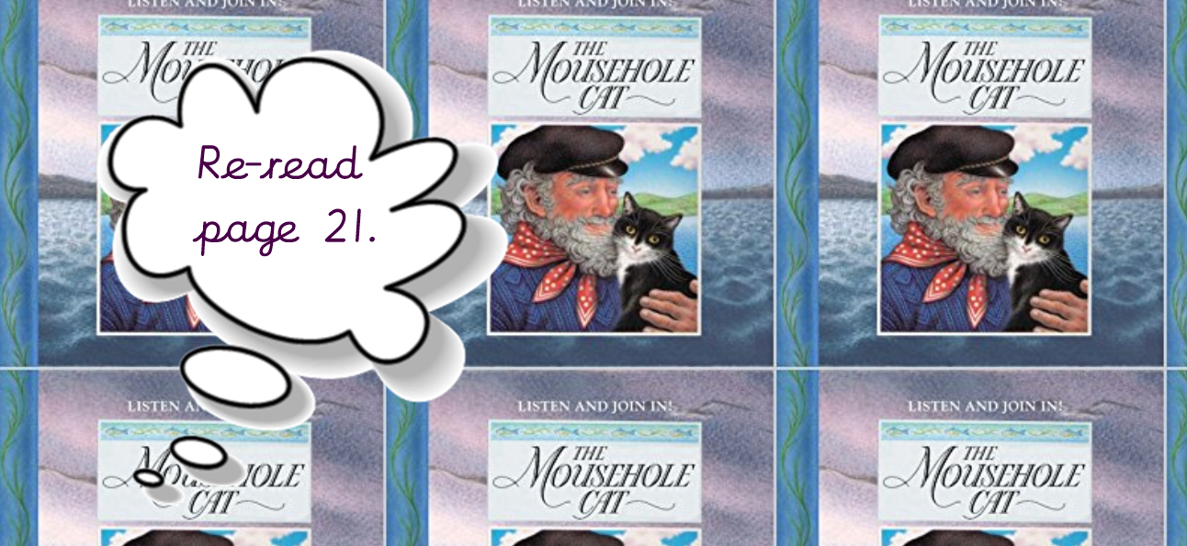
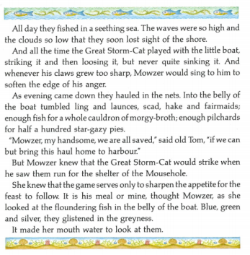

Slide 4
What tumbled into the boat?
What could you use to help you find the answer?

Slide 5
What glistened in the greyness?
What words will help you to help you retrieve?

Slide 6


