Slide 1


Slide 2
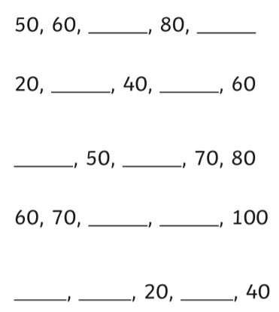
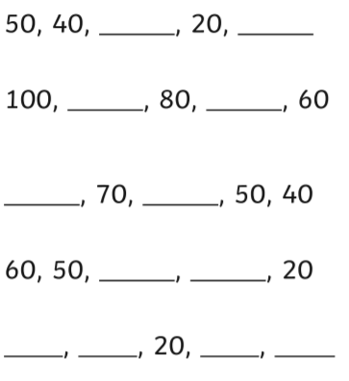
Starter
Count in 10s to fill in the missing numbers
1. Counting forwards
2. Counting backwards

Slide 3
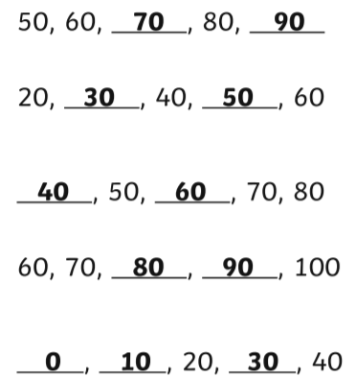
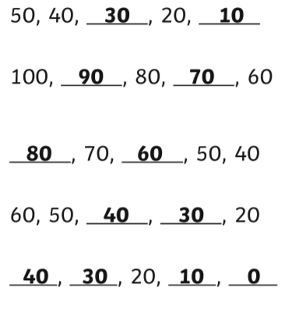
Starter - answers

Slide 4
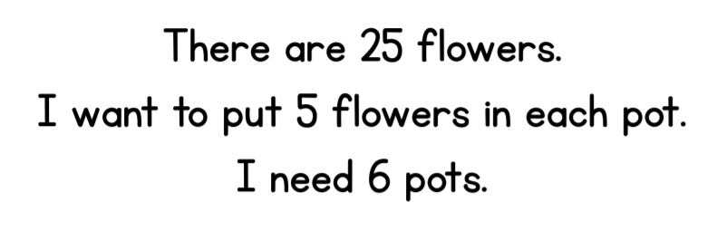
True or false?
Don’t forget to explain your answer.

Slide 5
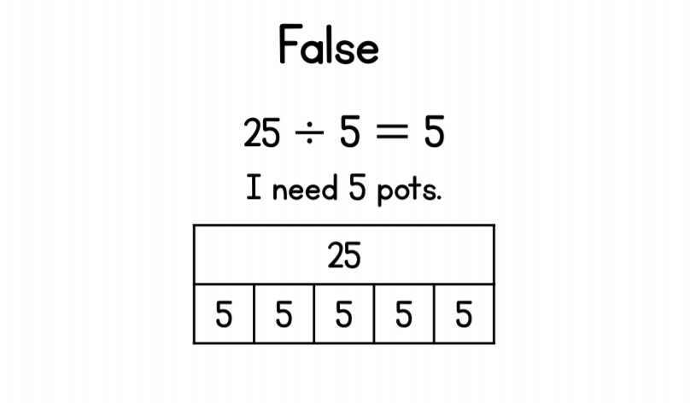
True or false? - ANSWER

Slide 6
Click on the link to play the video for today’s lesson
Click the link or copy and paste the link into Google to watch today’s lesson
https://vimeo.com/471009909

Slide 8


Are the groups equal or not equal?
2) Are the groups equal or not equal?
3) Are the groups equal or not equal?

Slide 9
Are the groups equal or not equal?
2) Are the groups equal or not equal?
3) Are the groups equal or not equal?
equal
not equal
equal

Slide 11





Ron is sharing out the strawberries.
How many strawberries will each child get?
There are ____ strawberries.
There are ____ children.
Each child will get ____ strawberries.

Slide 12
Ron is sharing out the strawberries.
How many strawberries will each child get?
12
There are ____ strawberries.
There are ____ children.
Each child will get ____ strawberries.
3
4

Slide 13

Ron is sharing out the strawberries.
How many strawberries will each child get?
There are ____ strawberries.
There are ____ children.
Each child will get ____ strawberries.

Slide 14
Ron is sharing out the strawberries.
How many strawberries will each child get?
12
There are ____ strawberries.
There are ____ children.
Each child will get ____ strawberries.
4
3

Slide 15

There are ____ strawberries.
There are ____ children.
Each child will get ____ strawberries.
There are ____ strawberries left over.

Slide 16
12
There are ____ strawberries.
There are ____ children.
Each child will get ____ strawberries.
There are ____ strawberries left over.
5
2
2

Slide 17

Did someone mention left over strawberries?

Slide 18





Whitney has 16 flowers.
Have a think
She shares them equally between some vases.
How many different ways could Whitney share her flowers to make equal groups?

Slide 19
2 vases with 8 flowers in each vase.

Slide 20
16 didn’t share into 3 equal groups.

Slide 21
2 vases with 8 flowers in each vase.
4 vases with 4 flowers in each vase.
8 vases with 2 flowers in each vase.
16 vases with 1 flower in each vase.

Slide 22
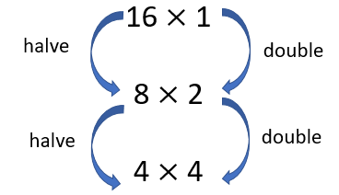

Slide 23
Have a go at questions
1 and 2 on the worksheet

Slide 24
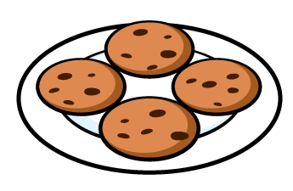



How can we represent this as a written calculation?
$$÷$$
8
2
$$=$$
4

Slide 25


How can we represent this as a written calculation?
20
$$÷$$
5
$$=$$
4

Slide 26

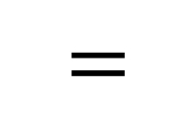
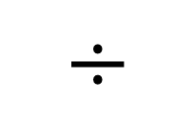
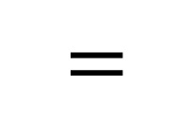
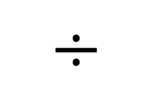
Which division calculation matches the problem below?
Dora has 6 plates.
She shares 18 cookies equally onto the plates.
$$=$$
$$÷$$
$$=$$
$$÷$$
18
6
6
18

Slide 27
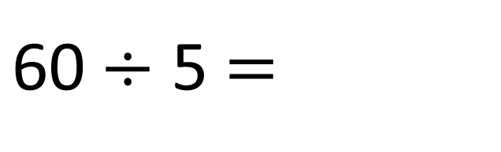
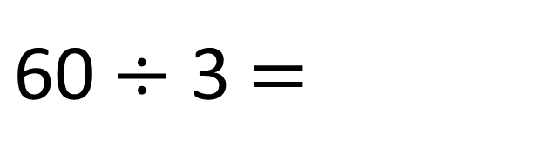
$\text{60}÷$ 3 $=$
20
$\text{60}÷$ 5 $=$
12

Slide 28
Have a go at the rest of the questions on the worksheet

