Slide 1
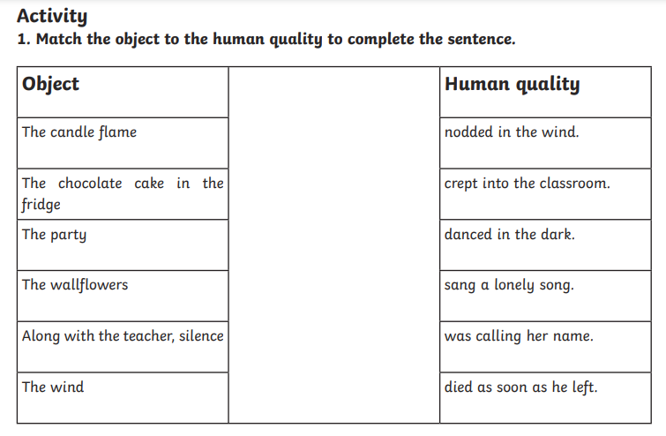

Let’s get started!

Slide 2
L.O. I am learning to perform a poem.

Slide 3
What is a stanza?
A group of lines forming a verse in a poem.

Slide 4
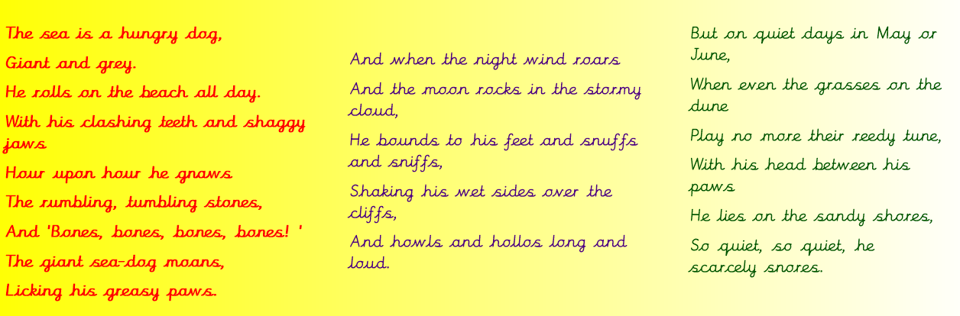
Pick a stanza and practice rehearsing it.
Can you learn it off by heart?

Slide 5


Tips to help you remember and perform your poem.
Match your actions with the lines that you are saying.
Practice a line and then add a line each time.
Make sure the tone of your voice matches what you are saying.
Speak clearly and confidently!

Slide 6

The award for the best actor!

