Slide 1

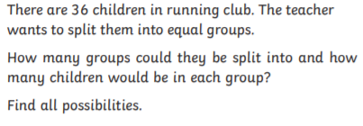
Maths challenge
Listen for Mr Viney’s top tips!
Equal groups

Slide 2
Answers – you need to check all the times tables where 36 appears
Two groups of 18 (18 + 18 = 36 or 2 x 18 = 36)
If I know 18 goes into 36 twice I can think about what numbers go in to 18. I know 9 goes in to 18 so I can use this number to make 36 too)
Four groups of 9 (9 + 9 + 9 + 9)
Six groups of 6 (6+6+6+6+6+6 = 36 or 6 x 6 = 36)
If I know 6 goes into 36 6 times I can think about what numbers go in to 6
4. 12 groups of 3 (3+3+3+3+3+3+3+3+3+3+3+3 or 12 x 3 = 36)

