Slide 1

Hello Year 3!
Over the next few lessons, we are going to be looking at how poems are written.
But first we need to understand what we are reading.

Slide 2
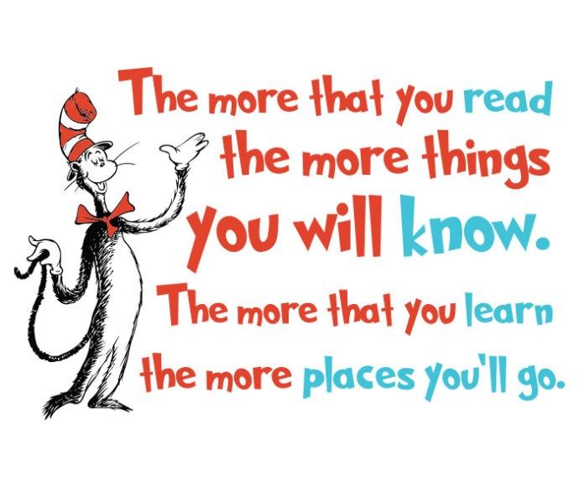
L.O. I am learning to understand what I have read.

Slide 3
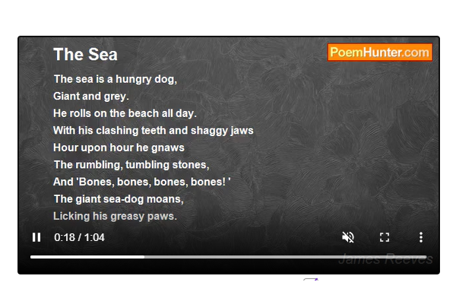
Listen to the poem online!
https://www.poemhunter.com/poem/the-sea-36/#content

Slide 4
Were there any words that you were not sure of?

Slide 5
What can we use to help us understand any words that we are not sure of?
Have you seen this word before?
Have you ever heard it before and when and how was it used?
Does it sound familiar to another word?
Re read the sentence, what do you think the author is trying to get you to imagine?

Slide 6
Task
Challenge
When you have done the task, use a dictionary to find their ‘actual’ definitions.
Are there any other words that you are not sure of and you can find the meaning of?
Read 'The Sea' and cut out the meanings of words and match them to the words in red.

