Slide 1

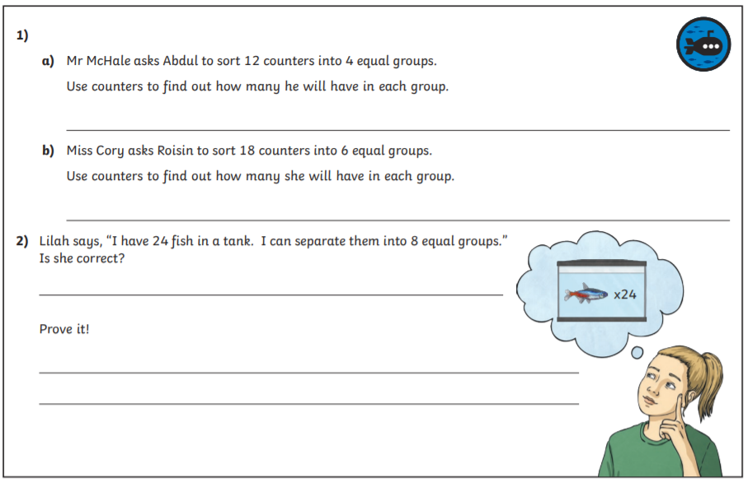
Maths challenge
Listen for Mr Viney’s top tips!
Equal groups

Slide 2
Answers
1a 3 + 3 + 3 + 3 = 12
If I have 4 groups, there must be 3 in each group to equal 12
3 x 4 = 12
1b 3 + 3 + 3 + 3 + 3 + 3 = 18
If I have 6 groups, there must be 3 in each group to equal 18
3 x 6 = 18
3 + 3 + 3 + 3 + 3 + 3 + 3 + 3 = 24
  Lilah can separate the fish into 8 groups of 3
I know this because 3 x 8 = 24 and I can prove it be showing the groups

