Slide 1


Slide 2
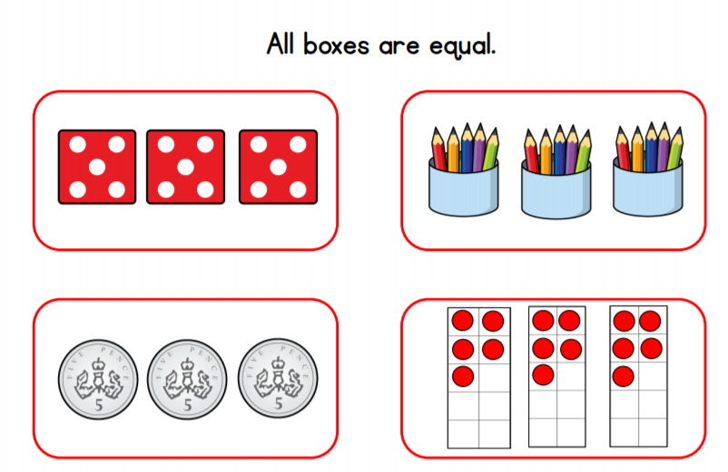
Starter
Don’t forget to explain your answer

Slide 3
Warm up
Say the 2 times tables aloud
0 x 2 = 0
1 x 2 = 2
2 x 2 = 4
3 x 2 = 6
4 x 2 = 8
5 x 2 = 10
6 x 2 = 12
7 x 2 = 14
8 x 2 = 16
9 x 2 = 18
10 x 2 = 20
11 x 2 = 22
12 x 2 = 24
Extra challenge
Can you say them backwards
What patterns that you notice?

Slide 4

Click on the link to play the video for today’s lesson
Listen to a quick introduction for today’s lesson
Click the link or copy and paste the link into Google to watch today’s lesson
https://vimeo.com/469786596

Slide 6





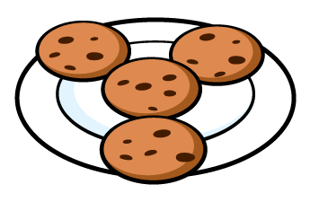

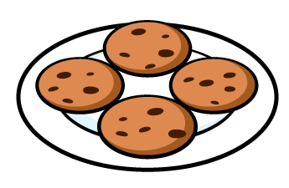
Are the groups equal or not equal?
2) Are the groups equal or not equal?
3) Are the groups equal or not equal?

Slide 7
Are the groups equal or not equal?
2) Are the groups equal or not equal?
3) Are the groups equal or not equal?
not equal
equal
equal

Slide 9


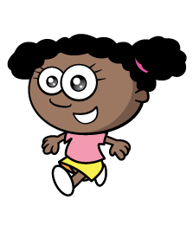


3
There are _____ plates.
There are _____ strawberries on each plate.
There are ____ equal groups of ____
5
3
5

Slide 10


5
There are _____ dice.
There are _____ spots on each dice.
There are ____ equal groups of ____
4
5
4
Have a think

Slide 11
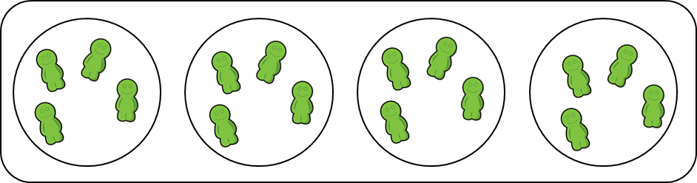
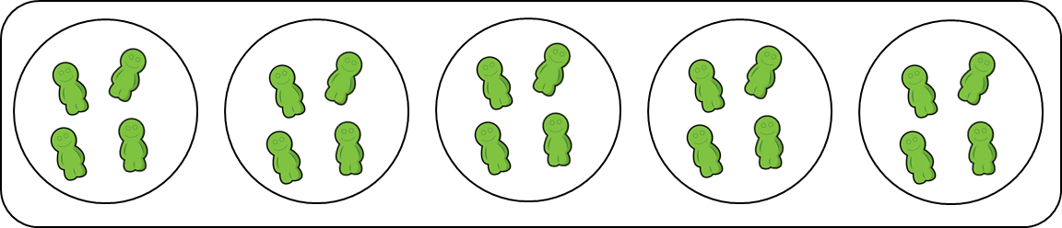
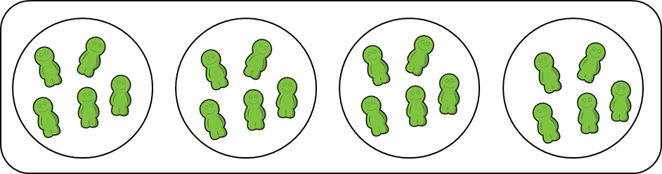
Have a think
4 groups of 5
4 groups of 4
5 groups of 4

Slide 12
Have a go at questions
1 - 3 on the worksheet

Slide 13



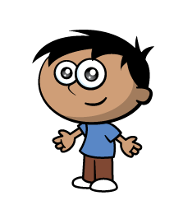
I tried to make 3 equal groups but it didn’t work.
Have a think
2 equal groups
4 equal groups

Slide 14
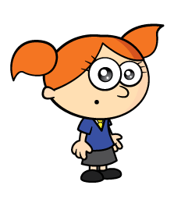

Have a think
So can I
I can see 3 groups of 6

Slide 15
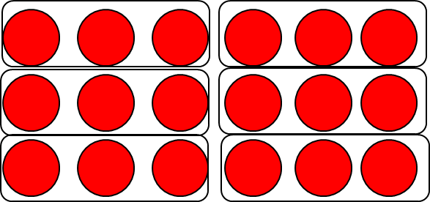
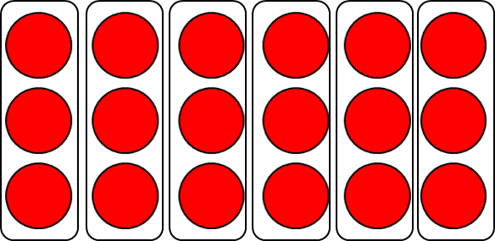
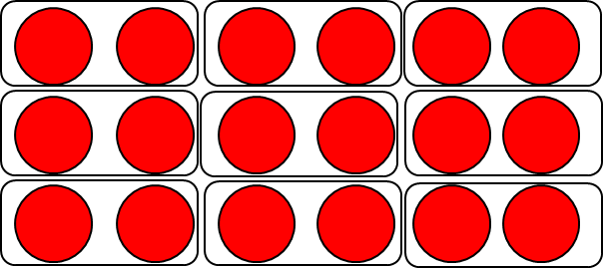
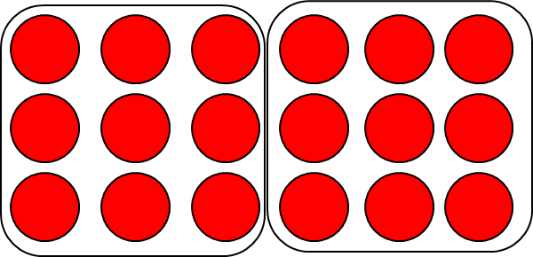
6 equal groups of 3
9 equal groups of 2
2 equal groups of 9

Slide 16
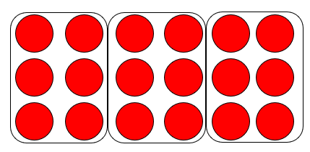
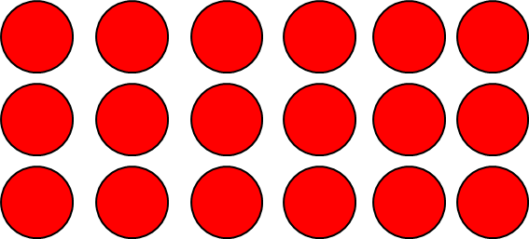
3 equal groups of 6
6 equal groups of 3
9 equal groups of 2
2 equal groups of 9
1 group of 18
18 groups of 1

Slide 17




How many cubes will I need to add to make 4 groups of 3?
Have a think
4 groups of 2 $=$ 2 groups of 4
4 groups of 3 $=$ 3 groups of 4

Slide 18
Have a go at the rest of the questions on the worksheet

