Slide 1

L.O. I am learning to identify words and phrases that capture the reader's interest.
Text: Mousehole Cat

Slide 2
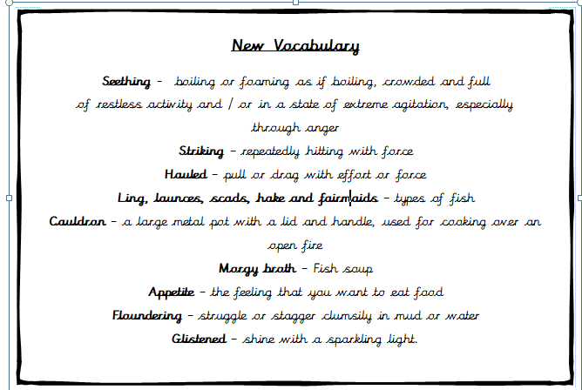
New Vocabulary

Slide 3
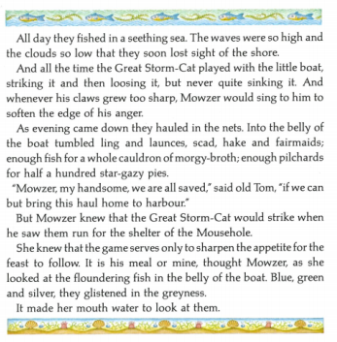
Read Page 21!

Slide 4
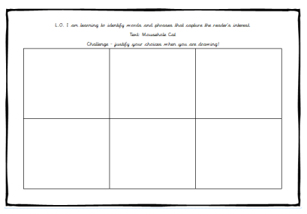
Which words or phrases capture your interest?
Select phrases and draw them!
Challenge:
Explain why the author has used these phrases.

Slide 5
Examples:
1) Lost sight of the shore. You would then draw a picture of this.
2) Striking it. You would draw a picture of the cat striking (hitting) the boat.
Challenge – This makes you think that the Great Storm Cat is going to break the boat.
Challenge - This phrase has been used to make the reader think that they cannot see where home is and then they may not get back.

