Slide 1


Slide 2
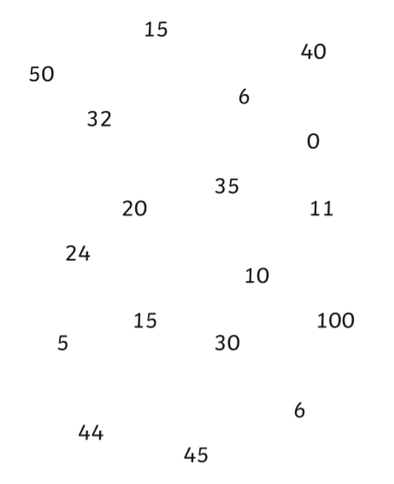
Starter
Write down all the numbers in the 5 times table
Fifty-five
thirteen
ten
Thirty-five
fifteen

Slide 3
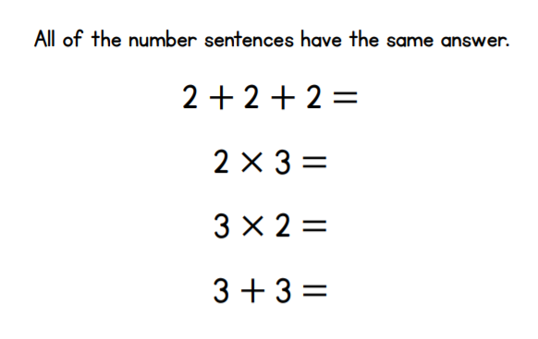
Starter
Don’t forget to explain your answer

Slide 4
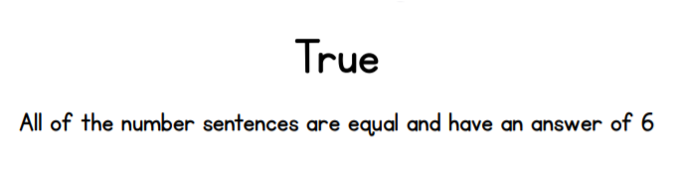
Starter - answer

Slide 5
Warm up
Say the 5 times tables aloud
0 x 5 = 0
1 x 5 = 5
2 x 5 = 10
3 x 5 = 15
4 x 5 = 20
5 x 5 = 25
6 x 5 = 30
7 x 5 = 35
8 x 5 = 40
9 x 5 = 45
10 x 5 = 50
11 x 5 = 55
12 x 5 = 60
Extra challenge
Can you say them backwards
What patterns that you notice?

Slide 6

Click on the link to play the video for today’s lesson
Listen to a quick introduction for today’s lesson
Click the link or copy and paste the link into Google to watch today’s lesson
https://vimeo.com/469787342

Slide 7


Continue the sequence
2, 4, 6, 8, ____, ____, ____, ____
Continue the sequence
5, 10, 15, 20, ____, ____, ____, ____
What is the total score in each row?
a)
b)

Slide 8
Continue the sequence
2, 4, 6, 8, ____, ____, ____, ____
Continue the sequence
5, 10, 15, 20, ____, ____, ____, ____
What is the total score in each row?
a)
b)
10 12 14 16
25 30 35 40
15
12

Slide 10





What do you see?
Have a think
There are ____ equal groups of ____
$+ + =$
$× =$

Slide 11
Answers
What do you see?
Have a think
3
4
There are ____ equal groups of ____
$+ + =$
4
4
4
12
$× =$
3
4
12

Slide 12

What do you see?
Have a think
There are ____ equal groups of ____
$+ =$
$× =$

Slide 13
Answers
What do you see?
Have a think
There are ____ equal groups of ____
$+ =$
6
6
12
$× =$
2
6
12

Slide 14


Have a think
2
2
2
2
8
$+ + + =$
$× =$
4
2
8

Slide 15
Answers
Have a think
$+ + + =$
$× =$

Slide 16
Have a go at questions
1 and 2 on the worksheet

Slide 17
$+ + + =$
$× =$
$× =$

Slide 18
Answers
2
2
2
2
8
$+ + + =$
$× =$
4
2
8
$× =$
2
4
8

Slide 19
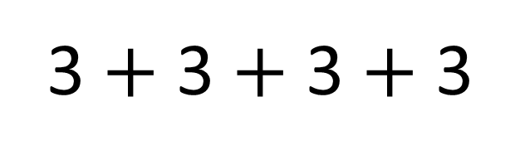
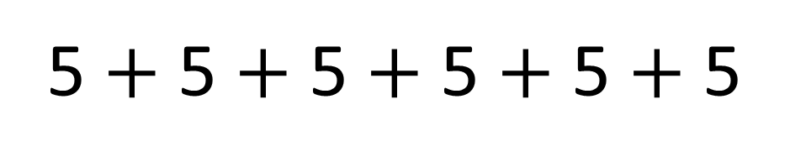
Have a think
5 $+$ 5 $+$ 5 $+$ 5 $+$ 5 $+$ 5
3 $+$ 3 $+$ 3 $+$ 3

Slide 20
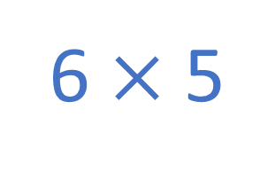
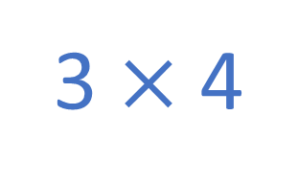
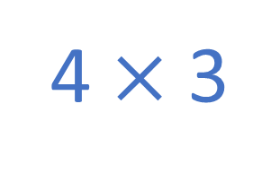
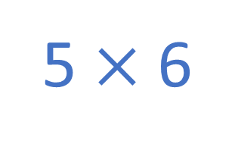
Answers
Have a think
5 $+$ 5 $+$ 5 $+$ 5 $+$ 5 $+$ 5
6 $×$ 5
5 $×$ 6
3 $+$ 3 $+$ 3 $+$ 3
4 $×$ 3
3 $×$ 4

Slide 21
Have a go at question
3 on the worksheet

Slide 22


Have a think
I can write 4 different multiplications
I think there are 8

Slide 23
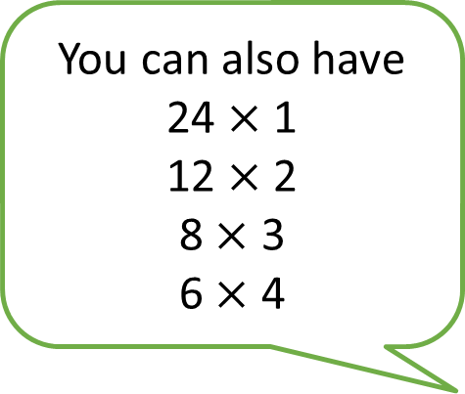
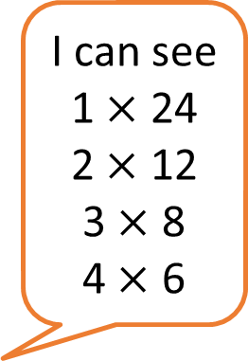
I can see
1 $×$ 24
2 $×$ 12
3 $×$ 8
4 $×$ 6
You can also have
24 $×$1
12 $×$ 2
8 $×$ 3
6 $×$ 4

Slide 24



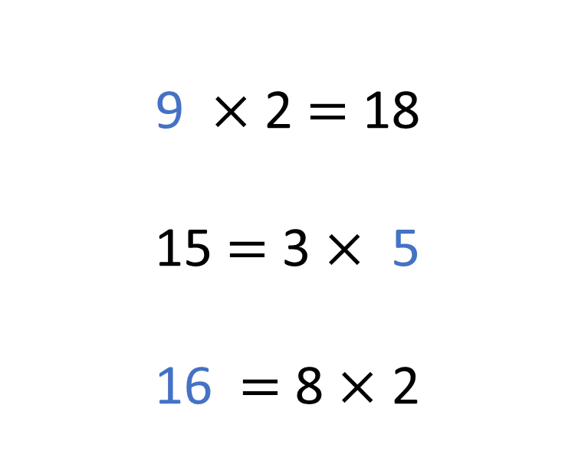
Have a think
4 $×$ 3 $=$ 12
9 $×$ 2 $=$ 18
15 $=$ 3 $×$ 5
16 $=$ 8 $×$ 2

Slide 25
Have a think
4 $×$ 3 $=$ 12
3
9 $×$ 2 $=$ 18
15 $=$ 3 $×$ 5
16 $=$ 8 $×$ 2
9
5
16

Slide 26
Have a go at the rest of the questions on the worksheet

