Slide 1

Welcome Back Year 3!
L.O I am learning to find personification in a poem.

Slide 2
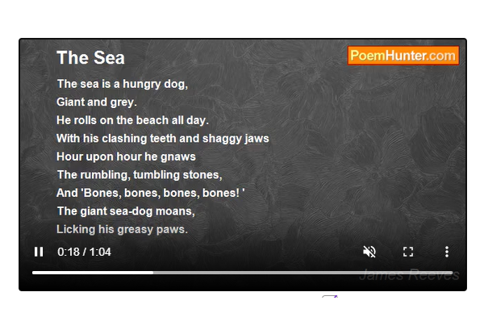
Listen to the poem again!
https://www.poemhunter.com/poem/the-sea-36/#content

Slide 3
Can you draw a picture to match the poem?

Slide 4
Personification!
The leaves danced in the wind.
Using this sentence, can you predict what personification is?

Slide 5
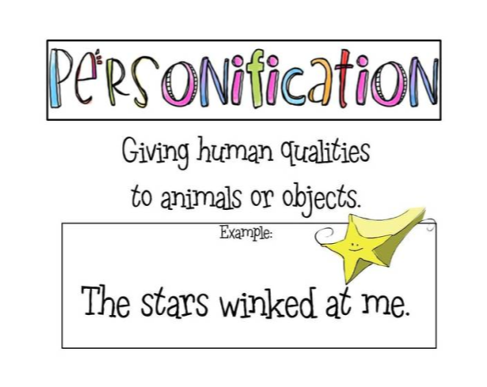
What human quality has the star been given?
https://www.youtube.com/watch?v=VqBZMR83wCg

Slide 6
Can you find the personification?
Task - Underline the personification phrases.
Challenge - Why has the author used the personification?
Example –
The sea is a hungry dog, (The sea cannot be hungry – the doesn’t eat)
Giant and grey.
He rolls on the beach all day. (The sea cannot roll)

