Slide 1
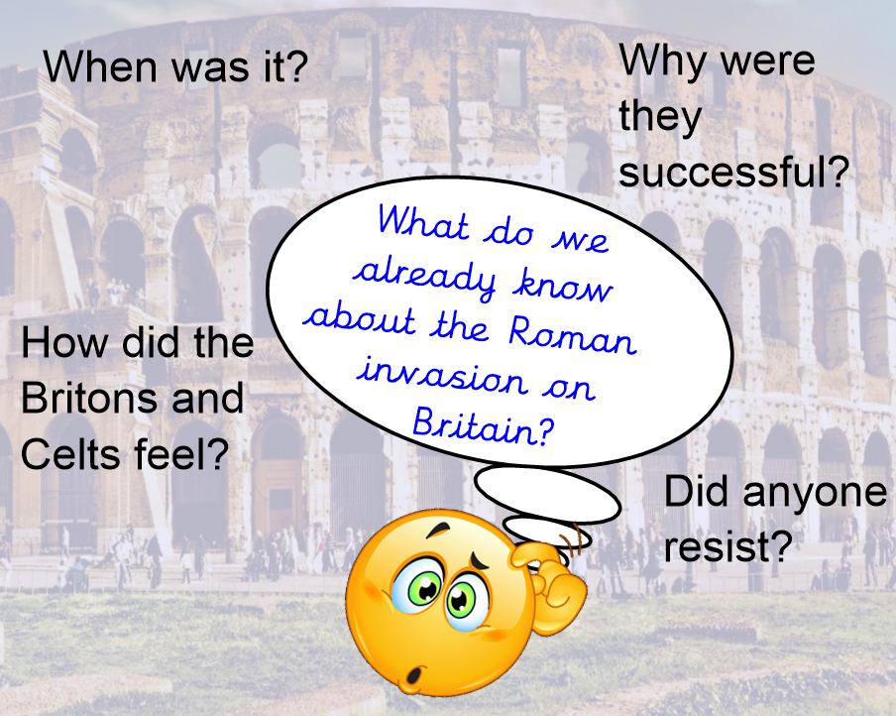

Slide 2
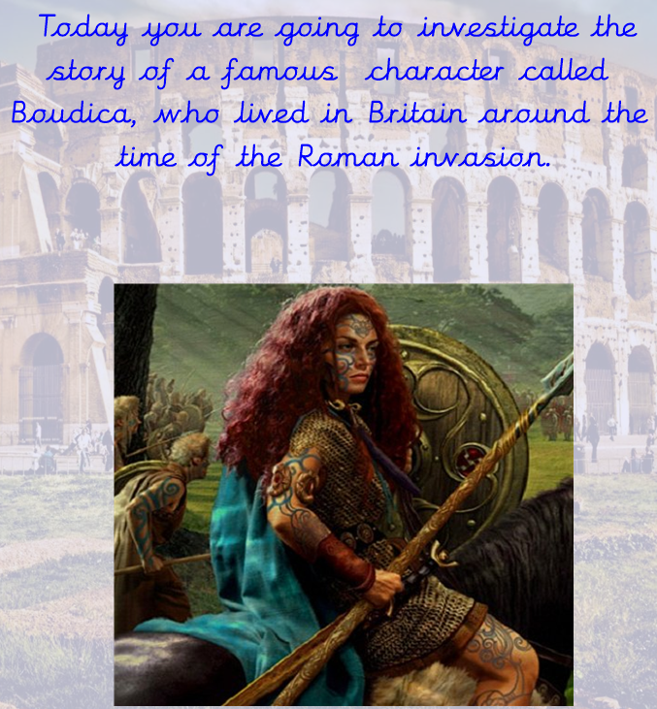
www.youtube.com/watch?v=eC7ONgTJGKw
Click on the link to find out more about Boudica.
https://

Slide 3


Slide 4


Slide 5


Slide 6
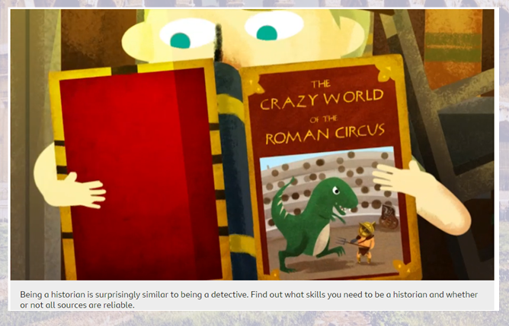
https://www.bbc.co.uk/bitesize/topics/zs3487h/articles/ztnvgk7

Slide 7
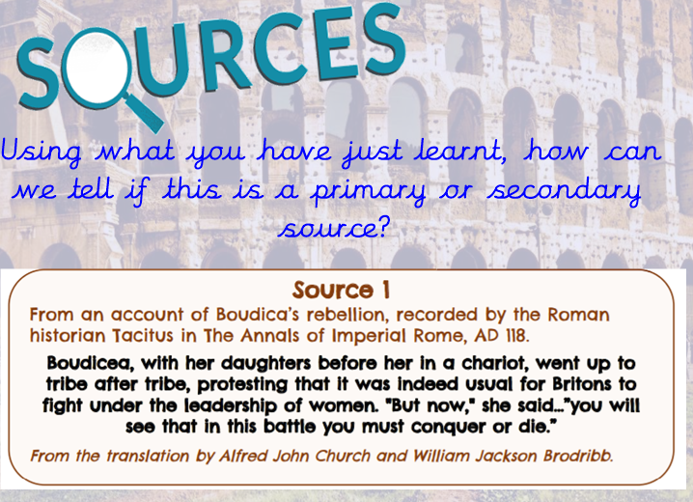

Slide 8
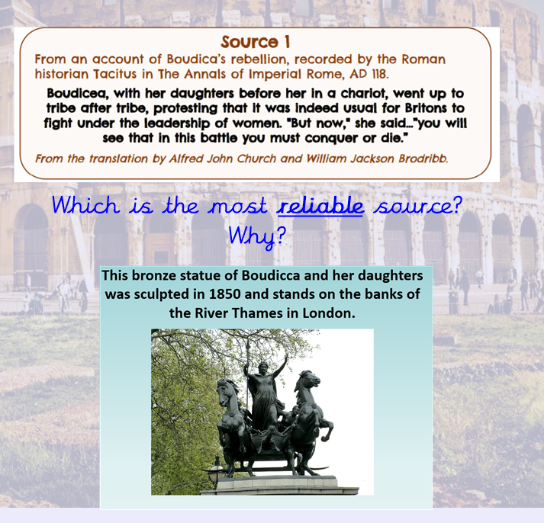

Slide 9
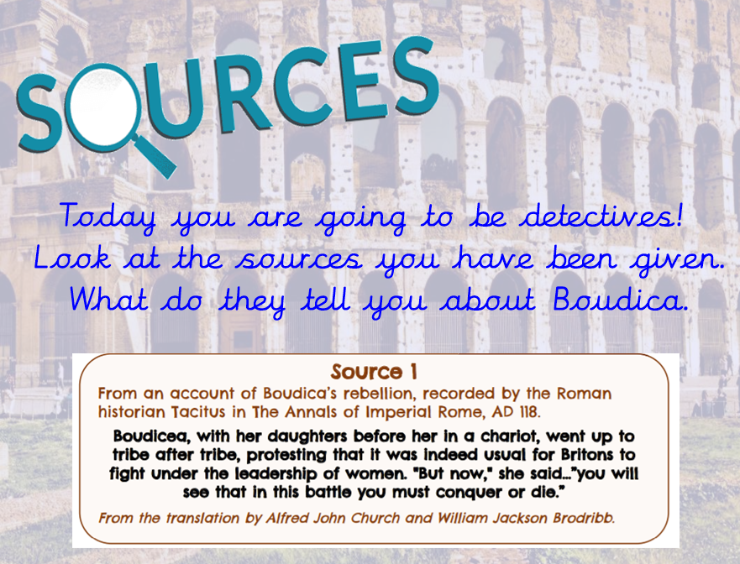

Slide 10
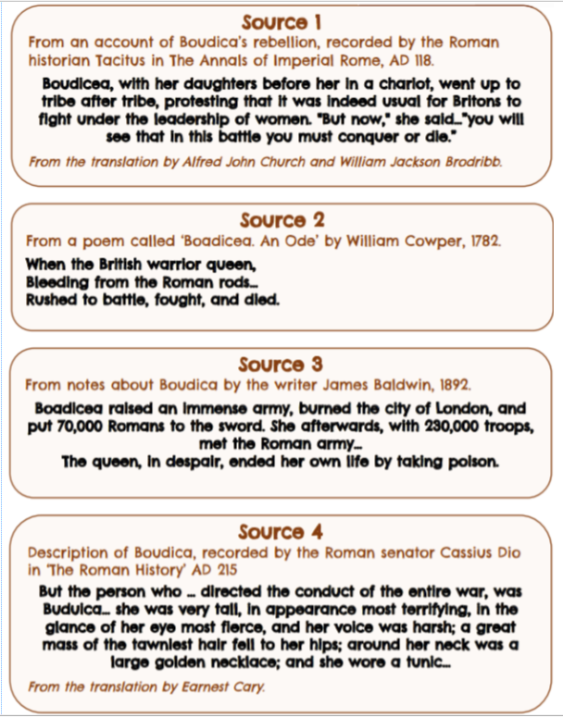
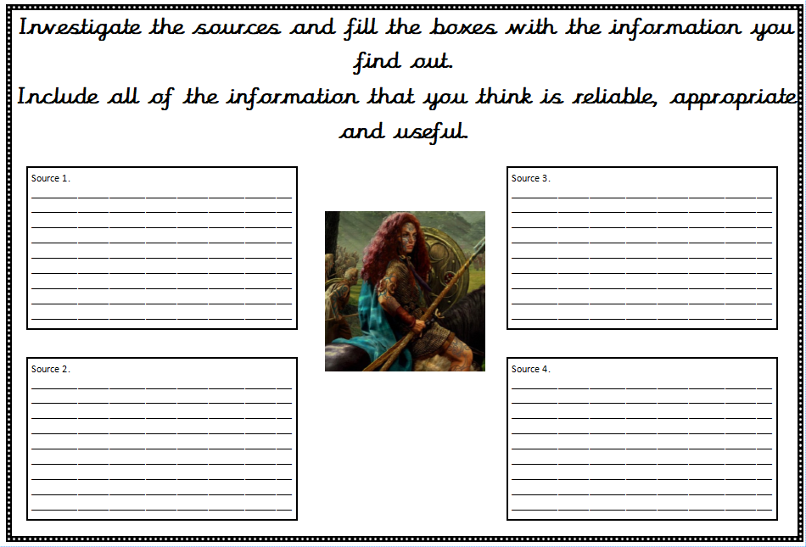
Record your findings in the sheet you have been given or create your own mind map of significant information.

Slide 11
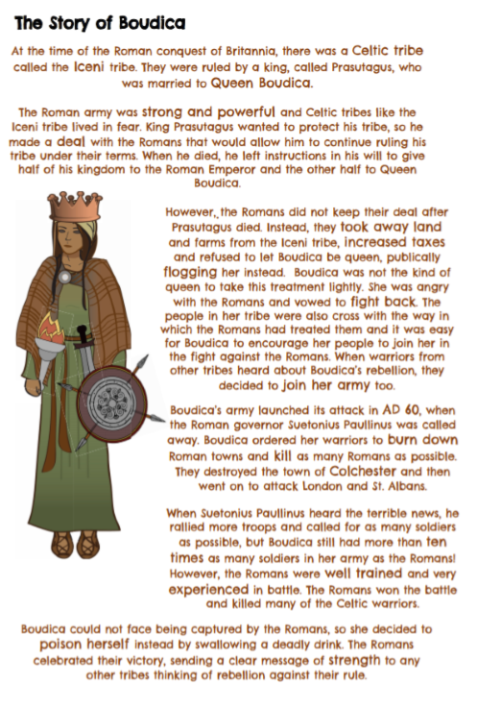
Now read the story of Boudica. Highlight or make a note of any significant facts that you read.

Slide 12
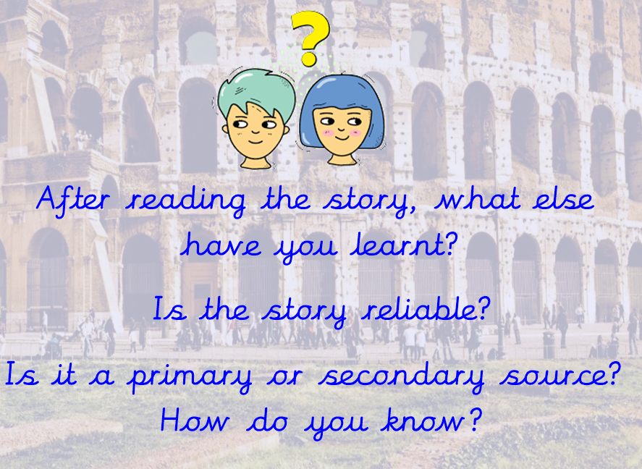

Slide 13
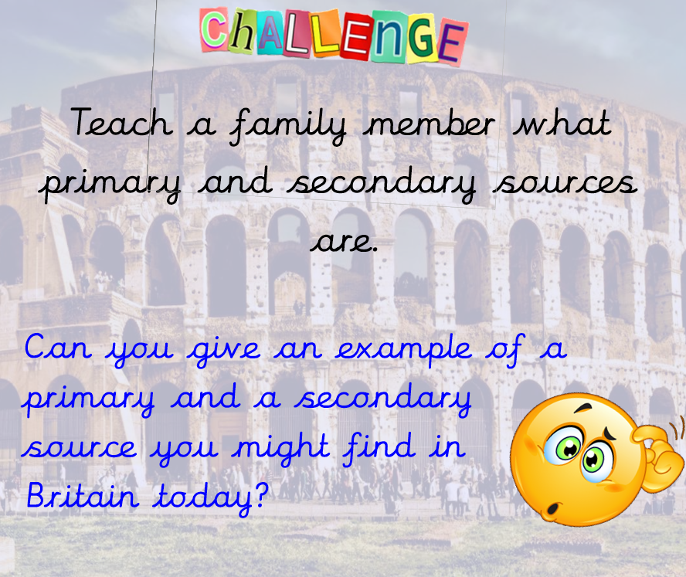

Slide 14
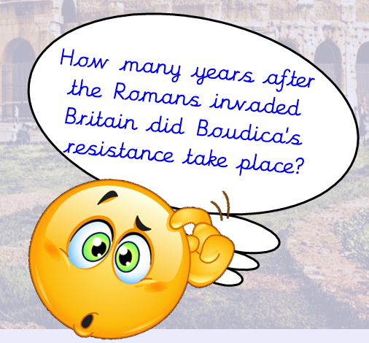
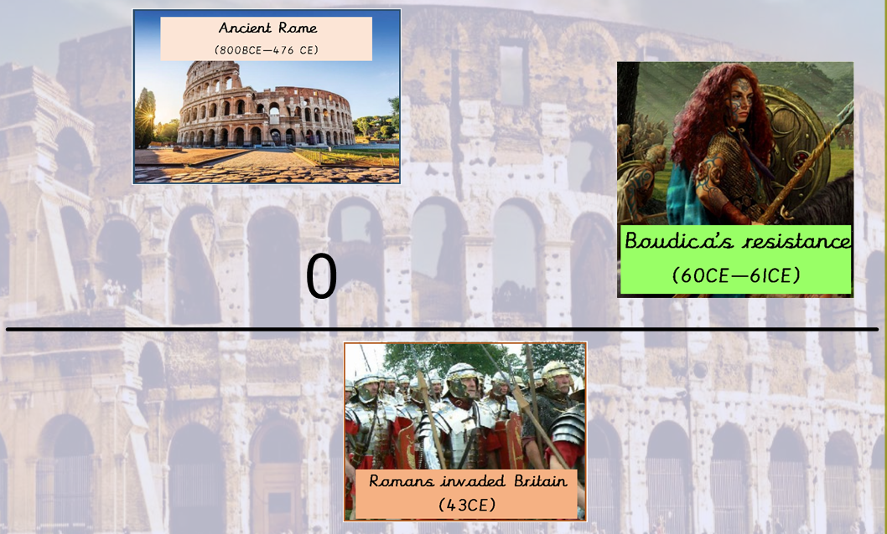

Slide 15
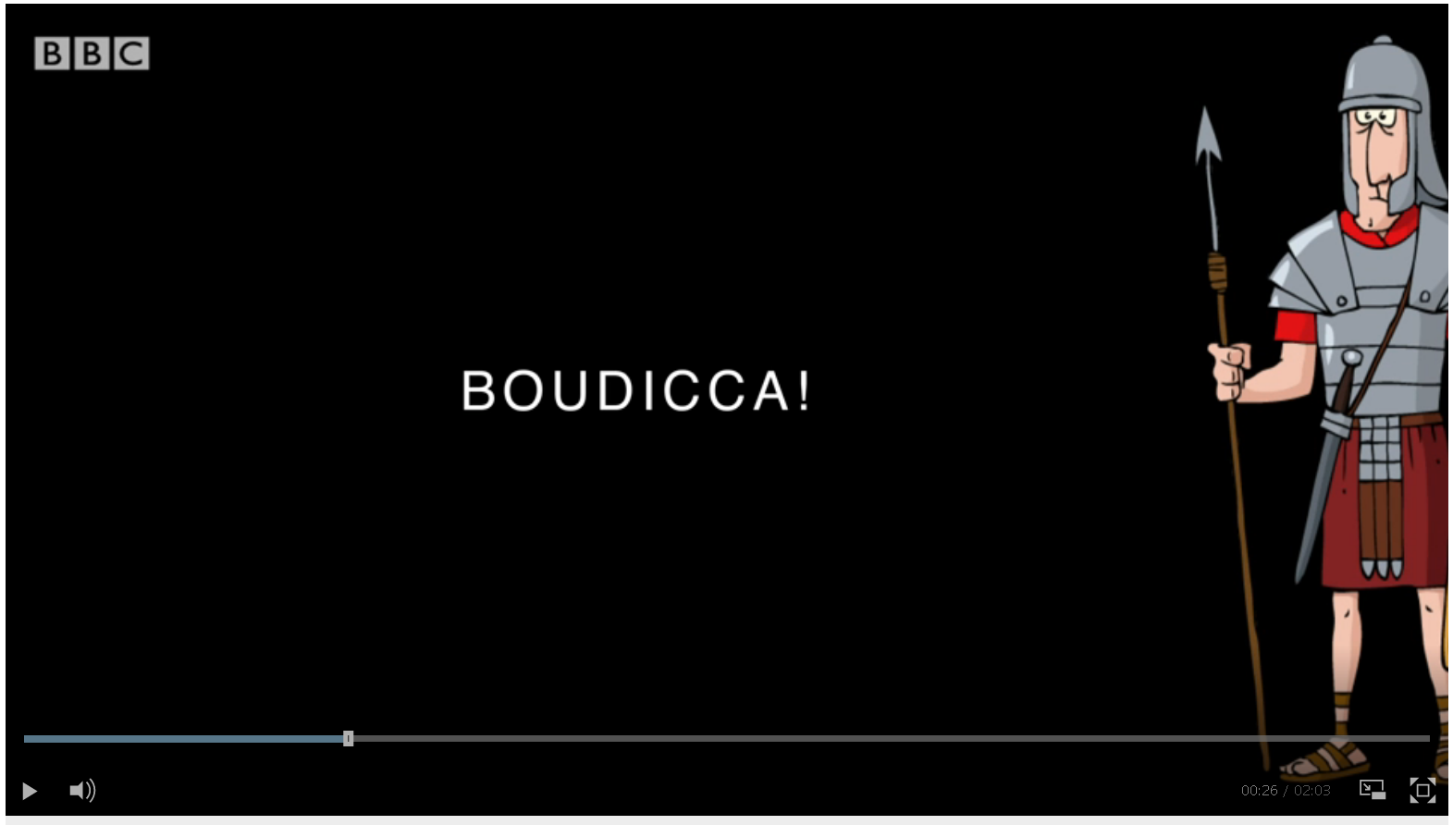
Click on the link to learn a song about Boudica!
https://www.bbc.co.uk/teach/school-radio/music-ks1-ks2-rocking-romans-3-boudicca/zk2rgwx

