Slide 1

What did you learn last lesson about non-chronological reports?

Slide 2


What is a sub heading?
A sub heading is a mini- headline given to a section or paragraph of your report that has a main theme.
The purpose of a sub heading is to stand - out and direct your reader. They do this because of the size and snappiness.
It acts as a guide to serve the reader through the page.

Slide 3
Now you have completed your research, you need to decide on the main theme for the paragraphs you are going to write about.
Here are some of the topics that we looked at in the previous lesson.
The Roman Empire
Romans in Britain
The Roman Army
Roman Legacies
Life as a Roman
Romans- rotten or not?
How could you make these subheadings more exciting?

Slide 4

Look at your notes from your research last lesson.
Choose at least three main themes about the Romans that you want to include in your writing.
Now brainstorm some catchy subheadings that you could use for each section.

Slide 5
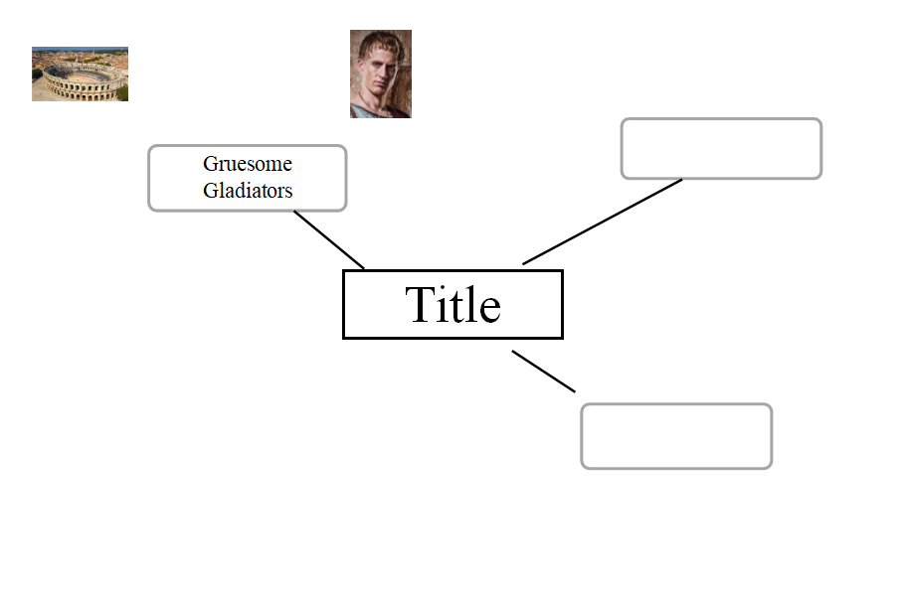
Once you have decided on your subheadings, you can start to plan.
Begin a mind map and add them.

Slide 6




What is a heading?
A title of a piece of writing.
It should catch the readers interest and summarise what the whole report is about!

Slide 7

Now add your title to your plan.

Slide 8
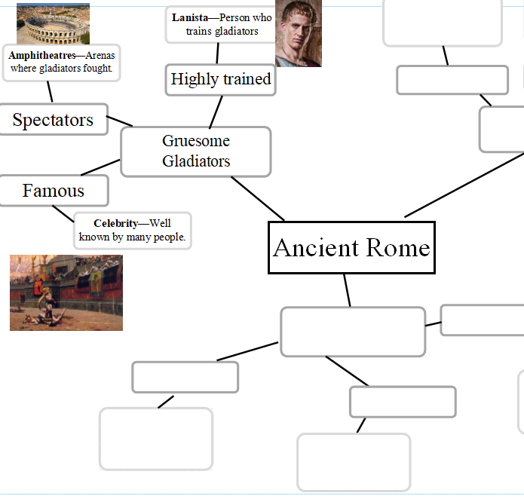
Now, thinking about your subheadings, return to your research.
What facts can you include in the paragraph to engage your reader?
Think carefully about these and add them to your plan around the appropriate subheading.

Slide 9
Reflect!
Is your plan complete?
Is it going to help you to write?
Are you clear about what you will write about in each section?
Is your title going to get the reader’s attention?
Show me your plans!

