Slide 1
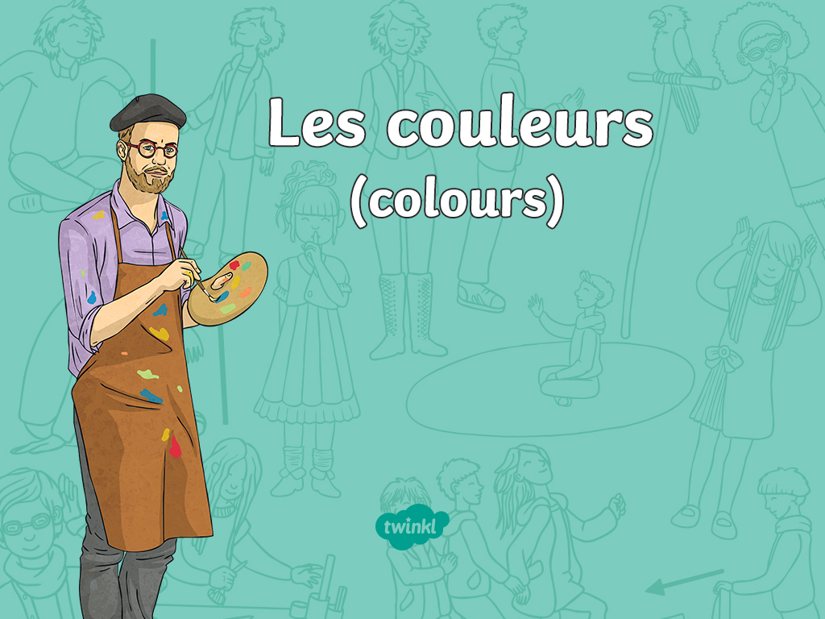

Slide 2



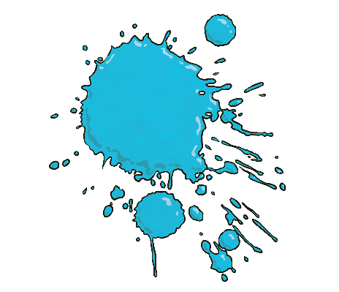
C’est de quelle couleur?
Click play buttons throughout to hear phrases and words.
(What colour is this?)
C’est bleu
Notes:
“Comment Dit-On ______ En Français?” means “How do you say _______ in French?”

Slide 3
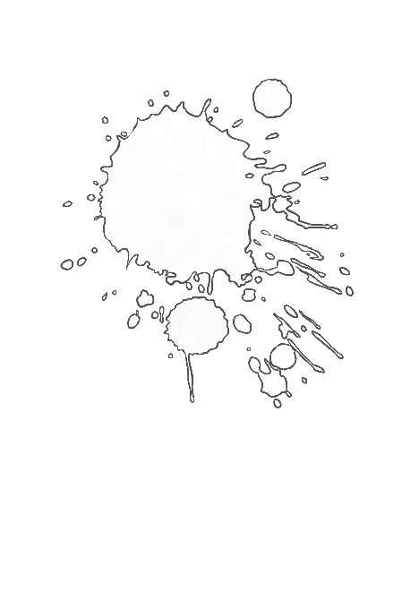
C’est de quelle couleur?
Click play buttons throughout to hear phrases and words.
(What colour is this?)
C’est blanc
Notes:
“Comment Dit-On ______ En Français?” means “How do you say _______ in French?”

Slide 4
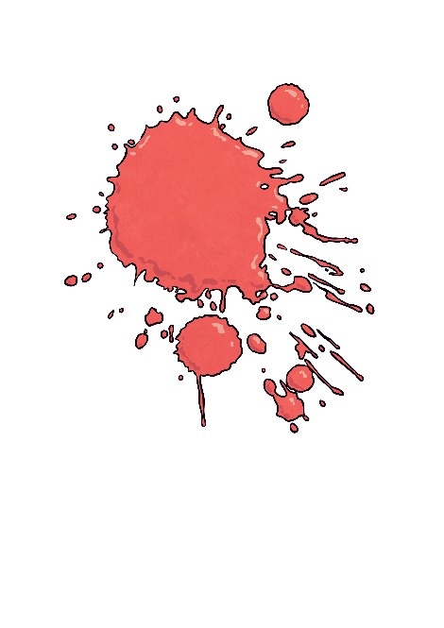
C’est de quelle couleur?
Click play buttons throughout to hear phrases and words.
(What colour is this?)
C’est rouge
Notes:
“Comment Dit-On ______ En Français?” means “How do you say _______ in French?”

Slide 5

C’est de quelle couleur?
Click play buttons throughout to hear phrases and words.
(What colour is this?)
C’est noir
Notes:
“Comment Dit-On ______ En Français?” means “How do you say _______ in French?”

Slide 6

C’est de quelle couleur?
Click play buttons throughout to hear phrases and words.
(What colour is this?)
C’est jaune
Notes:
“Comment Dit-On ______ En Français?” means “How do you say _______ in French?”

Slide 7
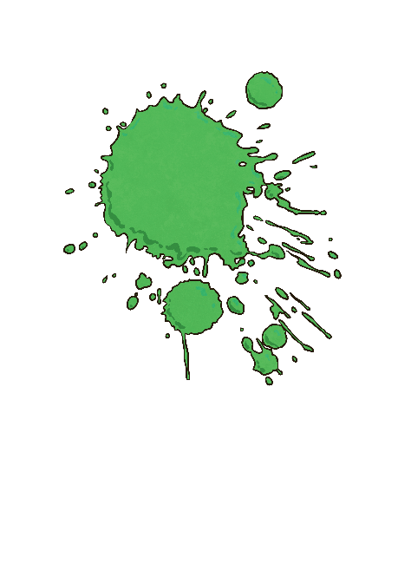
C’est de quelle couleur?
Click play buttons throughout to hear phrases and words.
(What colour is this?)
C’est vert
Notes:
“Comment Dit-On ______ En Français?” means “How do you say _______ in French?”

Slide 8
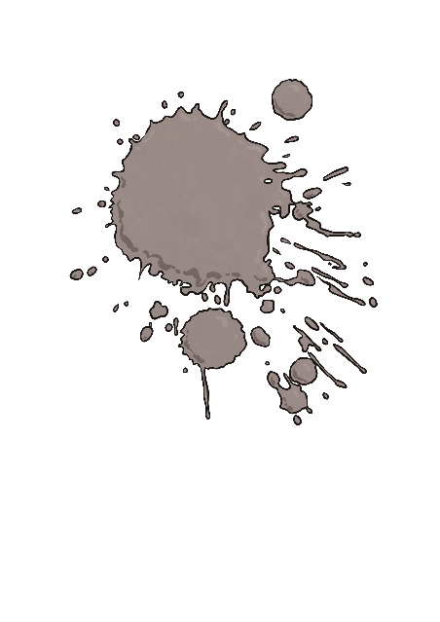
C’est de quelle couleur?
Click play buttons throughout to hear phrases and words.
(What colour is this?)
C’est gris
Notes:
“Comment Dit-On ______ En Français?” means “How do you say _______ in French?”

Slide 9

C’est de quelle couleur?
Click play buttons throughout to hear phrases and words.
(What colour is this?)
C’est marron
Notes:
“Comment Dit-On ______ En Français?” means “How do you say _______ in French?”

Slide 10

C’est de quelle couleur?
Click play buttons throughout to hear phrases and words.
(What colour is this?)
C’est orange
Notes:
“Comment Dit-On ______ En Français?” means “How do you say _______ in French?”

Slide 11

C’est de quelle couleur?
Click play buttons throughout to hear phrases and words.
(What colour is this?)
C’est violet
Notes:
“Comment Dit-On ______ En Français?” means “How do you say _______ in French?”

Slide 12

C’est de quelle couleur?
Click play buttons throughout to hear phrases and words.
(What colour is this?)
C’est rose
Notes:
“Comment Dit-On ______ En Français?” means “How do you say _______ in French?”

Slide 13
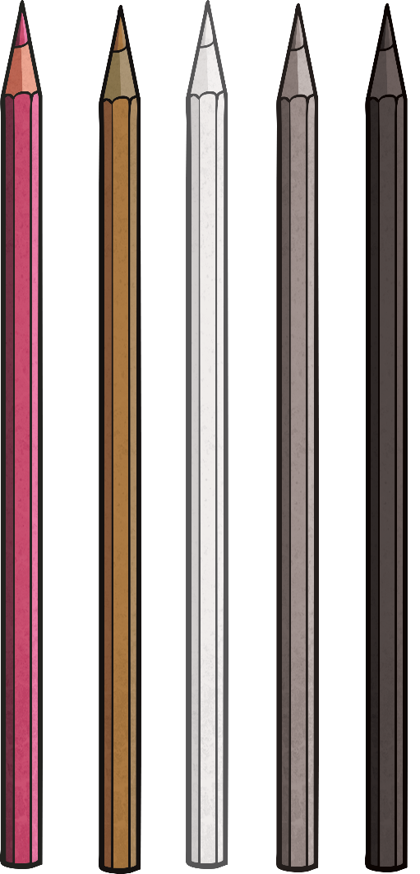
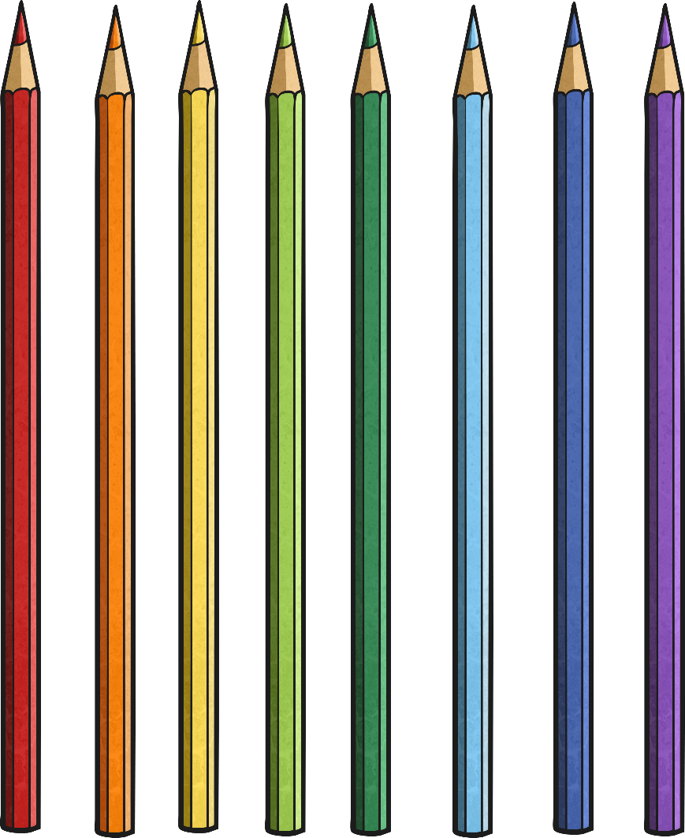

What Do You Know?

Slide 14

Let’s listen to a song! Join in when you can.
https://www.youtube.com/watch?v=fZR66TjjrDc

Slide 15
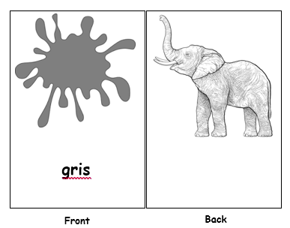
Allez-y!
Off you go!
Create flashcards with the different colours on them.
Write the French word under the colour on one side.
Then draw something that is the same colour on the back.
Here is an example.

Slide 16
Allez-y!
Off you go!
Now with your flashcard, choose a card at random (picture side), can you tell someone the colour in French?
How many can you get right?

