Slide 1

This week you will be writing a non-chronological report showing off everything you know about the Romans.

Slide 2
Write down everything that you know about a non-chronological report.

Slide 3

How do the authors capture your interests?
What features make the text more appealing?

Slide 4
Eye catching heading.
Rhetorical question.
Did you know facts.
Catchy sub headings.
Photos, pictures and diagrams.
Technical vocabulary in bold.

Slide 5
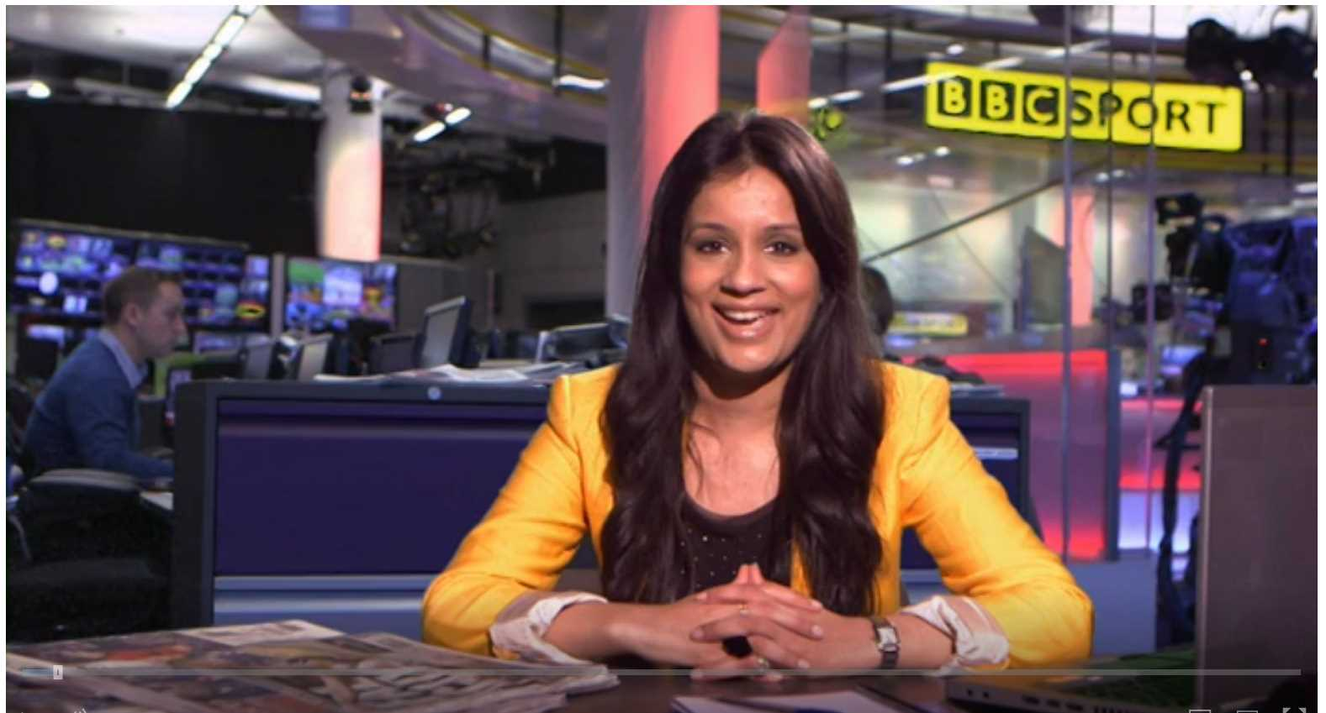
What is a non-chronological report and how do you write one?
Click on the link to learn!
https://www.bbc.co.uk/teach/class-clips-video/english-ks1-ks2-how-to-write-a-non-chronological-report/zvbtscw

Slide 6
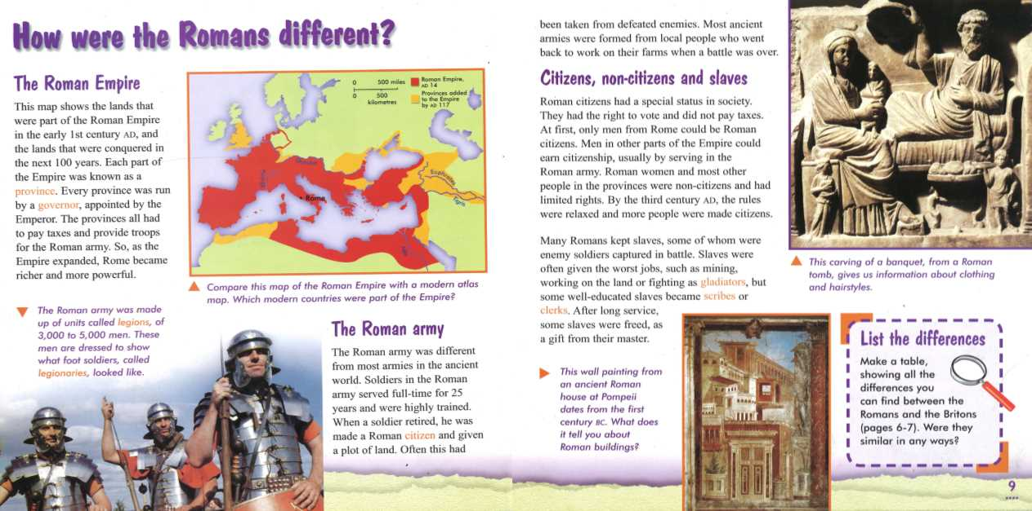
How many features can you find here?

Slide 7

Think
What do we know about the Romans already?
Let's remind ourselves.
https://www.youtube.com/watch?v=3X7D8yz6QFg&feature=emb_imp_woyt

Slide 8
You will begin your research today but first you need to think about what main paragraphs you will include in your report.
What could your main paragraphs be about?

Slide 9

The Roman invasion
The Roman Army
Roman Britain
Life as a Roman
Roman Legacies
Rotten or not?

Slide 10

Read through the information sheets that you have been provided with for today's lesson.
Think carefully about your paragraphs and make detailed notes under the subheadings that you have chosen to write about.

Slide 11
Additional Websites
https://www.bbc.co.uk/bitesize/topics/zwmpfg8
https://www.bbc.co.uk/bitesize/topics/zwmpfg8/articles/zqbnfg8
https://www.bbc.co.uk/bitesize/clips/zbns34j

Slide 12
Reflect!
Write a checklist of the features you will include in your report to capture the readers interest.

