Slide 1
Coasts
Lesson 1
Key Learning Question:
What physical features and landscapes are found at the coast and how do humans use and impact upon this environment?

Slide 2


Task 1
TASK: Draw your Brain (use at least ½ a page!)
Fill in your brain with knowledge you already know about coastlines and landscapes.
You can use diagrams/pictures as well as words.
Try to come up with AT LEAST 5 things.
Top tip – Are coasts all the same? Think about the different types of coasts there are.
Extension – write a definition of a coast.

Slide 3
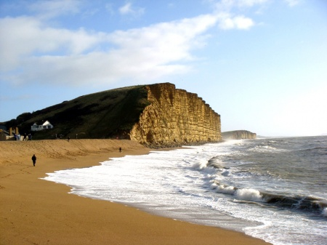
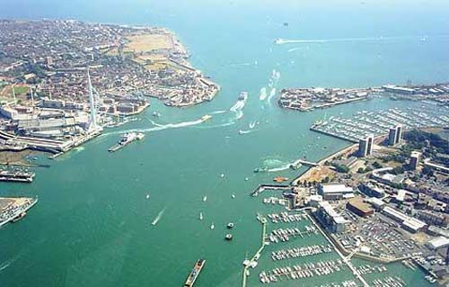
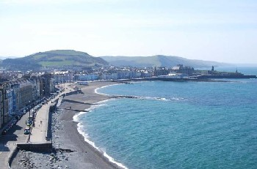
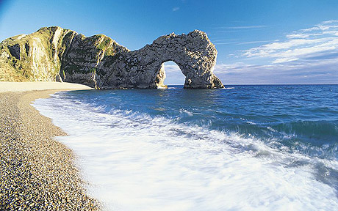
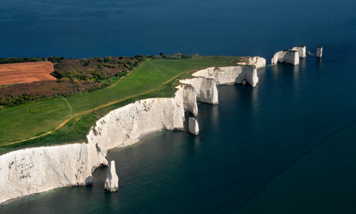
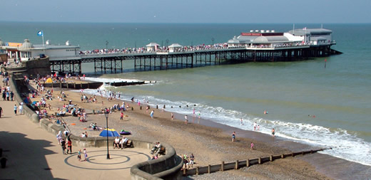
Nouns – People, places, things
TASK 2: LIST as many nouns as you can that DESCRIBE the following pictures and landscapes.
TASK 3: What is the same in each picture? What differences can you see?

Slide 4
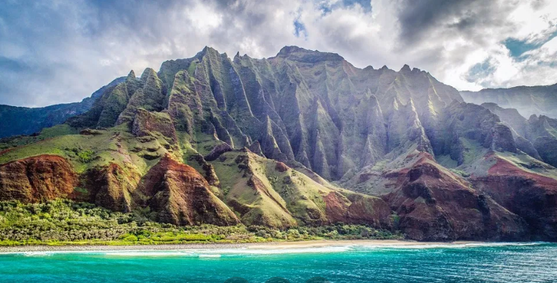
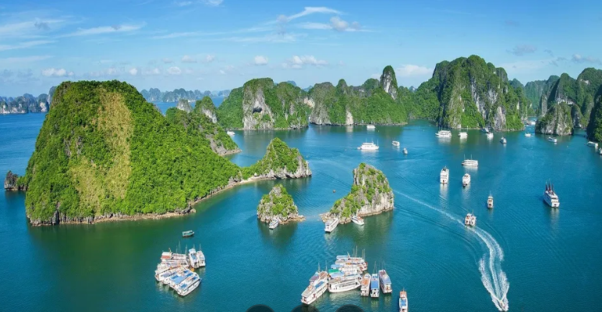
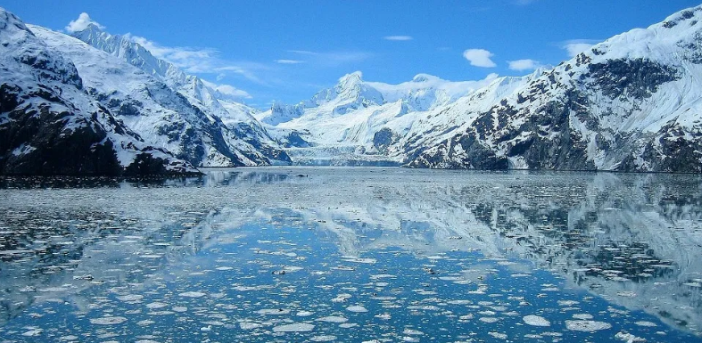
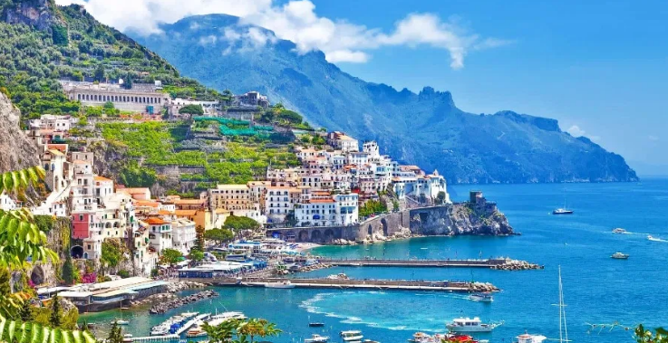
Adjectives – describing words
TASK 4: Write as many adjectives as you can that describe these coastlines.
e.g. Rocky, cold, warm, picturesque….

Slide 5
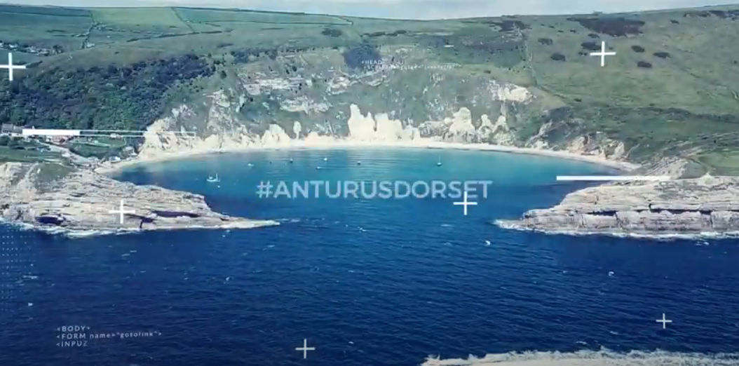
Coastal Features – Durdle Door
The coast is shaped by the process of erosion.
Coastal erosion is the is the wearing away and breaking up of rock along the coast.
The process of erosion creates lots of features at the coast.
TASK 5: Watch this video and write down as many of the key words (coastal features) as possible.
https://www.youtube.com/watch?v=VoHlr3lY6UY
Cliff
Wave Cut Notch
Cave
Bay
Headland
Arch
Stack
Stump

Slide 6
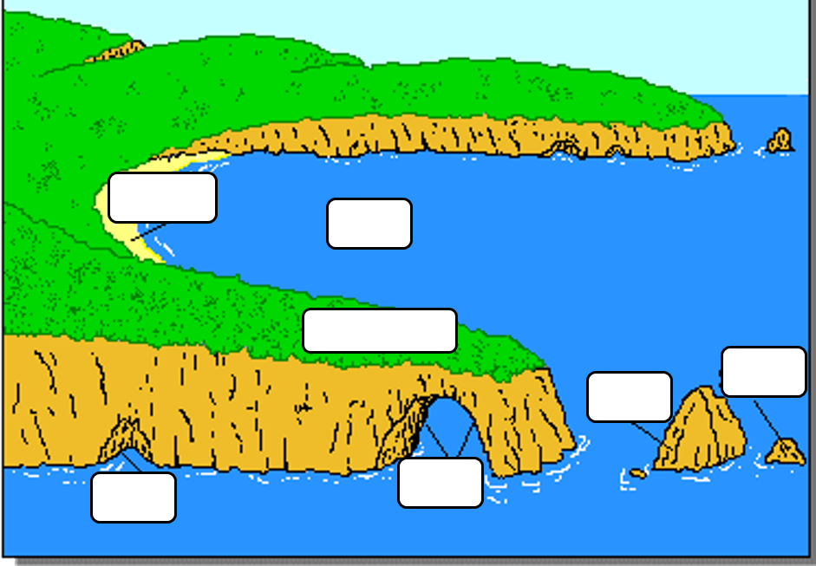
Task 6: Use the labels to identify the features of this coastline
Headland
Cave
Bay
1
2
Stack
Arch
3
7
6
Stump
Beach
4
5
Task 7 : Chose 1 feature and describe how it is formed

Slide 7
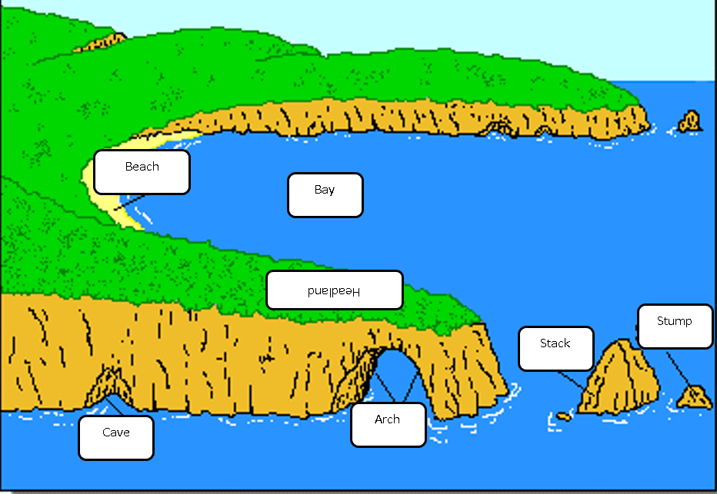
Coastal features - Answers

Slide 8
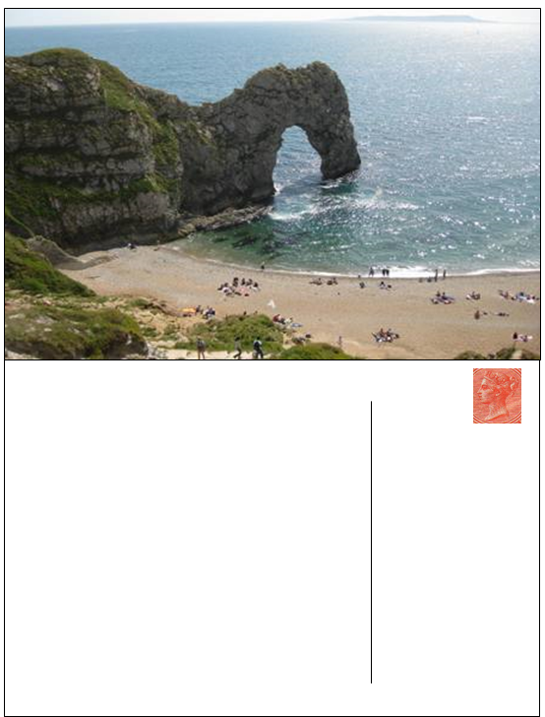
Write a post card about all the things you would be doing at Durdle Door
Task 8
Top tip – try to iclude some of the following
Landscape, activities, tastes, smells, sounds, rocks, beach, water, trees, flowers, animals

Slide 9
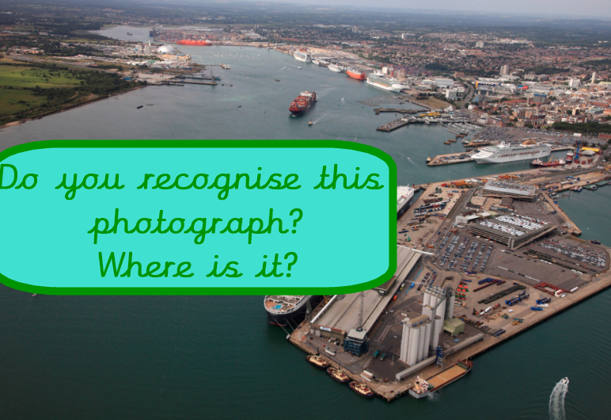
Human uses of the Coast

Slide 10
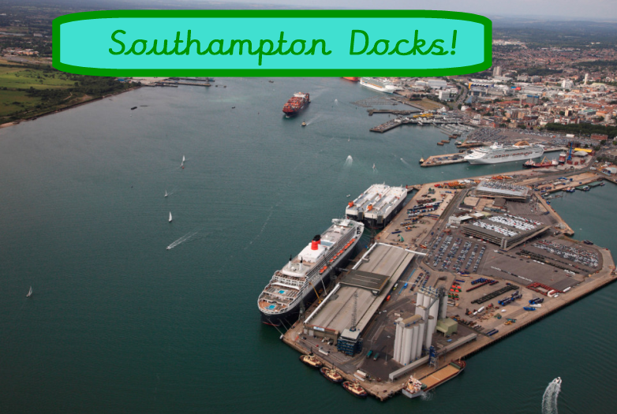
https://www.youtube.com/watch?v=V6nV12EfaYE
Task 9 – Look a the picture and watch the video
Write down as many nouns (things) that you can see

Slide 11
Write a post card about all the things you would see at Southampton Docks
Task 10
Top tip – try to include some of the following
Landscape, activities, tastes, smells, sounds, rocks, water, ships

Slide 12

Brain Revisited
TASK 11: Re-read your Brain
In a different colour, add in AT LEAST 3 new pieces of information that you have learnt in today’s lesson.
EXTENSION: In a different colour, write 2 questions that you want to ask about today’s topic inside your Brain.

