Slide 1
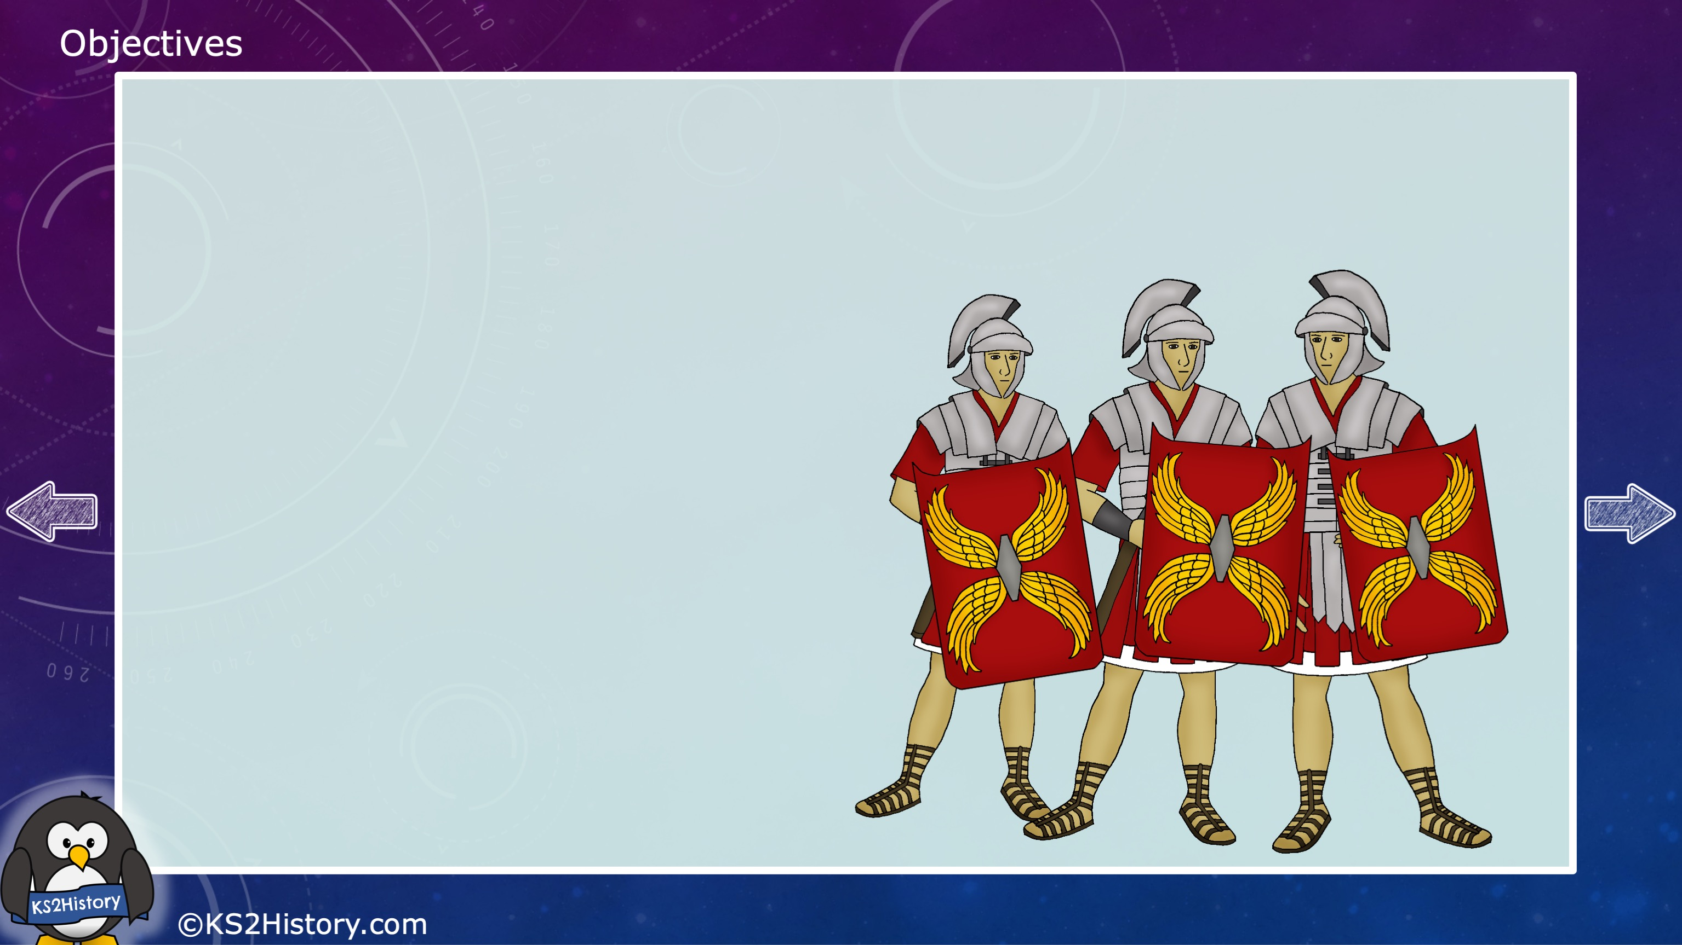
How did the Roman army help to expand the Roman Empire?

Slide 2
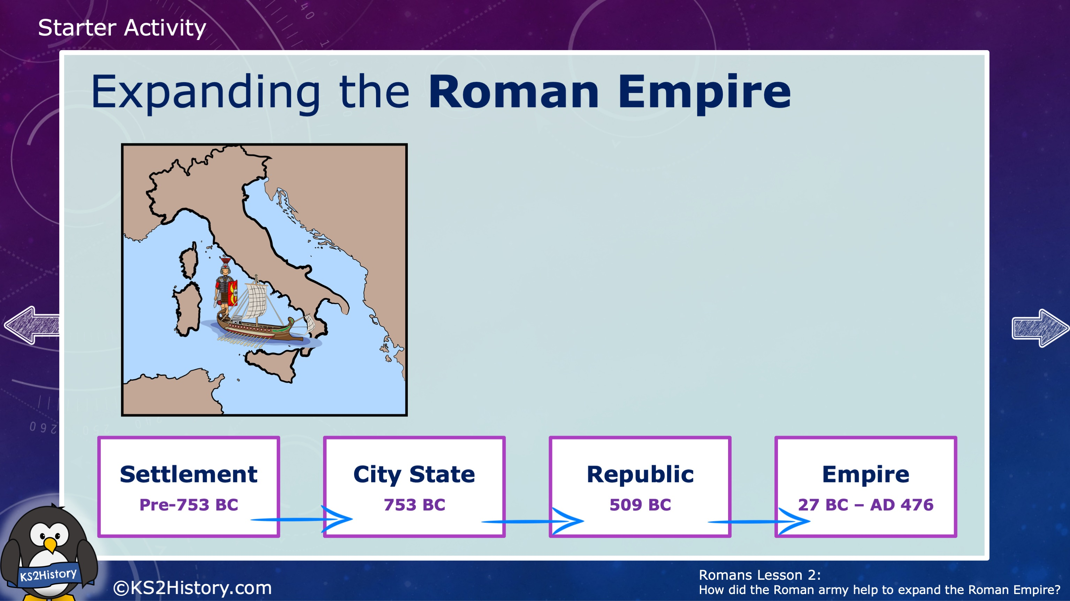
Although the Roman Empire had its beginnings in the city of Rome, over time it expanded its rule to include many different countries. It spread from a city-state to a republic (which means it was ruled by elected leaders), spanning across most of modern-day Italy, and then to an empire reaching countries in Europe, Africa and Asia.

Slide 3
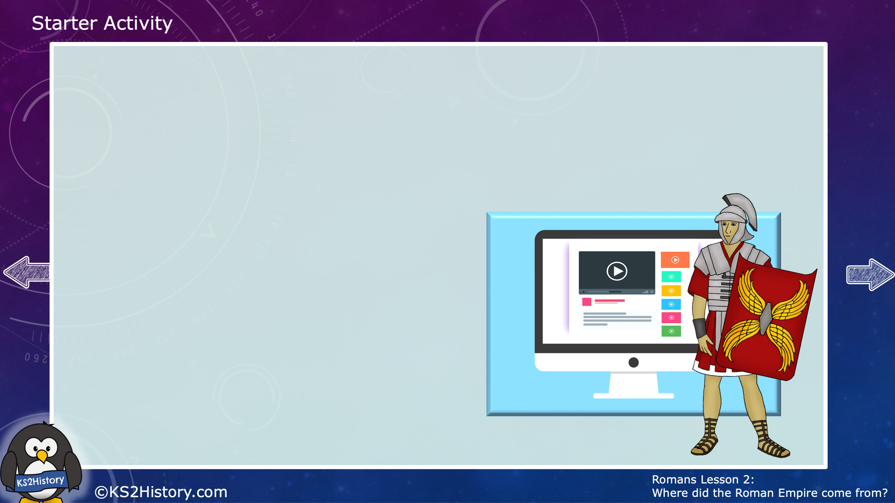
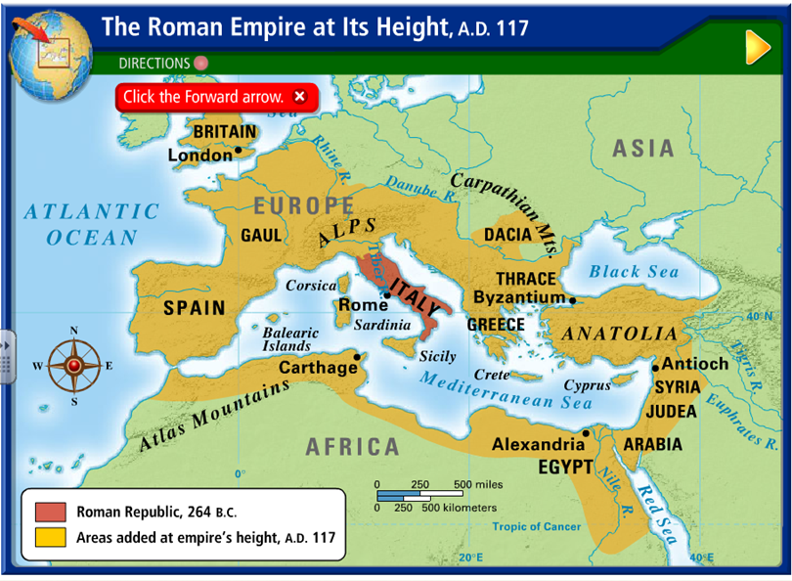
Expanding the Roman Empire
Where is Rome?
Think how far the Romans travelled to invade Britain!
How far did the Roman
Empire spread?
The Roman empire expanded from the settlements in Rome to a huge empire that included countries in Europe, Africa and Asia.

Slide 4
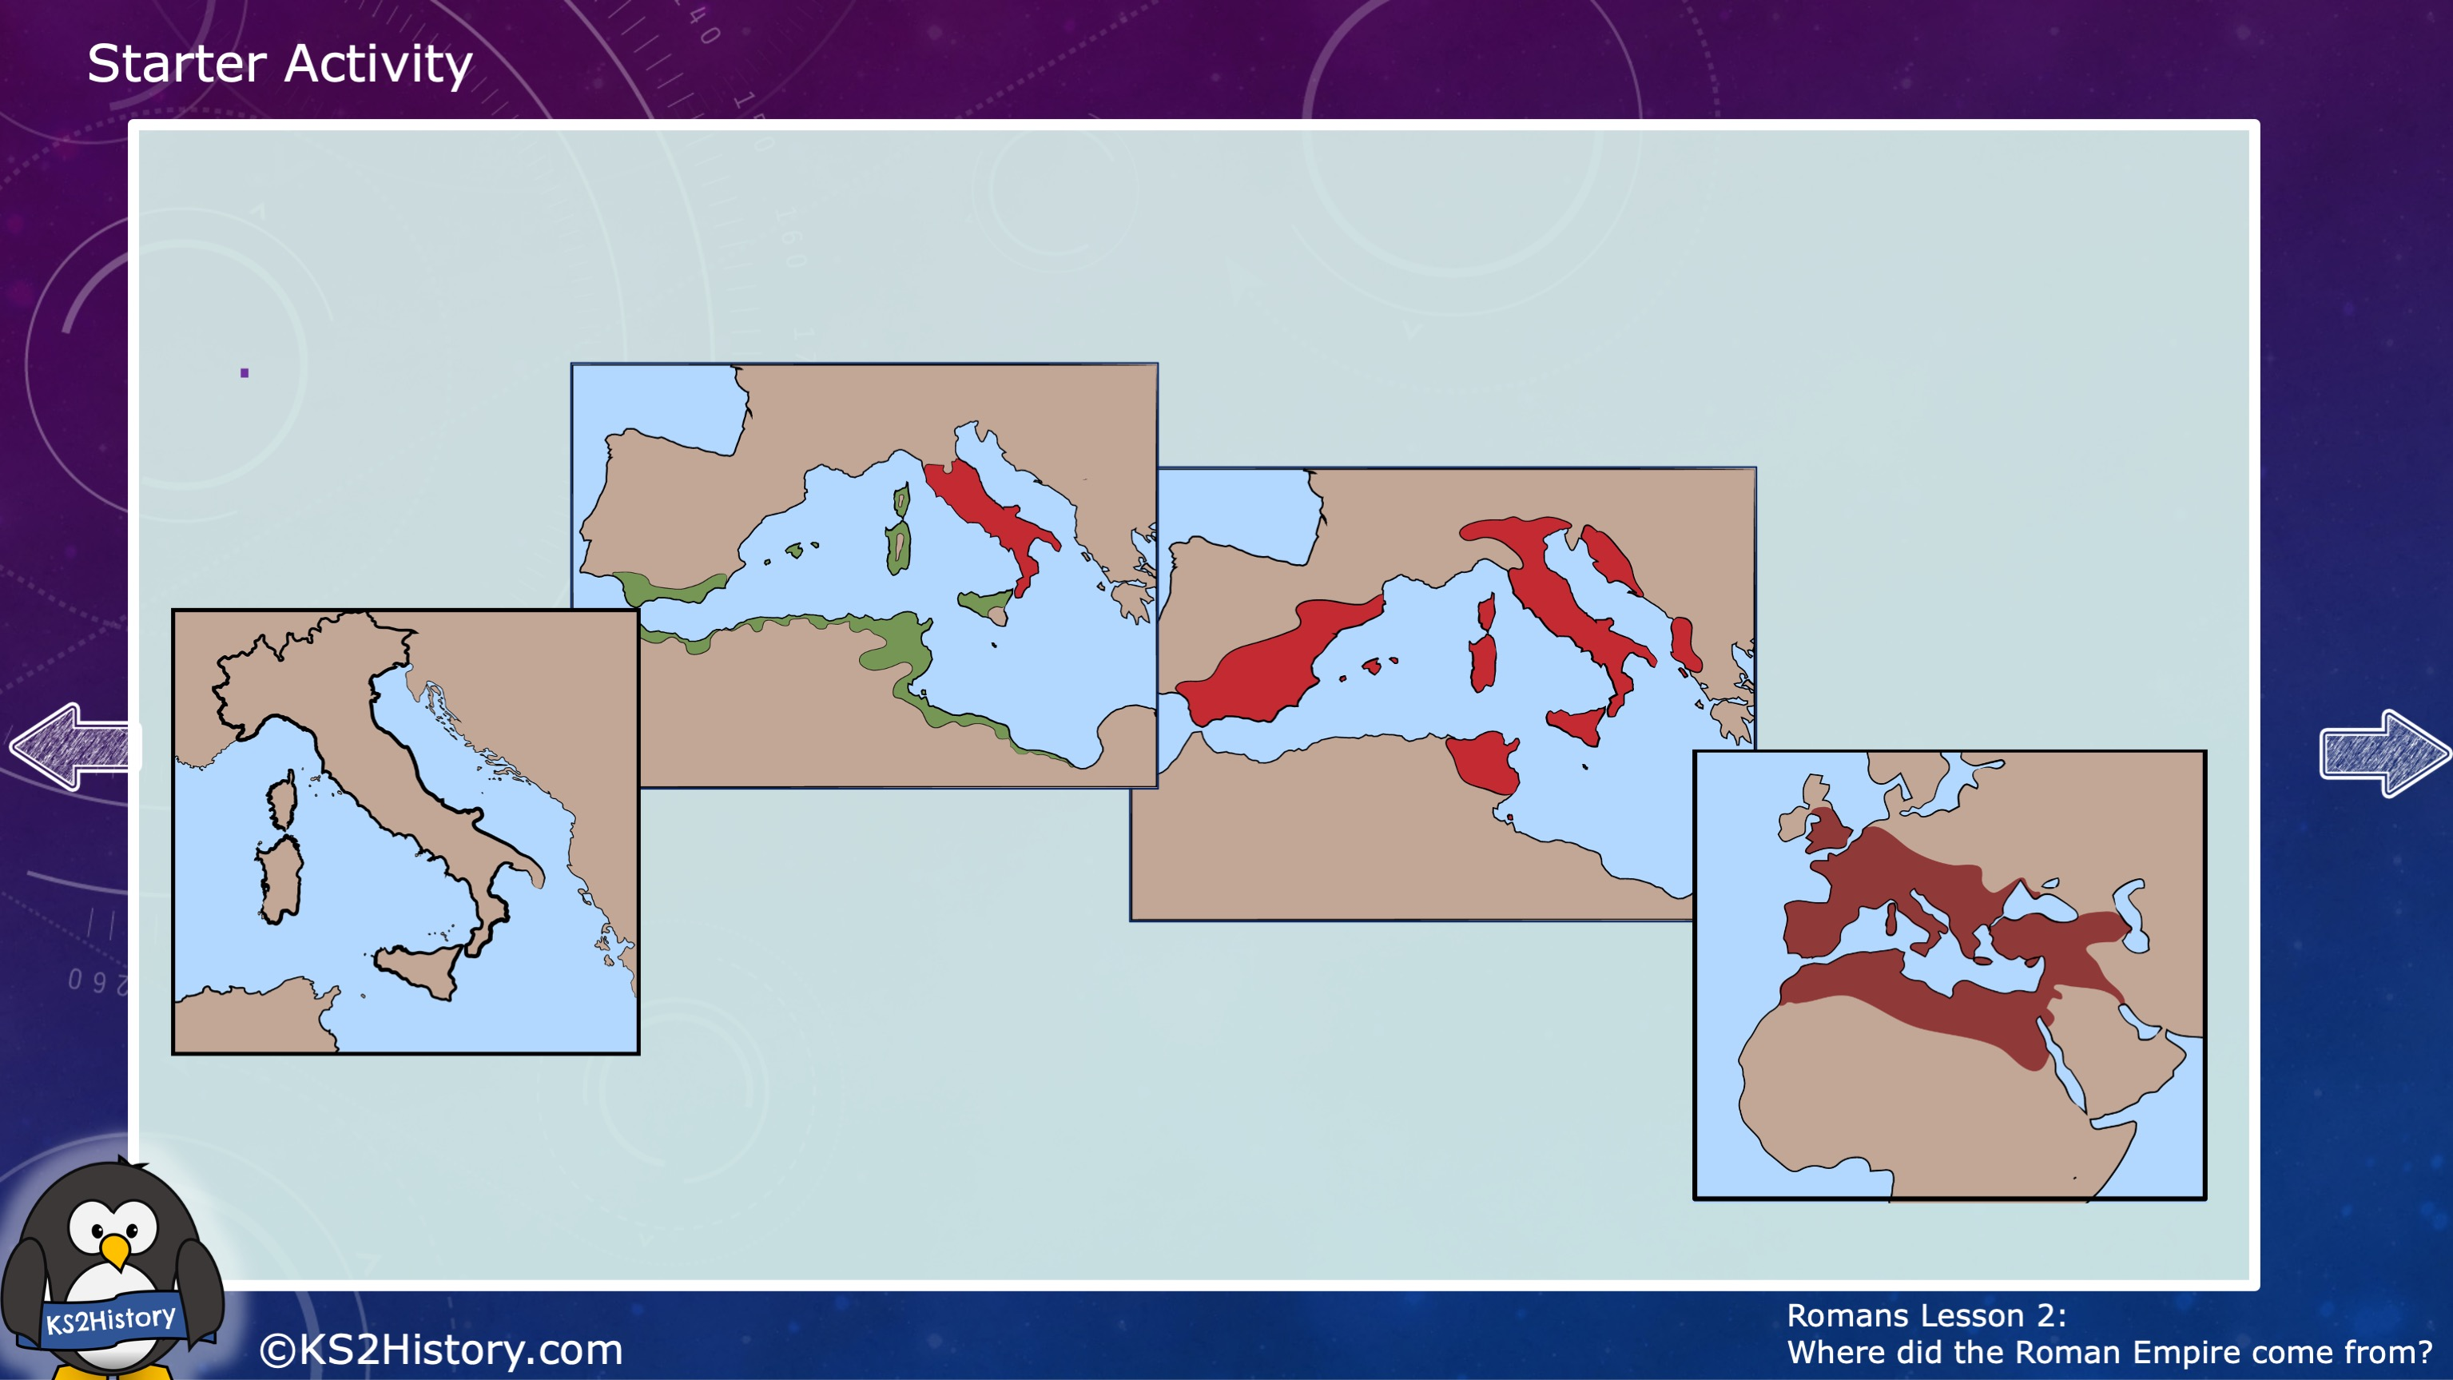
Expanding the Roman Empire

Slide 5
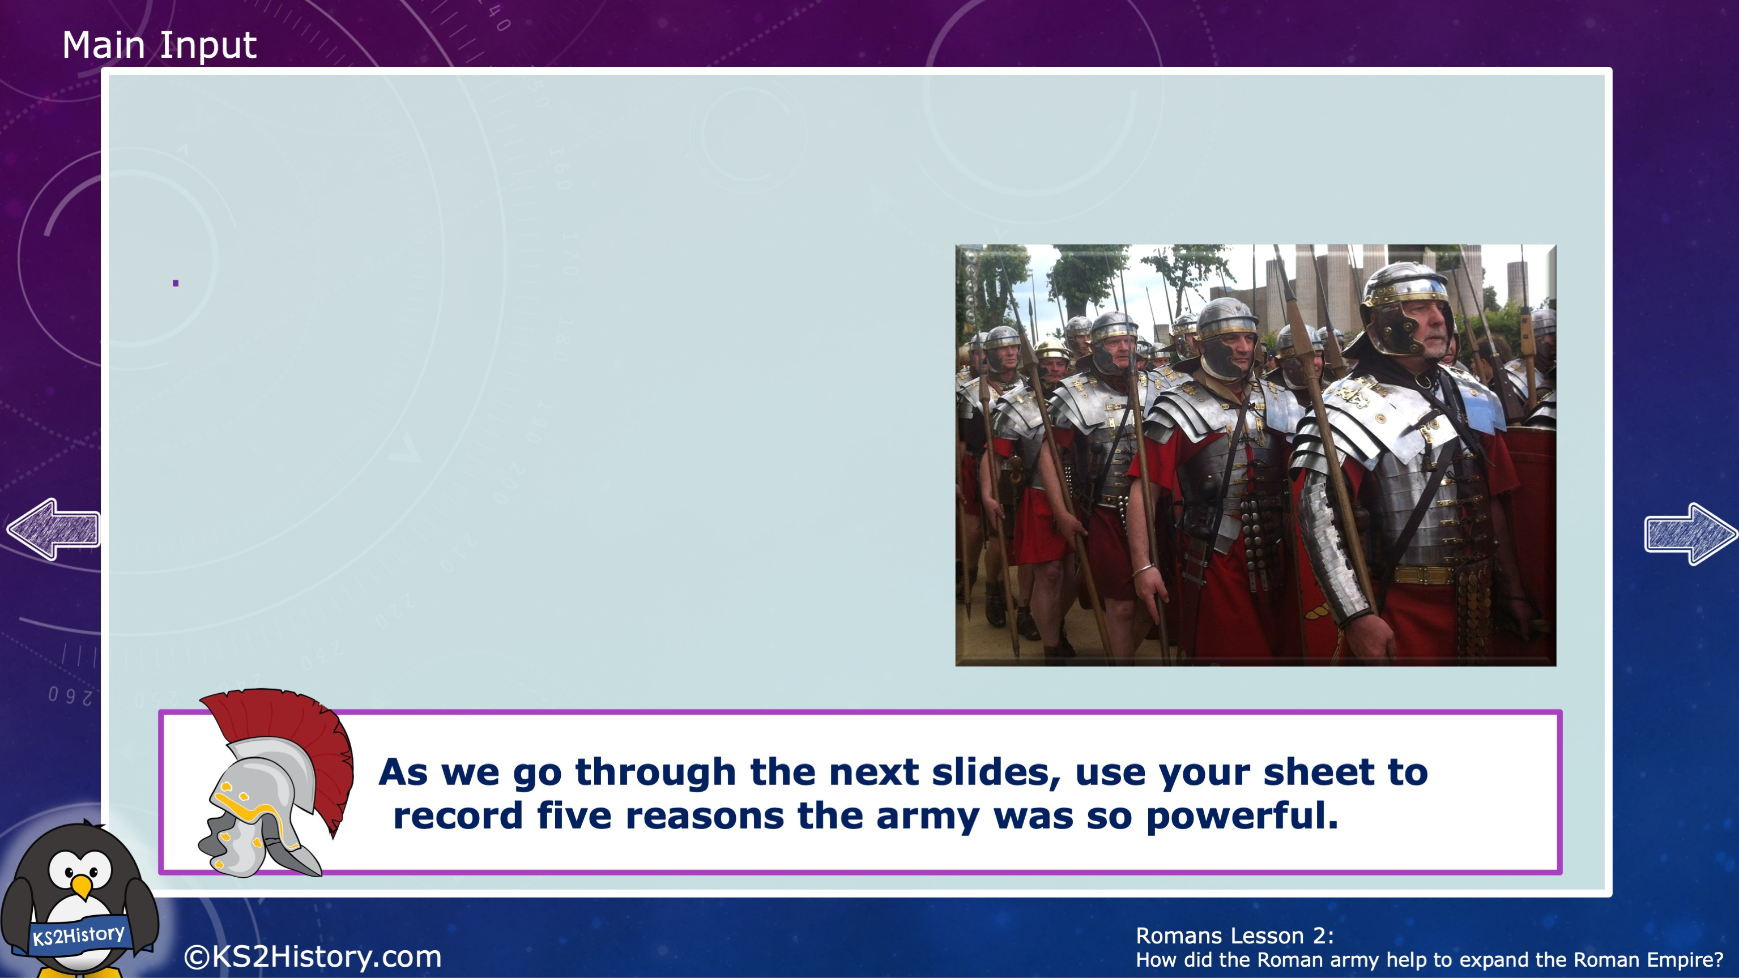
Introducing the Roman Army
Today we are going to evaluate how the Roman army contributed to the expansion of the empire
The Roman army was more powerful, organised and advanced than most others at the time. It was the first paid, professional army in the world and it was known to take on armies 10 times its size and still win!

Slide 6
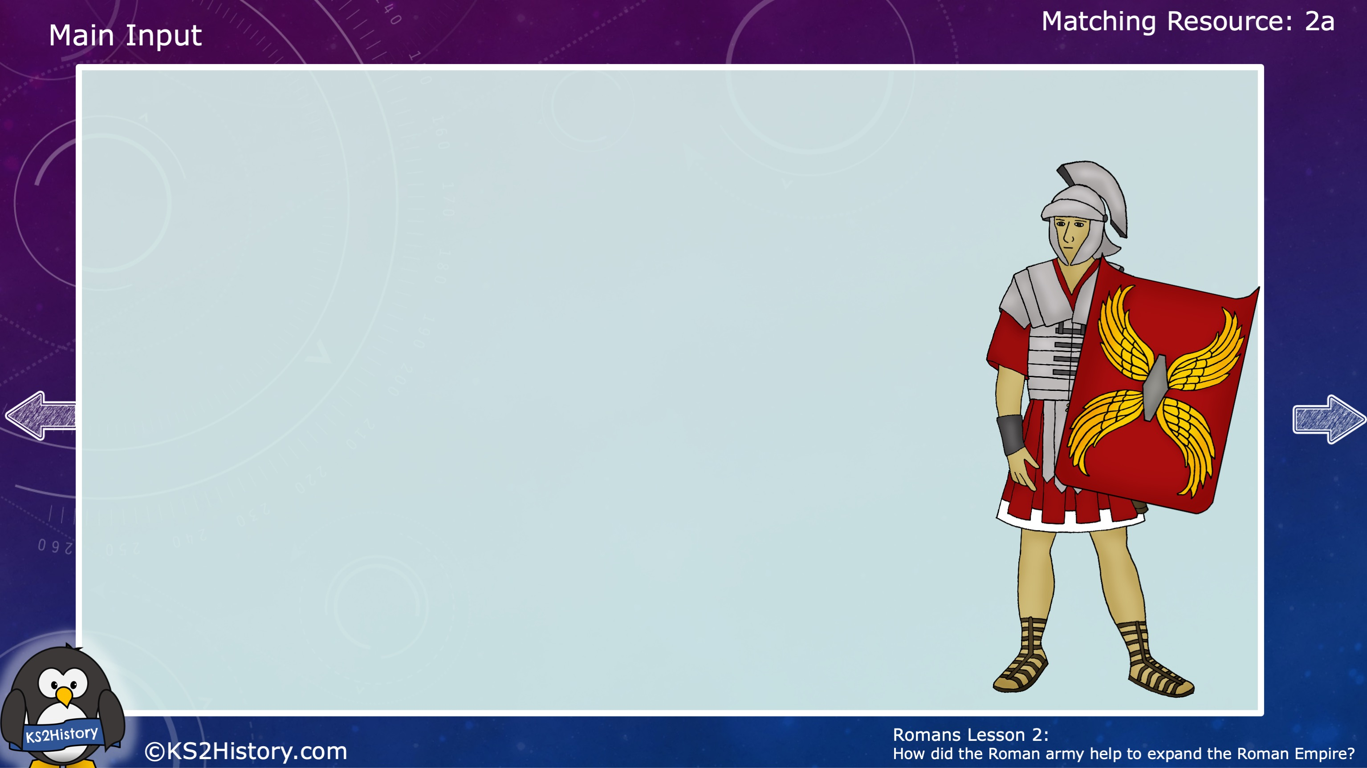
1. Only the strongest soldiers
Soldiers in the army had to be in top fitness condition and anybody not strong enough would be rejected. Only men could join the army, and they had to be tall enough to make the cut.
As the empire expanded, soldiers from other countries were recruited, with the army selecting top soldiers from Africa, the Middle East, France and Spain.
There were two types of soldiers: legionaries and auxiliaries. Soldiers recruited from outside tribes were auxiliaries. Roman citizens under 45 became legionaries, and there was a reward for lasting 25 years as a legionary.

Slide 7
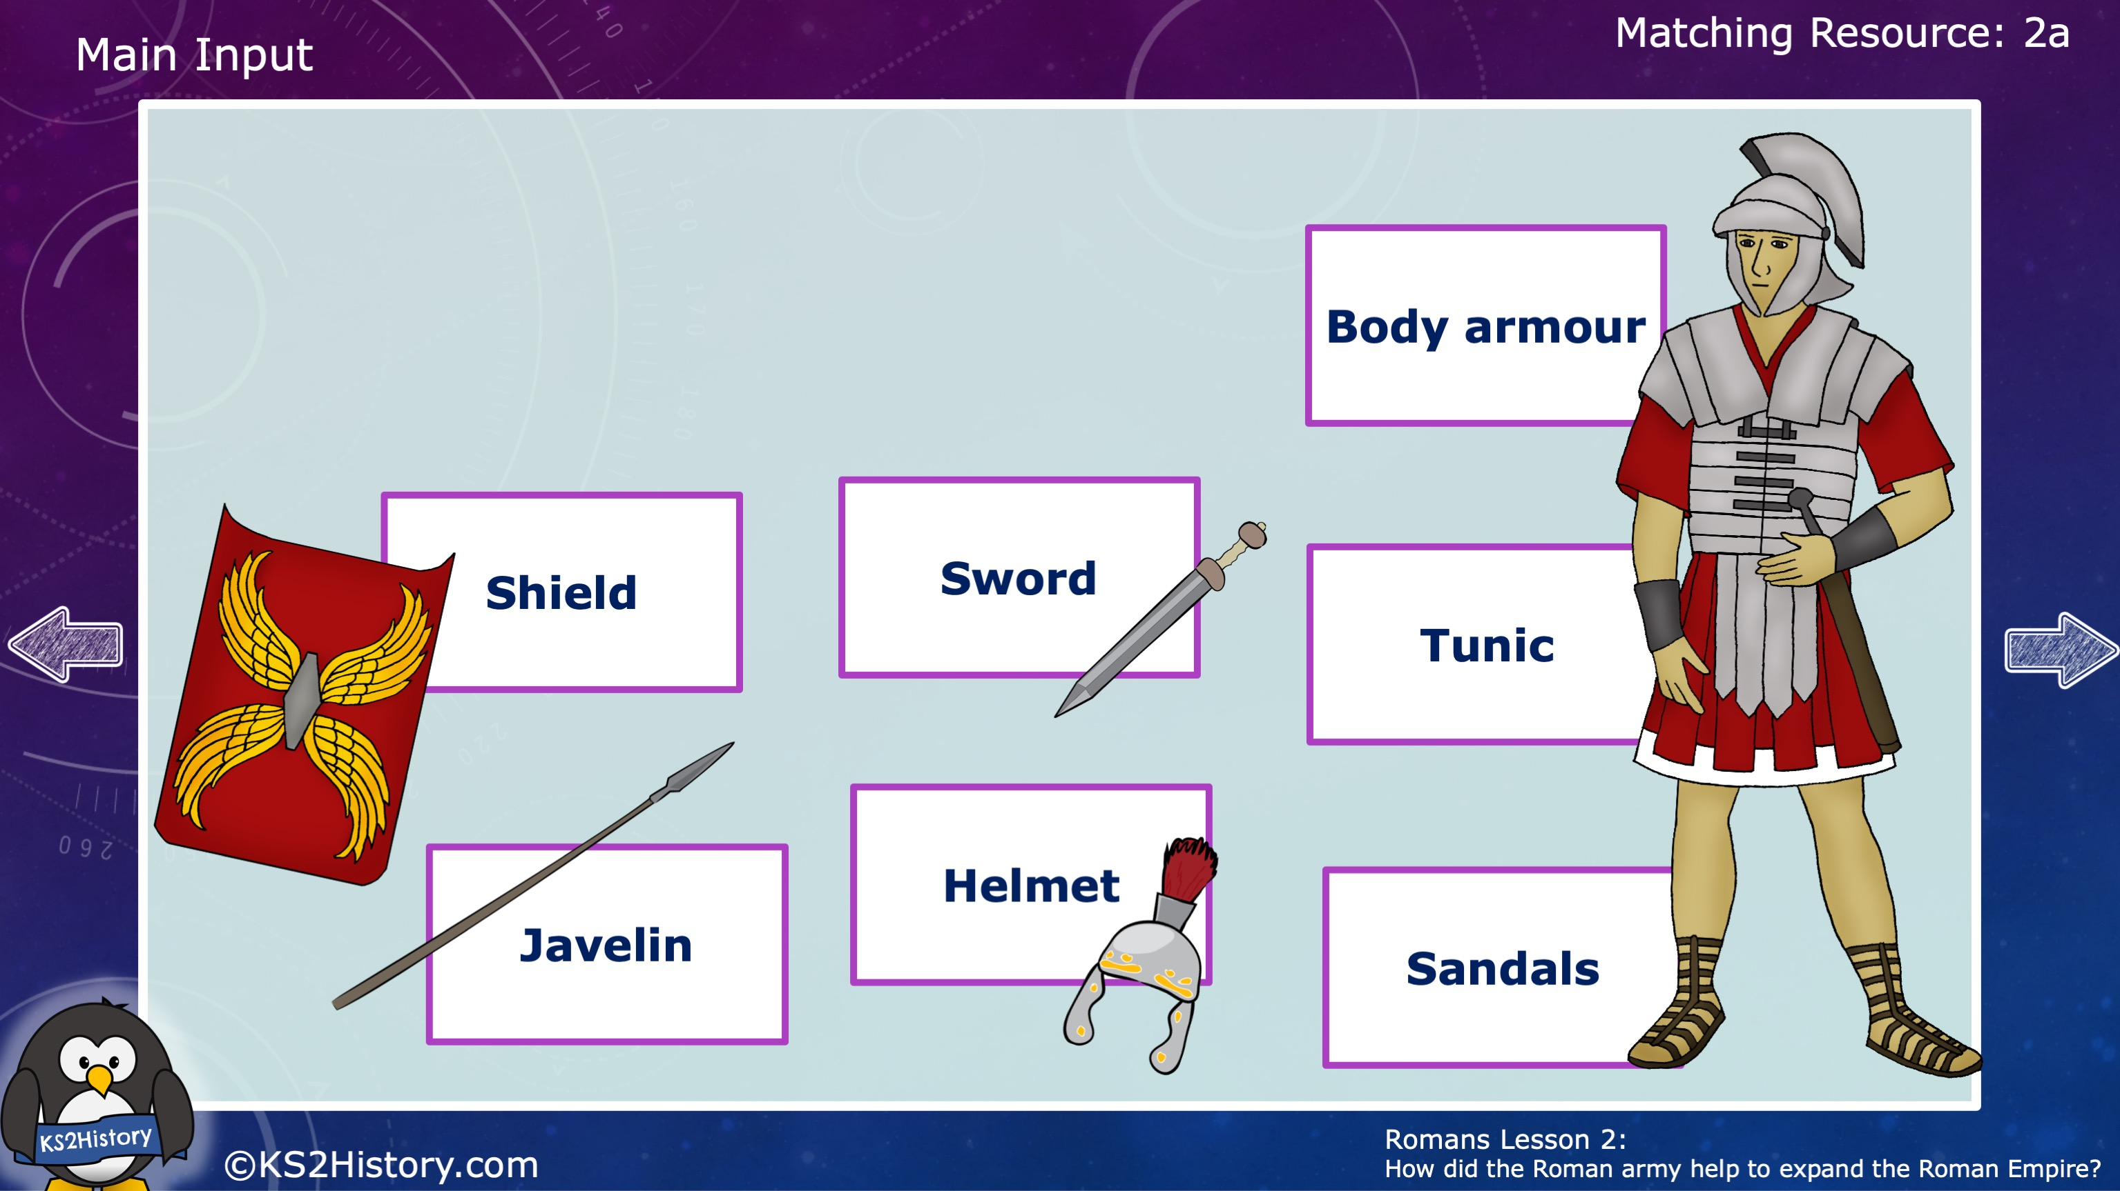
2. Effective equipment
Roman soldiers were equipped with armour and weapons that helped then to attack and defend successfully. Can you work out the role of each piece of equipment?

Slide 8
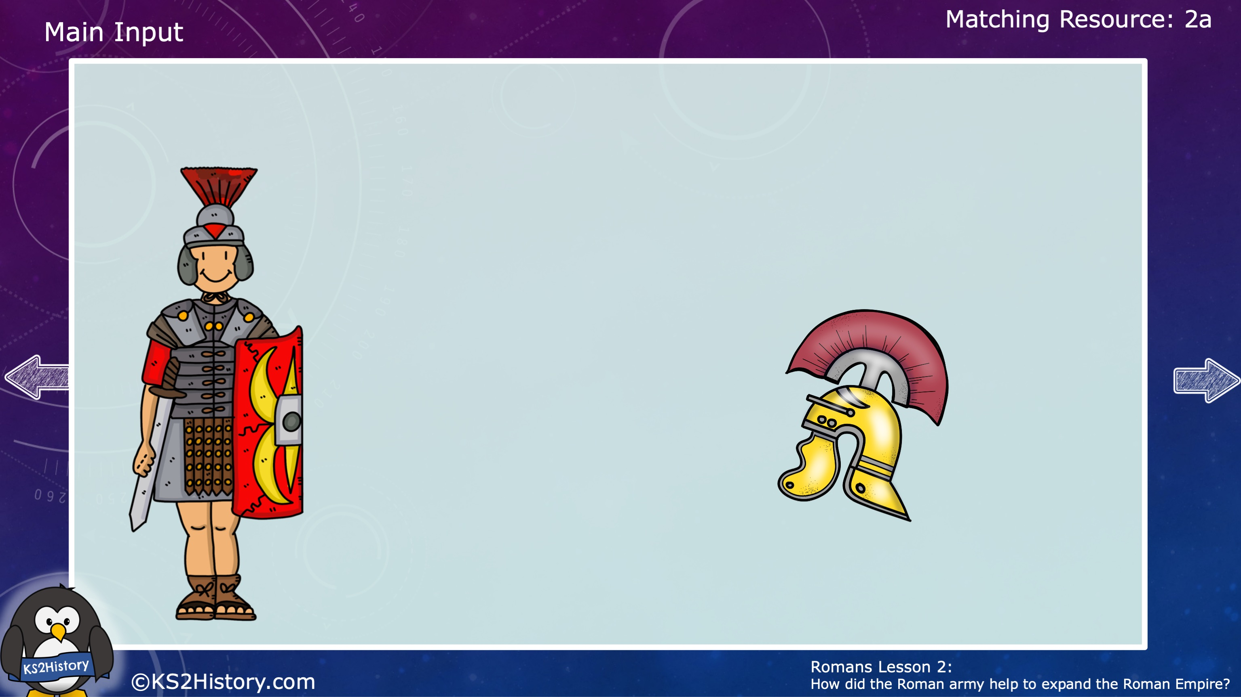
3. Top training
Roman soldiers spent a lot of time training for battle. Their ongoing training kept their fitness levels high and taught them the best fighting strategies. They were also trained to build forts and camps wherever they travelled.
Soldiers were trained how to:
engage in combat
march for miles
build camps
swim across rivers
attack forts
follow exact orders.
Soldiers who did not follow orders were punished or even sentenced to death!

Slide 9
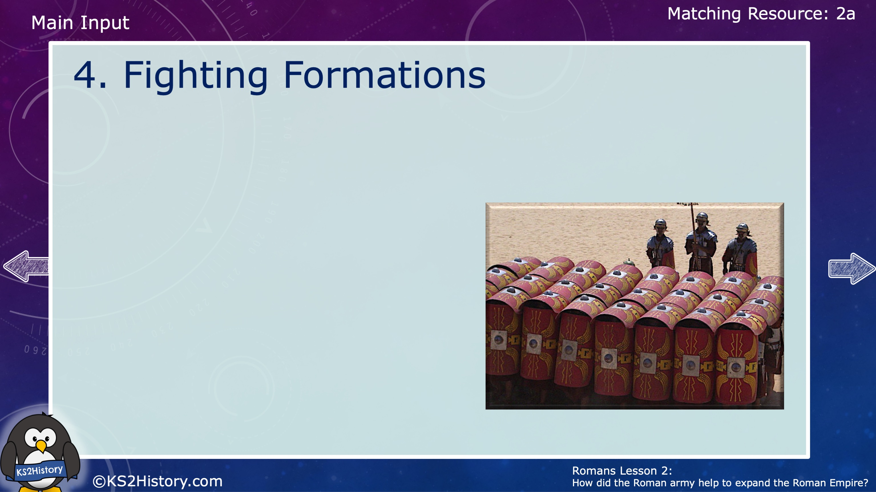
When fighting in formation, Roman soldiers would stand close together to form a particular shape, choosing particular types of soldiers to take important positions.
They had a range of different formations. One of the most famous was the tortoise formation. The soldiers in front and side rows interlocked their shields together like a wall. The soldiers in the back lines placed their shields up above their heads to form a protective shell over the top. The shell was so strong that it was difficult to penetrate, and this meant that the soldiers could stay protected from the shields while approaching enemy forts.

Slide 10
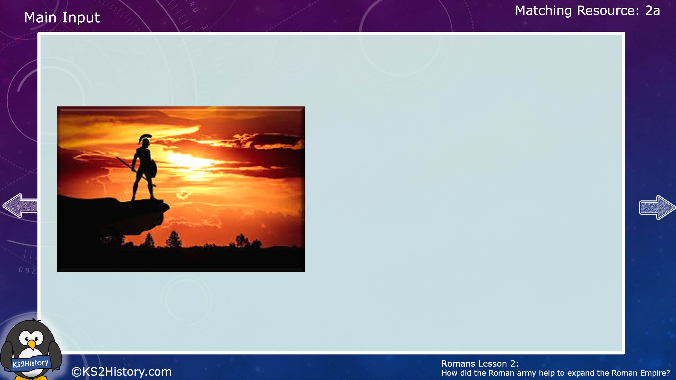
5. Never accepting defeat
Rome invested well in its army by offering desirable payment and rewards, and the attitude of the Roman army was to never admit defeat. Soldiers saw themselves as fighting machines with only one aim: to never stop pursuing victory. If they lost a battle, they would often regroup and try again.
This mentality of never giving up made the Roman army incredibly hard to beat!

Slide 11
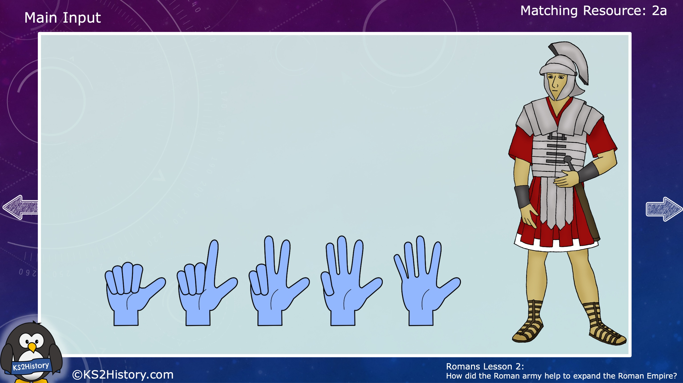
The Roman army was very important because conquering new places is how the empire expanded.
Can you tell someone at home five reasons why the Roman army was so successful?

Slide 12
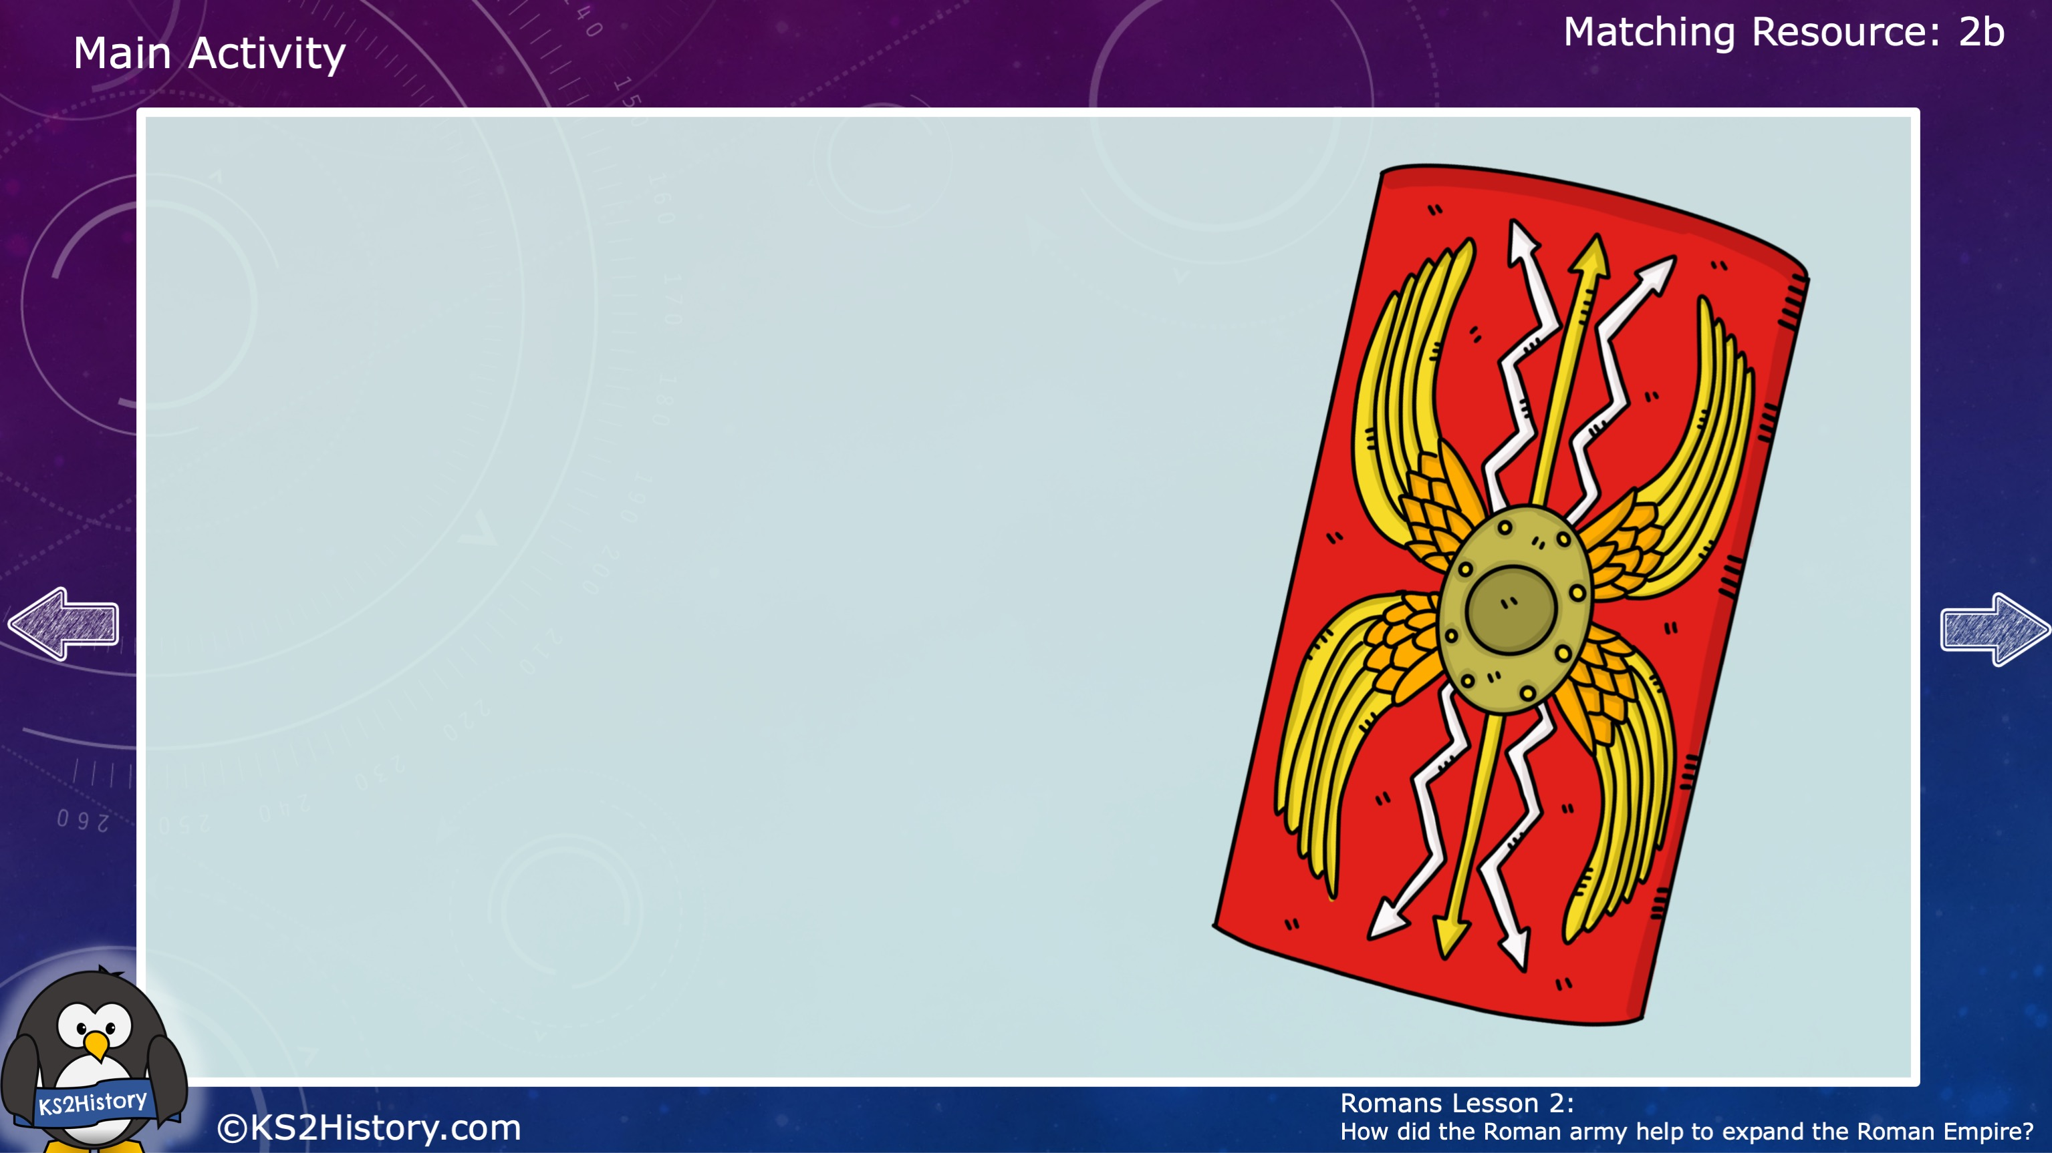
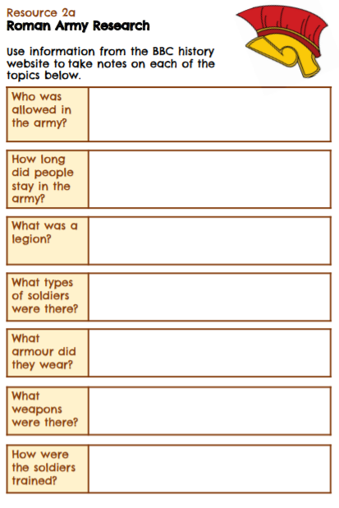
History detective!
Click on the link to find out more about the Roman army.
https://www.bbc.co.uk/bitesize/topics/zwmpfg8/articles/zqbnfg8
Complete the research sheet as you uncover more facts.

Slide 13
Make a Roman shield
You are going to design a Roman shield that could be used for forming a tortoise shell formation.
Look at the ideas sheet before you make your design, using the following design features:
Rectangular shape
Red and gold design
Large enough to crouch behind

Slide 14
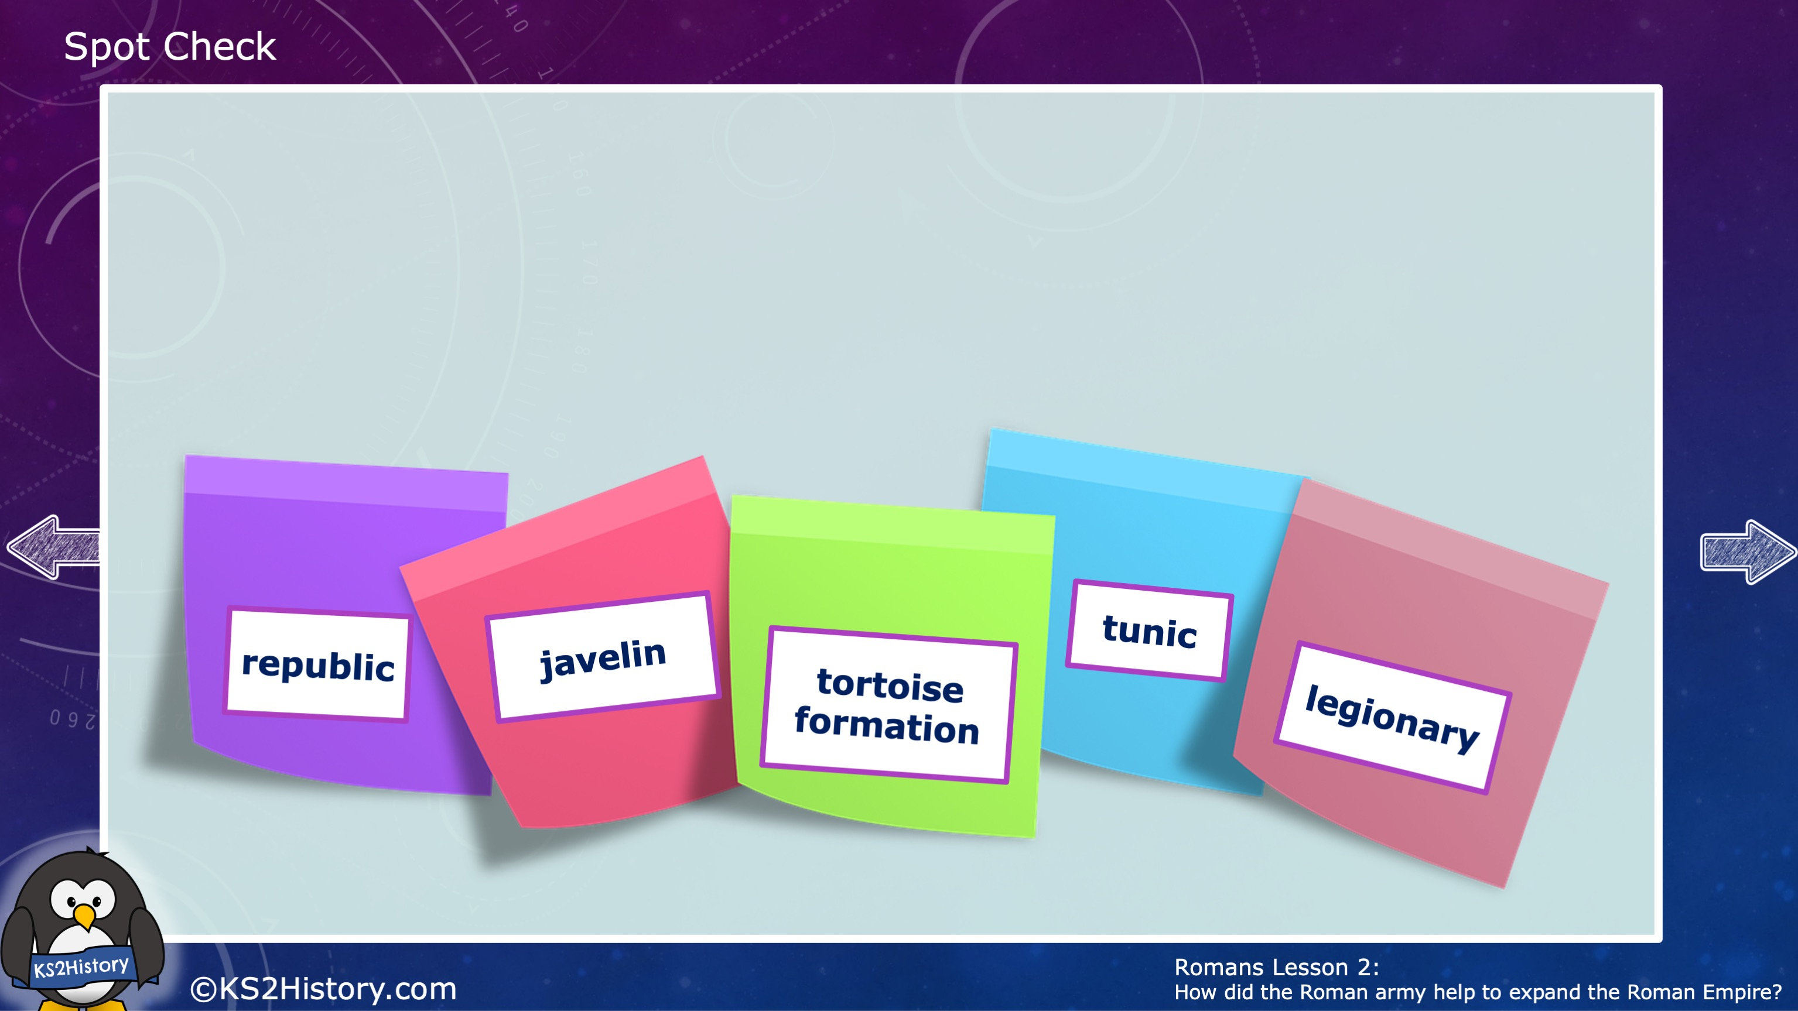
Spot Check
How many of these words can you define?

Slide 15
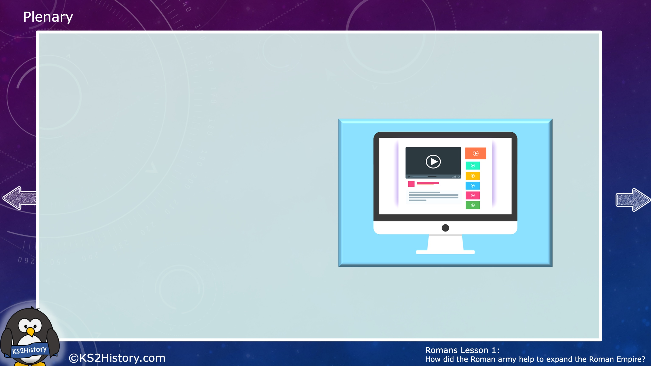
Let’s think about what we have learnt today…
Watch the video to recap how the Roman army was organised.

