Slide 1
1
1
Words ending with the /f/, /l/, /s/, /z/ or /k/ sound in English almost always have double consonant.

Slide 2
Stage: 1 | Words ending with the /f/, /l/, /s/, /z/ or /k/ sound in English almost always have double consonant. Name:
List: 1
puff
doll
back
clock
grass
kiss
fluff
bell
buzz
fizz

Slide 3
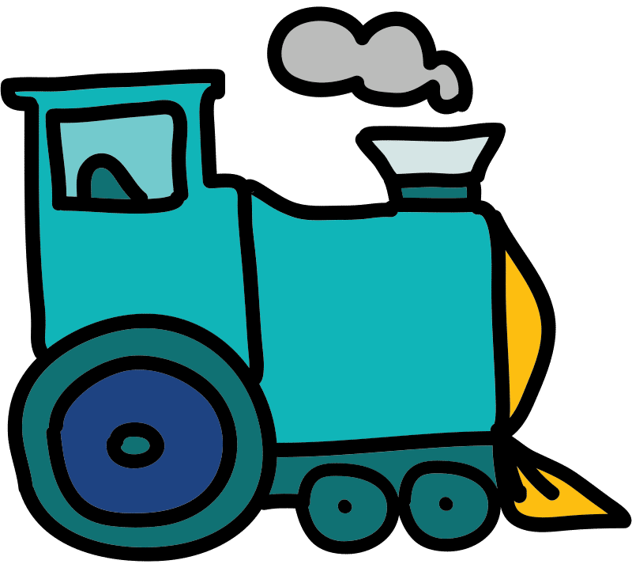
A _______ of smoke came from the train.

Slide 4
A _puff_ of smoke came from the train.
Answer:

Slide 5
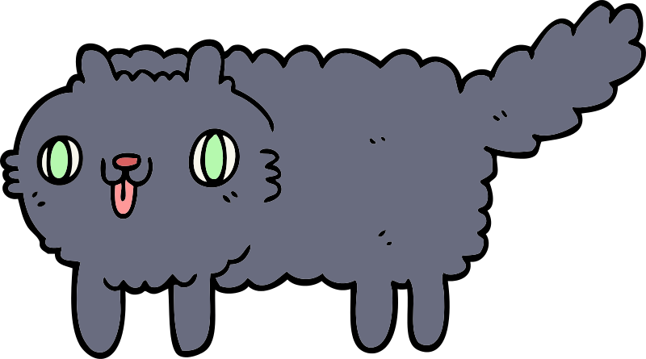
The kitten was covered in _______.

Slide 6
The kitten was covered in _fluff_.
Answer:

Slide 7

The teacher rang the _______.

Slide 8
Answer:
The teacher rang the _bell_.

Slide 9
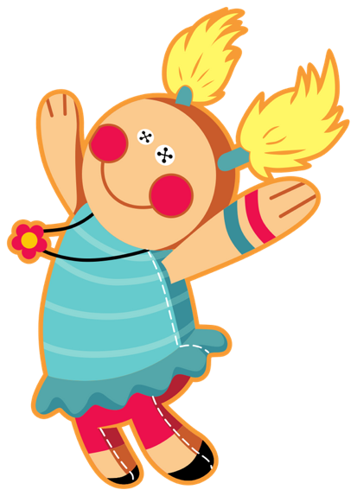
The _______ has a blue dress.

Slide 10
The _doll_ has a blue dress.
Answer:

Slide 11

The _______ on the field is green.

Slide 12
The _grass_ on the field is green.
Answer:

Slide 13
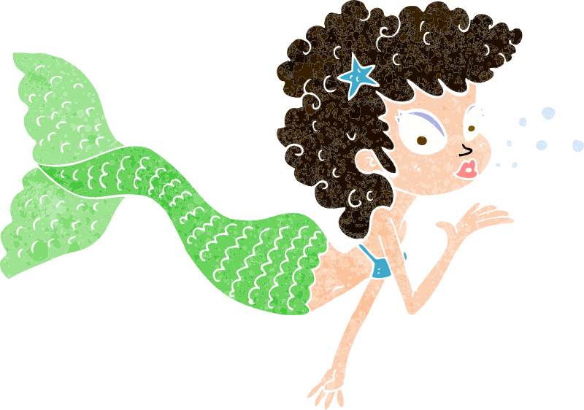
The mermaid blew a _______.

Slide 14
Answer:
The mermaid blew a _kiss_.

Slide 15
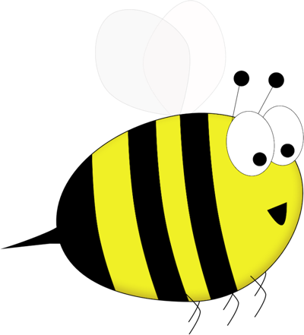
Bumble’s wings _______.

Slide 16
Bumble’s wings _buzz_.
Answer:

Slide 17
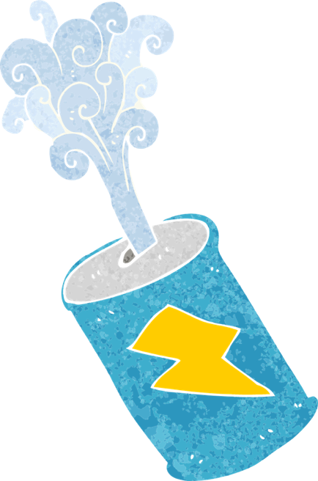
The can was full of _______.

Slide 18
Answer:
The can was full of _fizz_.

Slide 19

You tell the time by using a _______.

Slide 20
You tell the time by using a _clock_.
Answer:

Slide 21

The girl’s hair ran down her _______.

Slide 22
The girl’s hair ran down her _back_.
Answer:

