Slide 1
Sound

Slide 2

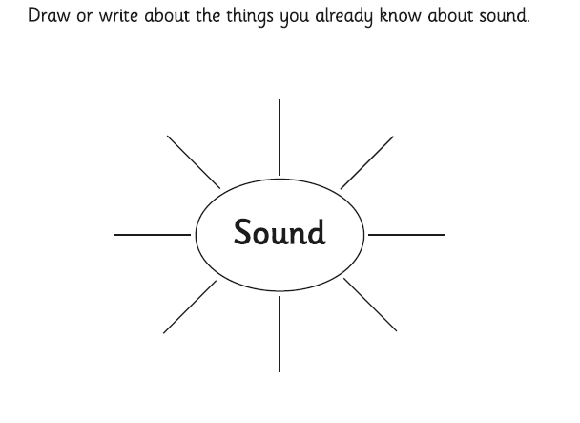
What is Sound?
What do you already know about sound and do you know anything about how sounds are made?
Complete your Sound Mind Map to show what you already know, and to ask questions about what you want to find out.

Slide 3
What is sound?
In this lesson, we will learn about how sound travels, how we hear it in our ear and complete an experiment.
Notes:
Teacher Note - Please check your volume is set to the appropriate level for this video. Please do not let the next video automatically play at the end of the clip. Please check the content in this link, including any comments, is suitable for your educational environment before showing. Twinkl accepts no responsibility for the content of third party websites.

Slide 4
What is sound?
Click on the link below, it will take you to today’s video.
Please join in with as much as you can. When the video asks a question, pause and try and answer it. Then continue playing.
There will be a couple of times where you need to pause to complete a short activity. These details are on the next slide.
https://classroom.thenational.academy/lessons/what-is-sound-chh30r?activity=video&step=1
Notes:
Teacher Note - Please check your volume is set to the appropriate level for this video. Please do not let the next video automatically play at the end of the clip. Please check the content in this link, including any comments, is suitable for your educational environment before showing. Twinkl accepts no responsibility for the content of third party websites.

Slide 5
What is sound?
Pause the video at 3:17 and create a definition page, like we do in class, using the star words. The words are on the next page for you.
Remember to lay out your page carefully. You can draw pictures and write down a short definition for each word.
Once you have done this, continue with the video.
Pause the video at 16:08. You can draw the ear or there is a picture you can print off. Try and label your ear before continuing the video.
https://classroom.thenational.academy/lessons/what-is-sound-chh30r?activity=video&step=1
Notes:
Teacher Note - Please check your volume is set to the appropriate level for this video. Please do not let the next video automatically play at the end of the clip. Please check the content in this link, including any comments, is suitable for your educational environment before showing. Twinkl accepts no responsibility for the content of third party websites.

Slide 6
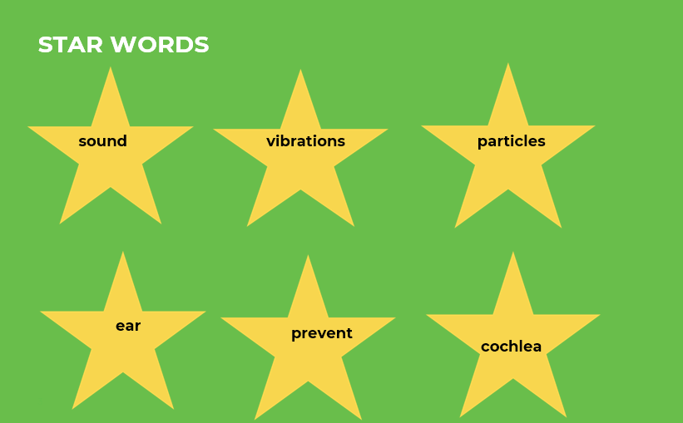
Once you have done this, continue with the video. Pause at 16:08.
Notes:
Teacher Note - Please check your volume is set to the appropriate level for this video. Please do not let the next video automatically play at the end of the clip. Please check the content in this link, including any comments, is suitable for your educational environment before showing. Twinkl accepts no responsibility for the content of third party websites.

Slide 7
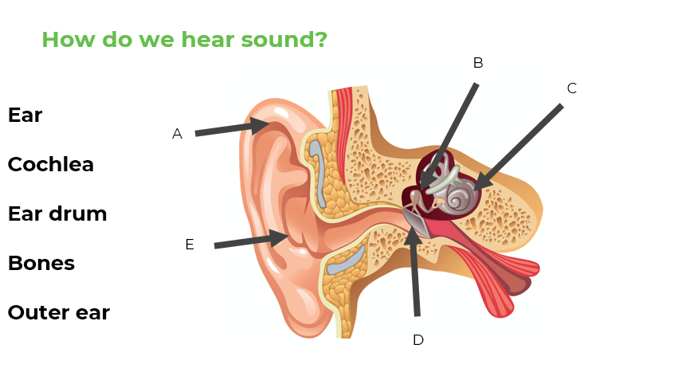
Notes:
Teacher Note - Please check your volume is set to the appropriate level for this video. Please do not let the next video automatically play at the end of the clip. Please check the content in this link, including any comments, is suitable for your educational environment before showing. Twinkl accepts no responsibility for the content of third party websites.

Slide 8
How did your experiment go?
What did you notice?
Were you surprised by anything?
https://classroom.thenational.academy/lessons/what-is-sound-chh30r?activity=video&step=1
Notes:
Teacher Note - Please check your volume is set to the appropriate level for this video. Please do not let the next video automatically play at the end of the clip. Please check the content in this link, including any comments, is suitable for your educational environment before showing. Twinkl accepts no responsibility for the content of third party websites.

