Slide 1
Reading
Mousehole Cat
Lesson 3

Slide 2
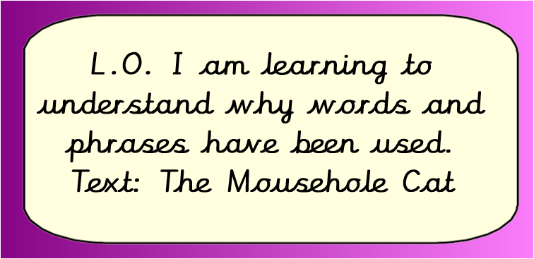

Slide 3
Here are some sentences containing the word “havoc”.
The hurricane ripped through the town causing havoc.
The floods that filled the town wreaked havoc on the town.
The bored children caused havoc in the classroom during wet break.
Write your own definition for the word “havoc”.
Write your own sentence using the word “havoc”.

Slide 4
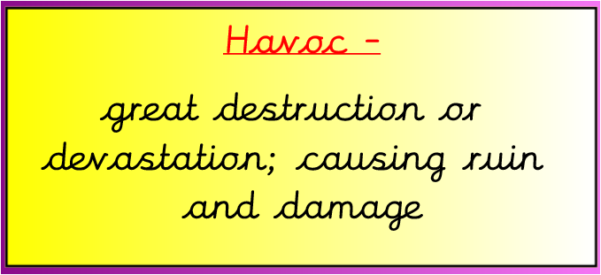
Is your definition similar to this?
If not, find the definition in a dictionary.

Slide 5

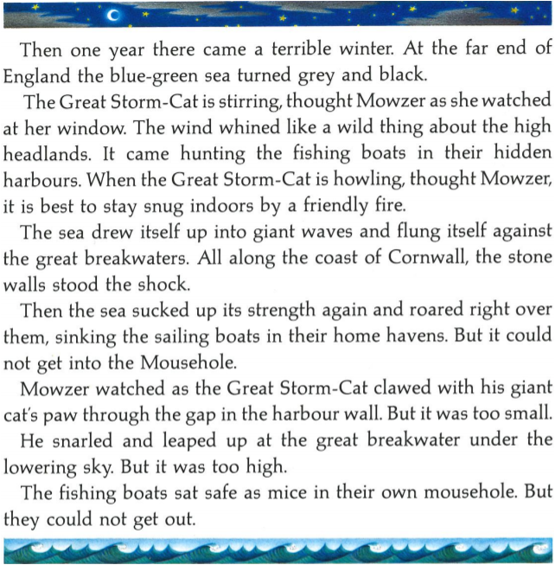
Read the page one more time
Which words or phrases show that the Great Storm-cat is causing havoc?
To start you off I have chosen…
The wind whined like a wild thing
How many more phrases can you see?
Play

Slide 6
These are some of my answers but you may have your own
The wind whined like a wild thing
It came hunting the fishing boats
Flung itself against the great breakwaters
He snarled and leaped up at the great breakwater
How many more did you find?

Slide 7
Choose three of your phrases and explain why you think that the Great Storm-Cat is wrecking havoc
To start you off I have chosen…
The wind whined like a wild thing
I think this described the Storm-Cat wrecking havoc because the word ‘whine’ makes me feel that the storm is making a horrible noise and the phrase ‘like a wild thing’ suggests that it is out of control.
Play

Slide 8
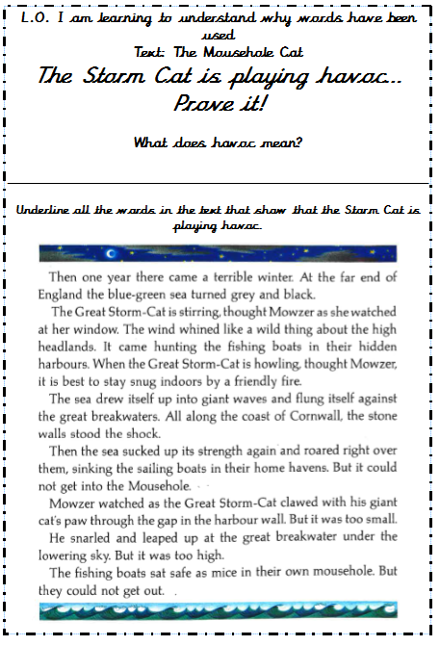

Slide 9


