Slide 1
Numbers up to 10
Say these numbers aloud and listen to the video to help you.
https://www.youtube.com/watch?v=cjqbIvJqPtc

Slide 2
1
2
3
4
5
6
7
10
8
9
Notes:
Click. As number appears, audio is heard.

Slide 3
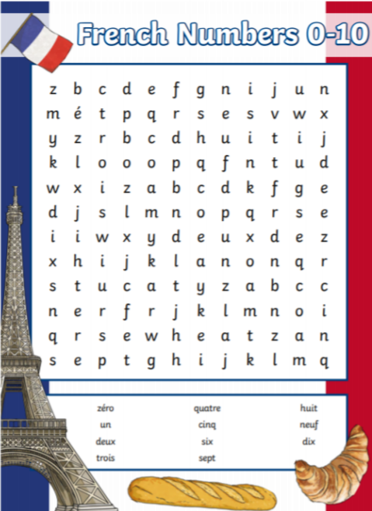
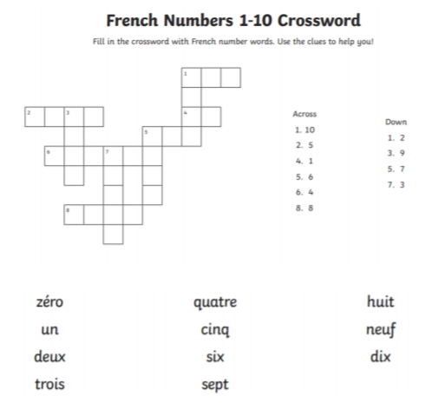
Complete the worksheets to practise your numbers to 10

Slide 4
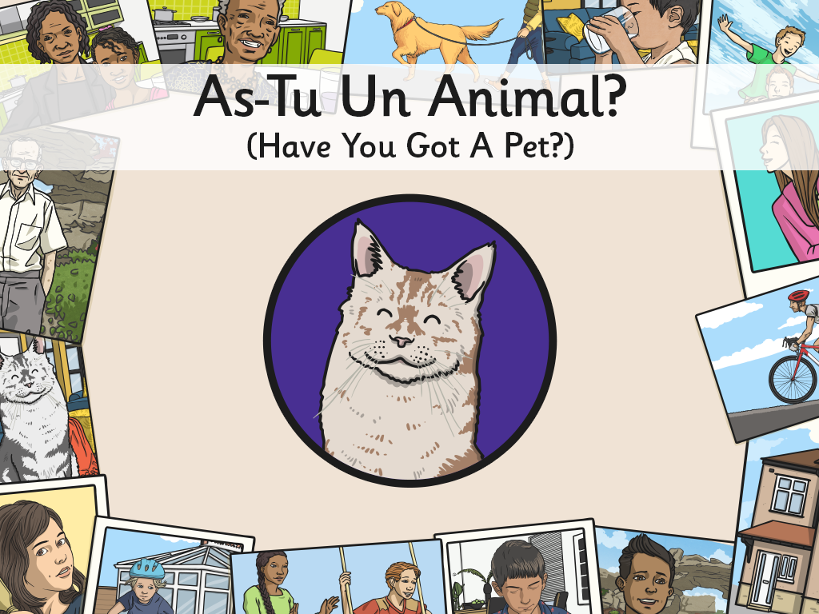


Slide 5
Aim
I can develop strategies for remembering new language.
I can match subject and verb correctly when talking about pets.
Success Criteria
I can use gestures to help me remember pets vocabulary.
I can link sounds and meanings.
I can make sentences about myself using ‘je’.
I can use ‘tu’ to ask questions about a partner.

Slide 6

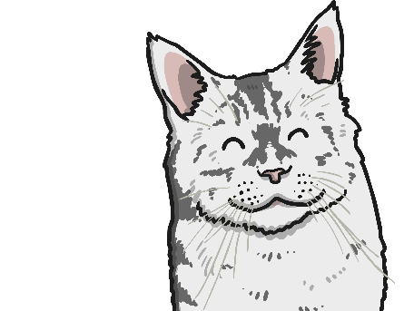
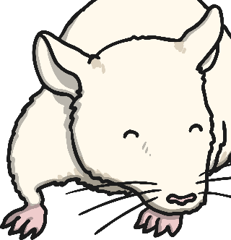
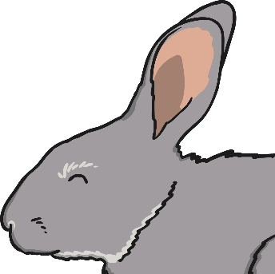
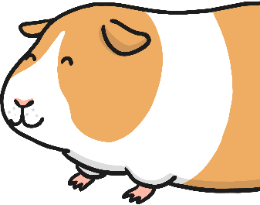
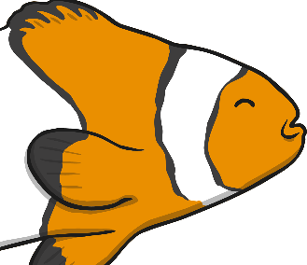
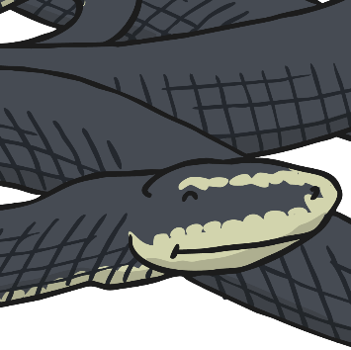
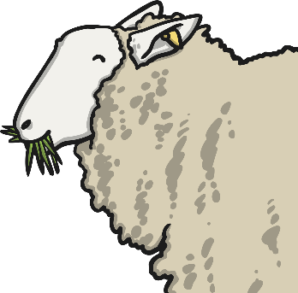
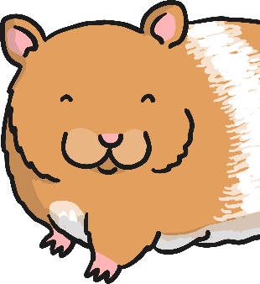
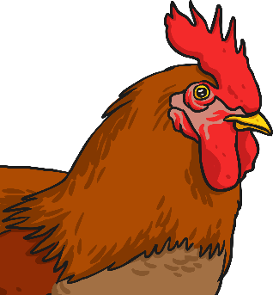
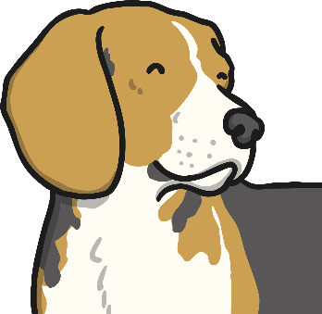
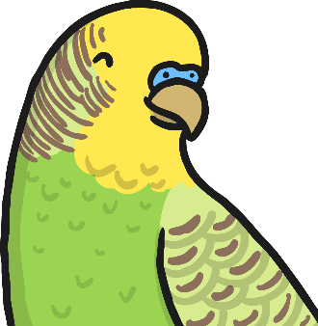
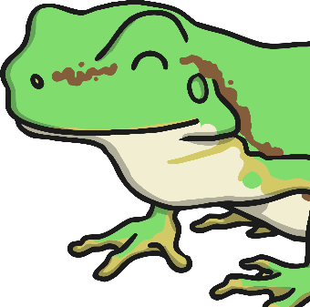
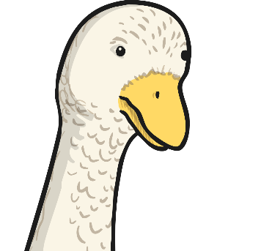
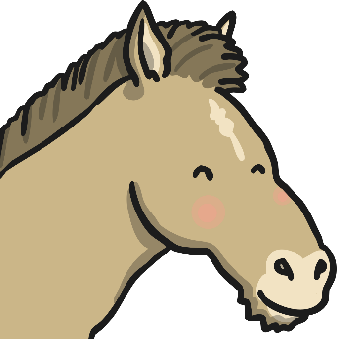
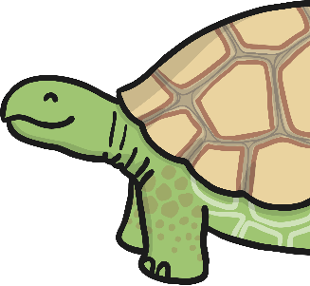
Our Pets
Do you have any pets?
What do you have?
What would you like to have?

Slide 7
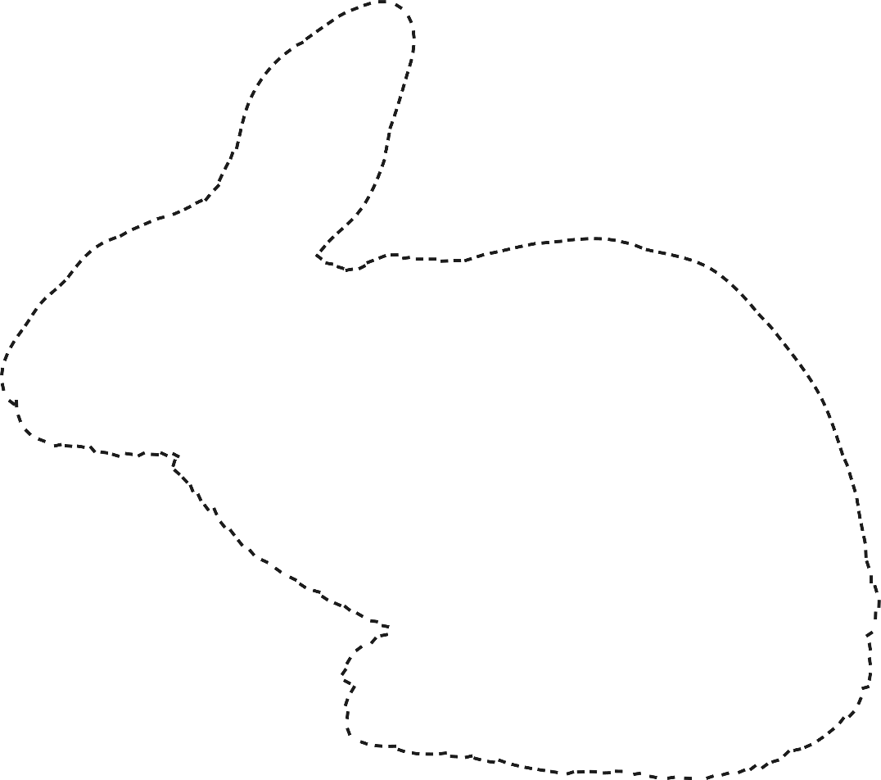
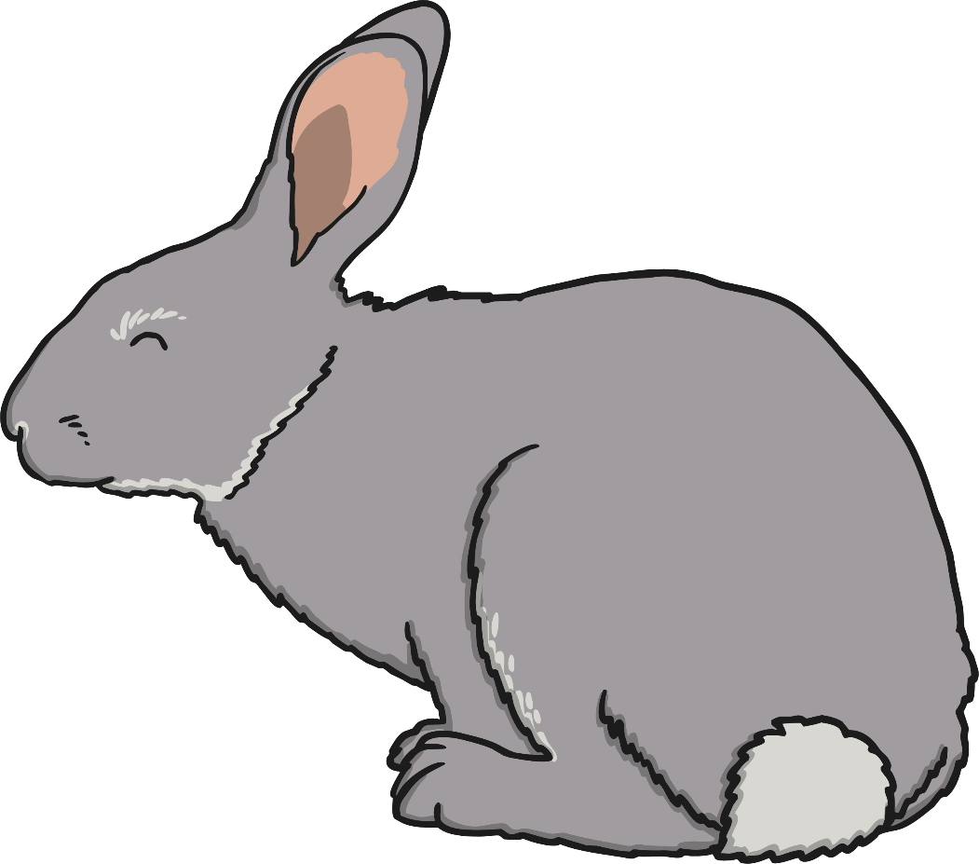
Introduction
Qu’est-ce que c’est?
What is it?
C’est un lapin!
It’s a rabbit

Slide 8
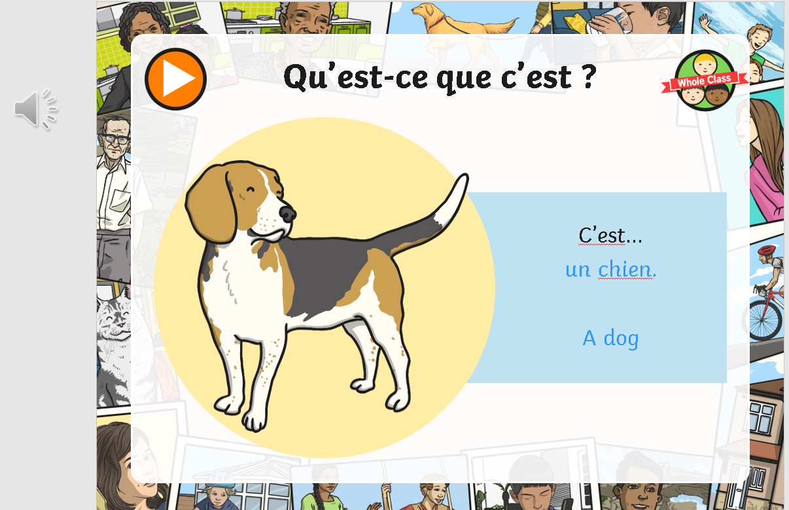
What to do!
Click on the microphone to hear the word and repeat until you are confident saying it

Slide 9


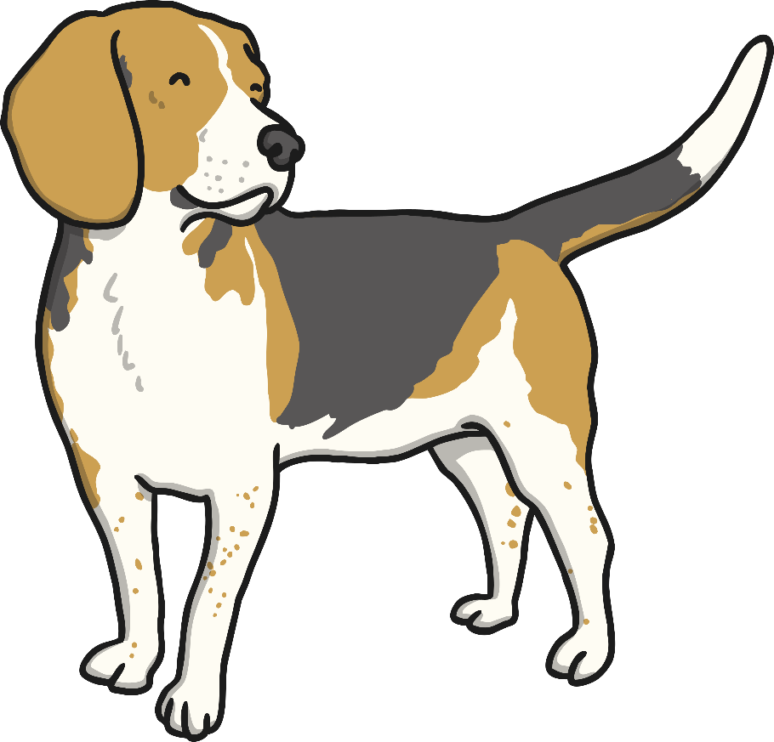
Qu’est-ce que c’est ?
C’est...
un chien.
A dog

Slide 10
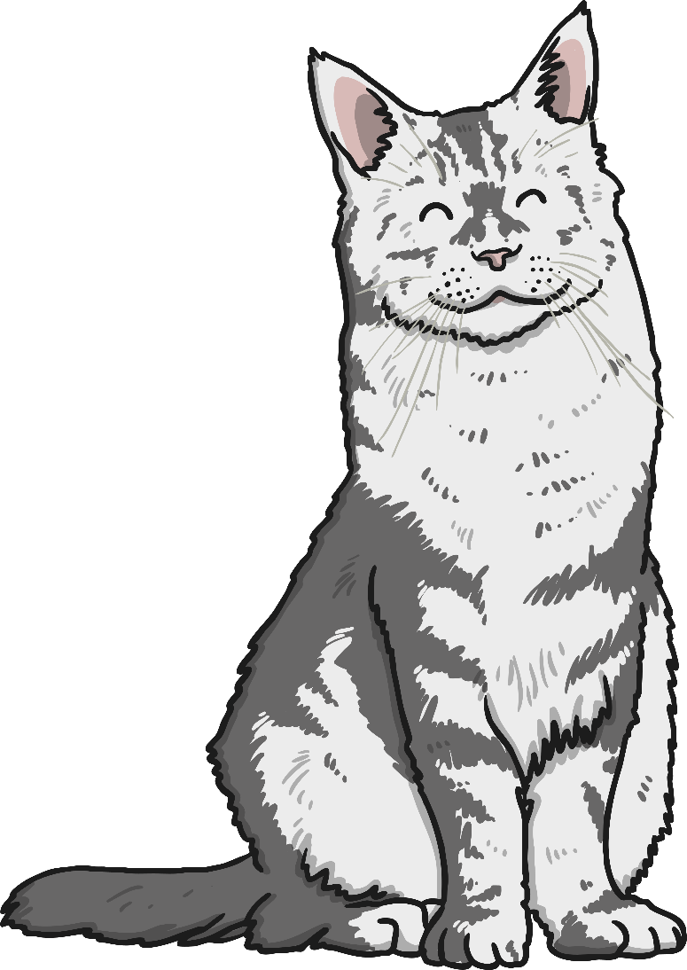
Qu’est-ce que c’est ?
C’est...
un chat.
A cat

Slide 11
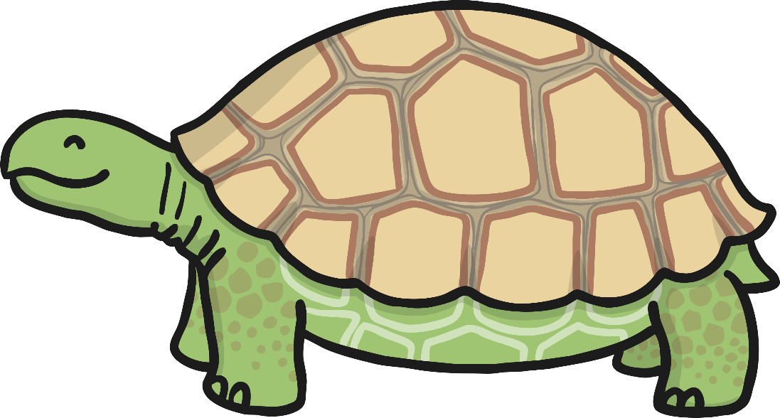
Qu’est-ce que c’est ?
C’est...
une tortue.
A tortoise

Slide 12
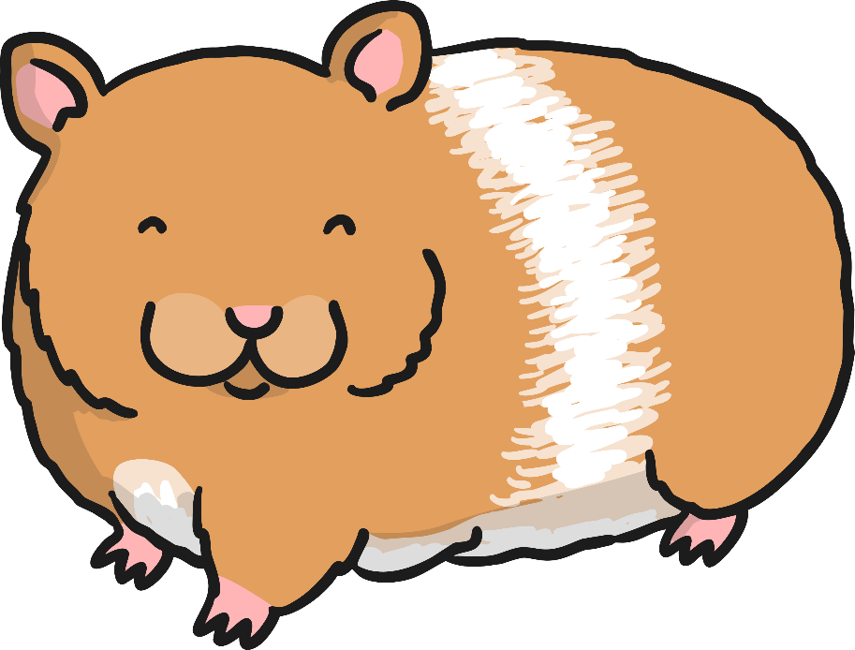
Qu’est-ce que c’est ?
C’est...
un hamster.
A hamster!

Slide 13
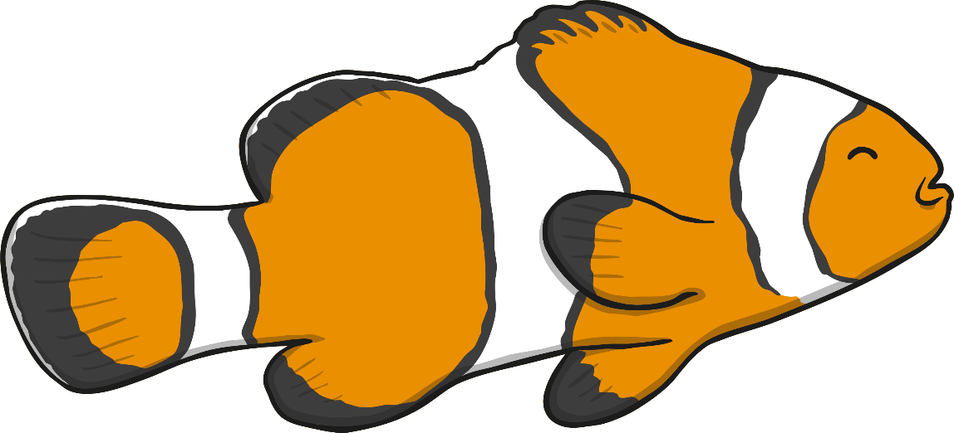
Qu’est-ce que c’est ?
C’est...
un poisson.
A fish

Slide 14
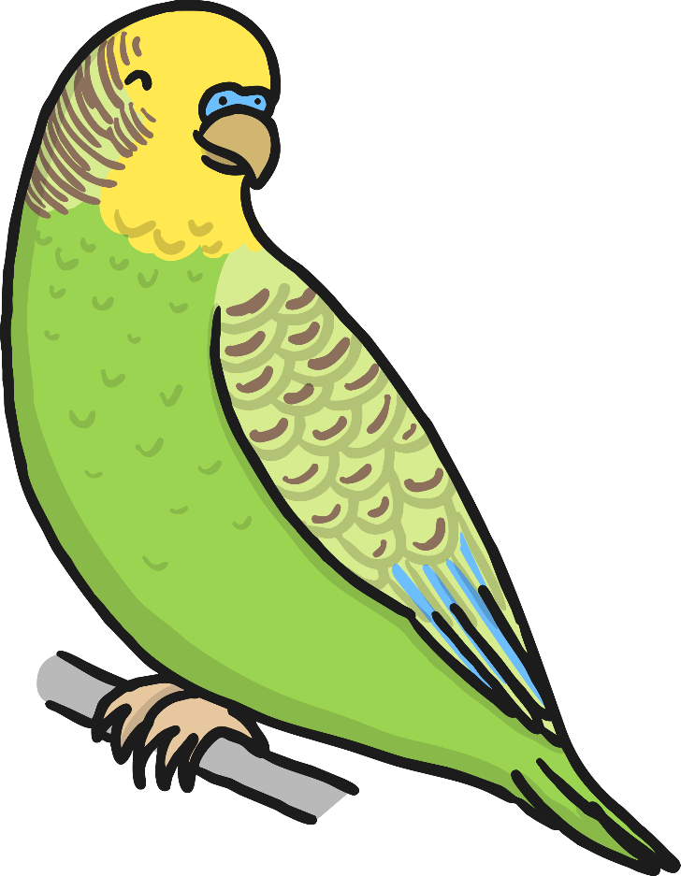
Qu’est-ce que c’est ?
C’est...
un oiseau.
A bird

Slide 15
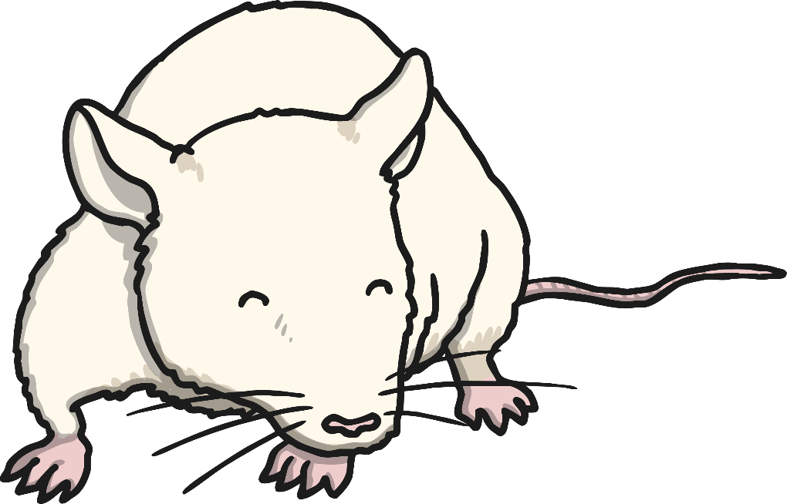
Qu’est-ce que c’est ?
C’est...
une souris.
A mouse

Slide 16
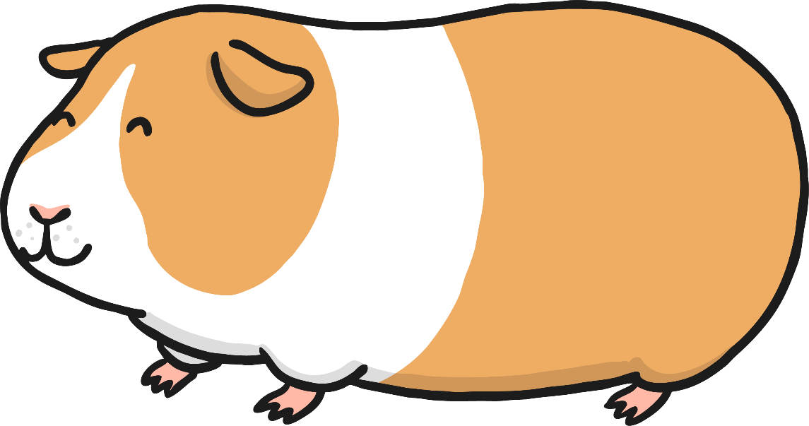
Qu’est-ce que c’est ?
C’est...
un cochon d’inde.

Slide 17
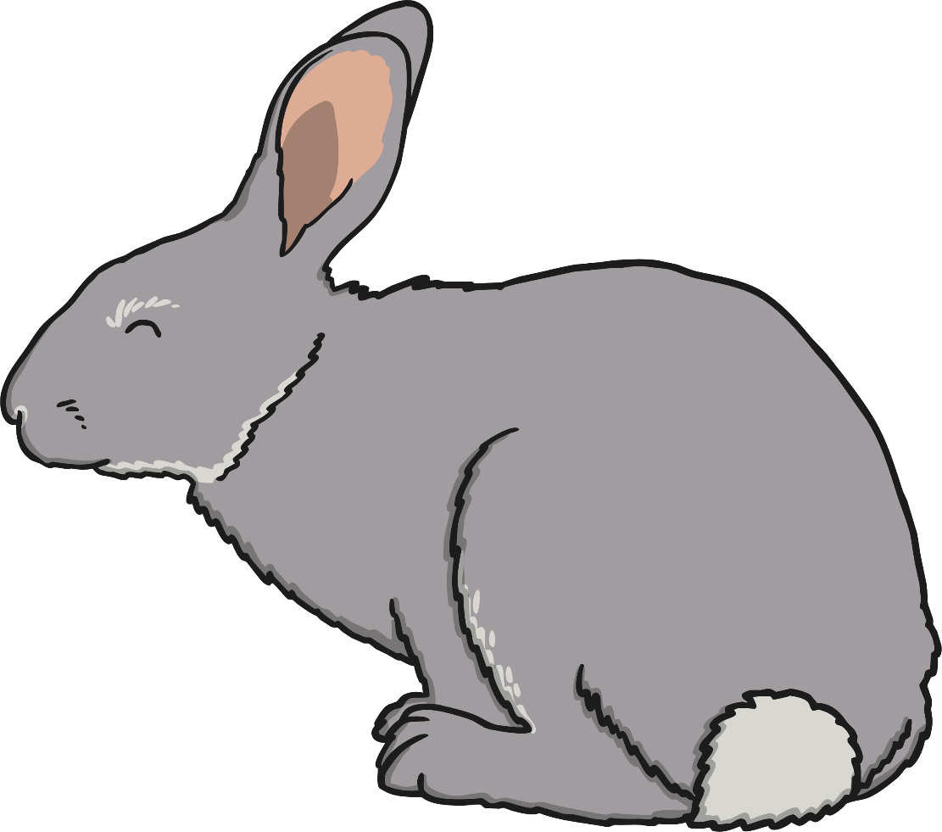
Qu’est-ce que c’est ?
C’est...
un lapin.
A rabbit

Slide 18
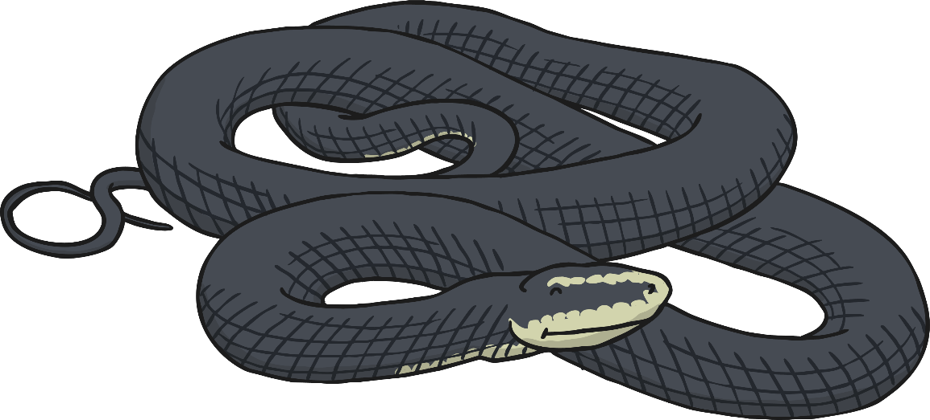
Qu’est-ce que c’est ?
C’est...
un serpent.
A snake

Slide 19








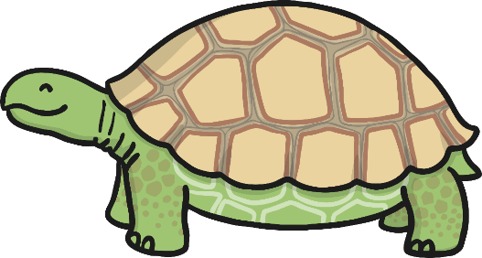

Now challenge yourself to remember the French names of the animals. Say the names of the animals before checking that you are correct.

Slide 20
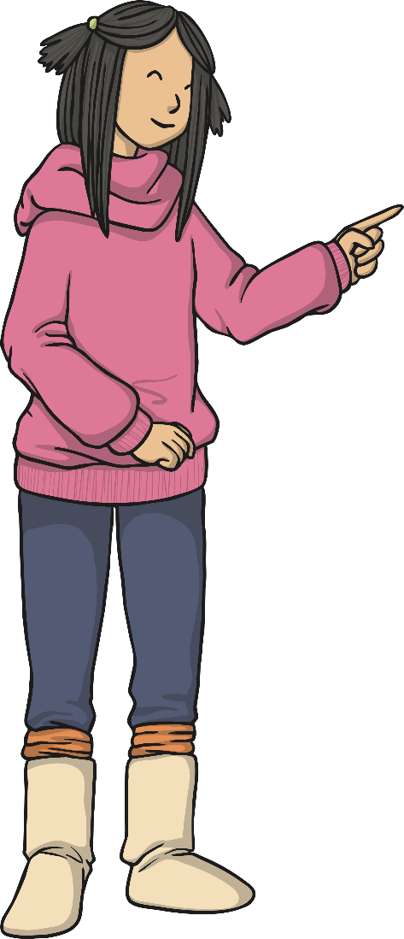


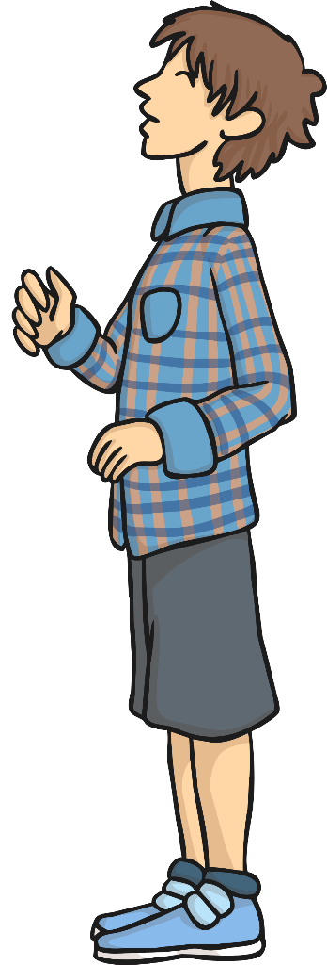

La grammaire
(Grammar Point)
As-tu un animal?
Oui, j’ai un chien.
Yes, I have a dog.
You have an animal

Slide 21
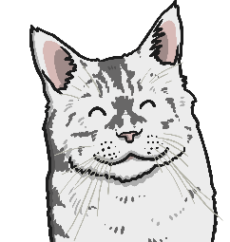



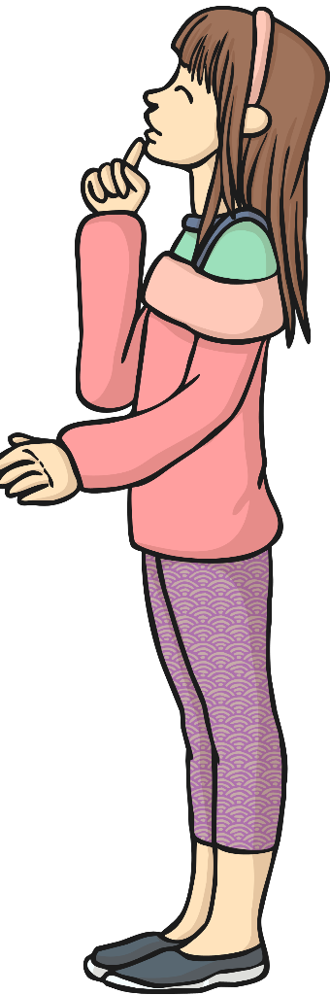


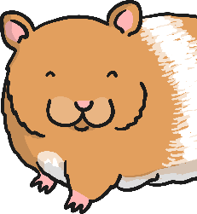







Practise the conversation using difference animals
As-tu un animal ?
Oui, j’ai un/une...

Slide 22

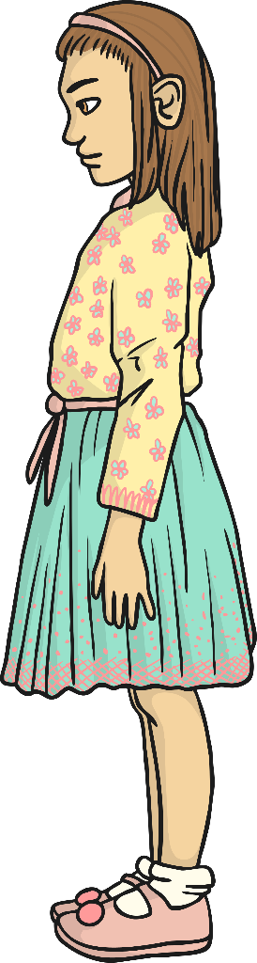
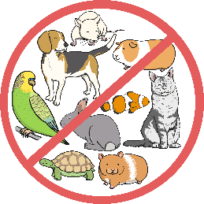
Practise the conversation and say you don’t have an animal
As-tu un animal ?
Non, je n’ai pas d’animal.
No, I don’t have an animal

Slide 23
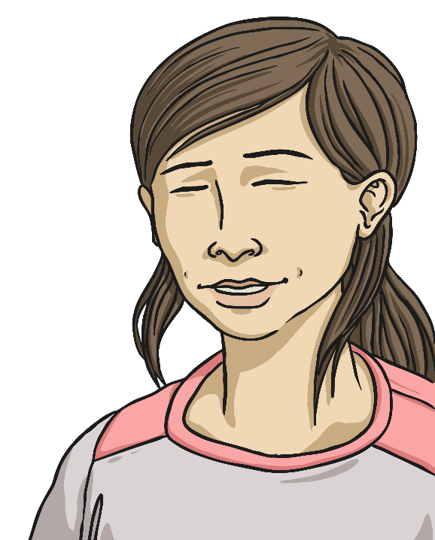
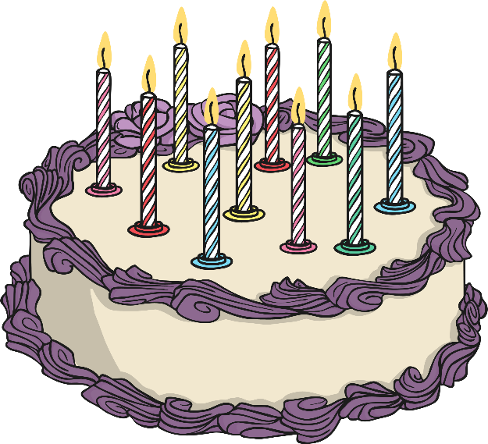

You have used J’ai before when you’ve said your age!
Where might you have heard ‘J’ai…’ before?
It means ‘I have…’
J’ai dix ans.

Slide 24
Practise the conversation with someone in your house choosing a different animals each time.

Slide 25
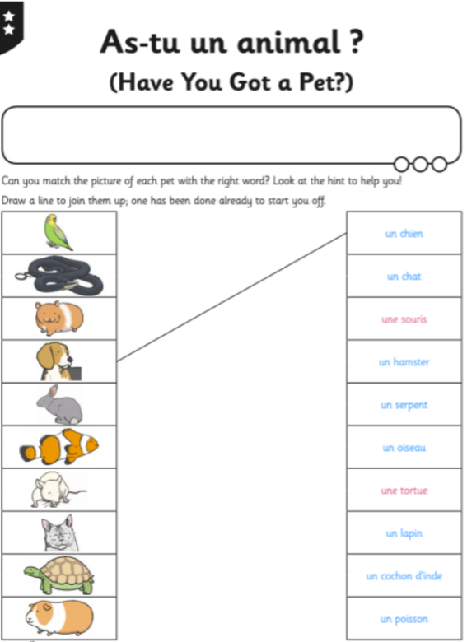
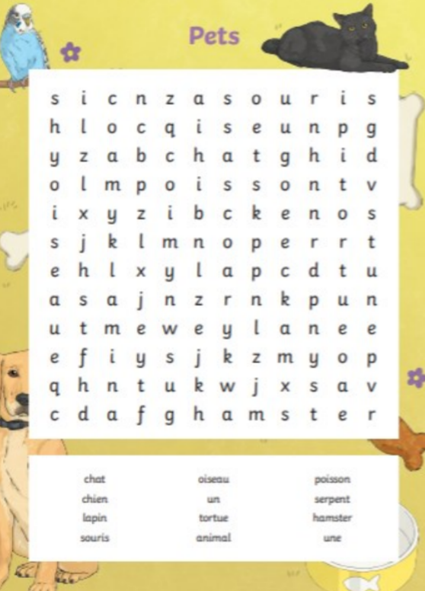
Now complete the tasks

