Slide 1
Reading
Mousehole Cat
Lesson 2

Slide 2
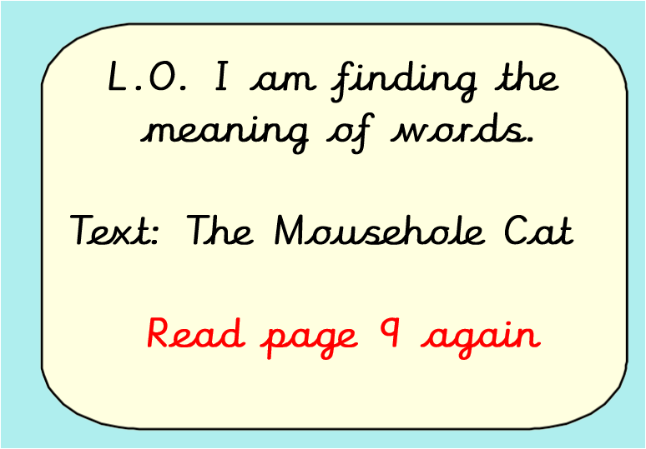

Slide 3
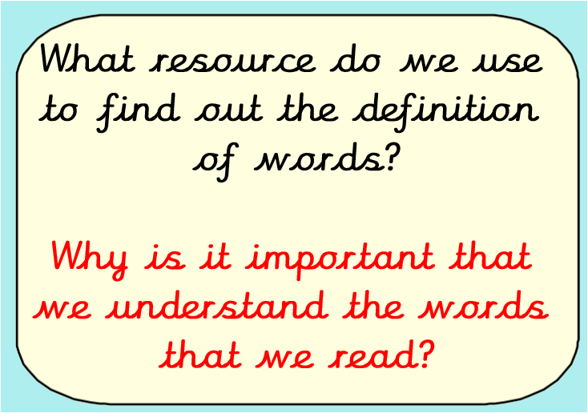
Write down your answers to the following questions

Slide 4
A resource that we use to find the meaning of words is called a dictionary.
It’s important that a reader understands the meaning of words because it enables the reader to comprehend what is written and aids the enjoyment of reading. As a writer we are then able to use these words in our own writing to add impact for our readers.

Slide 5
What advice would you give someone to help them use a dictionary
Write a ‘how to’ use a dictionary
Top tip – think of the correct order

Slide 6
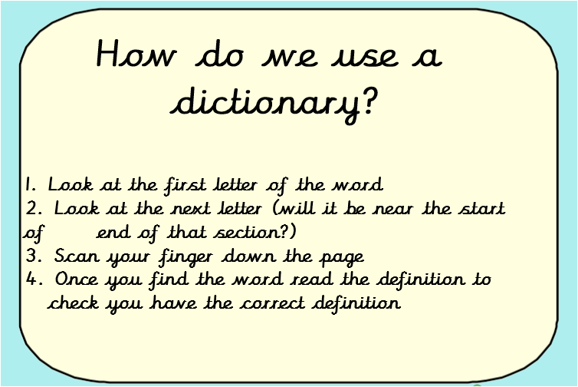
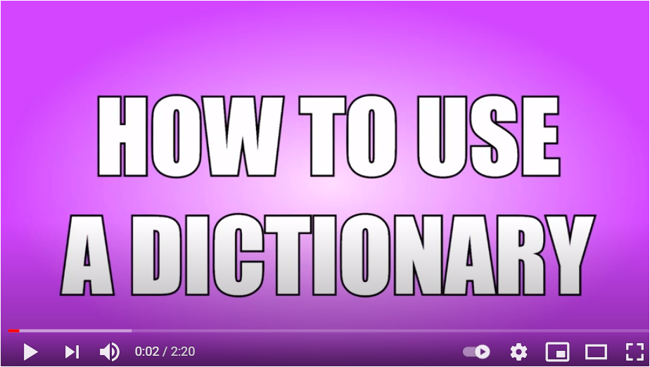
Listen to the video and read these instructions then go back and improve your ‘How to’.
https://www.youtube.com/watch?v=vEtGg631K5Y

Slide 7
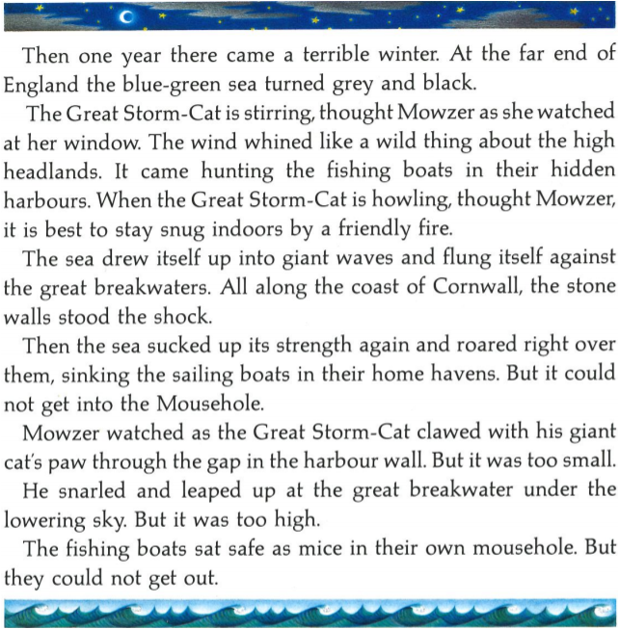

Play

Slide 8
Read the page one more time
1). Write down a list of words or phrases (a few words that are link like “the wind whined”) that you think are impactful.
2). Write down a list of words (up to 5) that you don’t know the meaning of.

Slide 9
Your task is to find out the meaning of some of the words you’ve read on page 9.
First, you’ll be asked to write your own definition.
A top tip is to read the sentence where the word appears to see if that helps you work out its meaning. Usually when we don't know a meaning of a word we can have a good guess based on what we’ve read so far.
Then you’ll be asked to find the definition.
If you have a dictionary at home please use this, otherwise you can use an online dictionary. If you type the word in google followed by the word meaning that can help you find the definition.

Slide 10
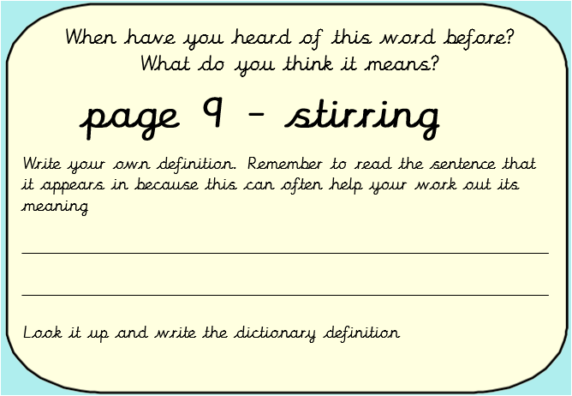

Slide 11
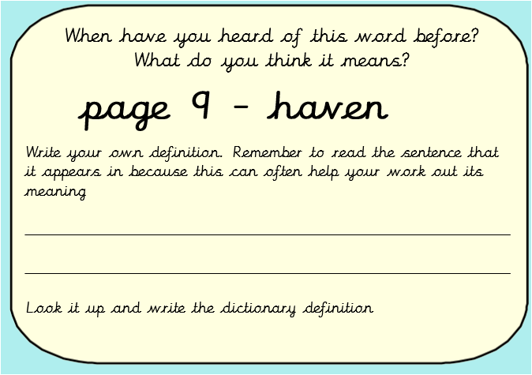

Slide 12
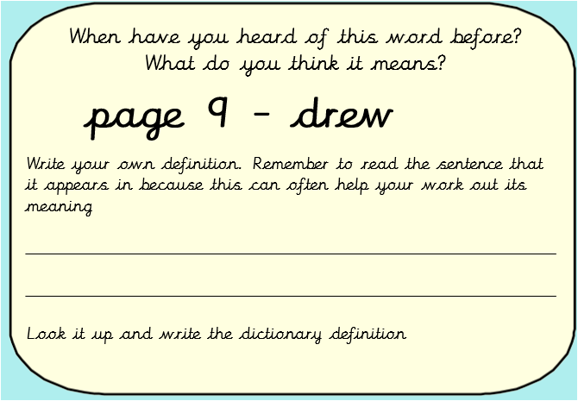

Slide 13
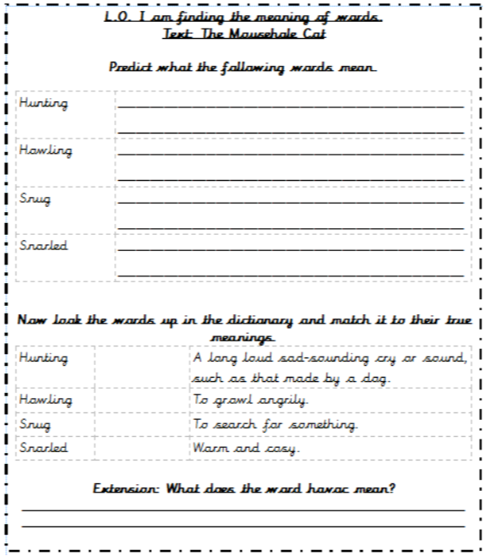
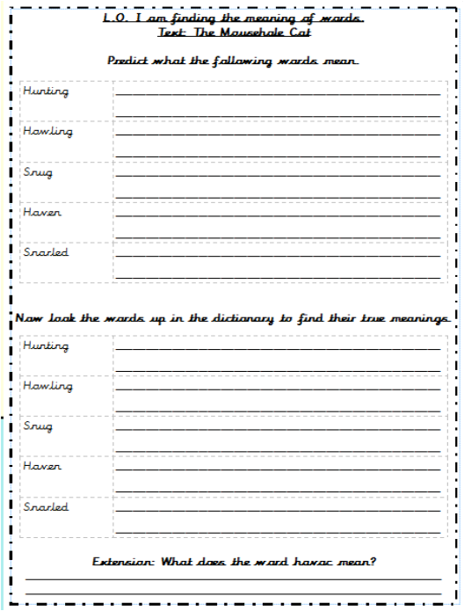
Complete the worksheet that is right for you.

Slide 14
Challenge
Find the word “hunting” on page 9.
Now answer these questions.
What impact does have on the reader?
How does it make you feel?
Why has the author used this?

