Slide 1
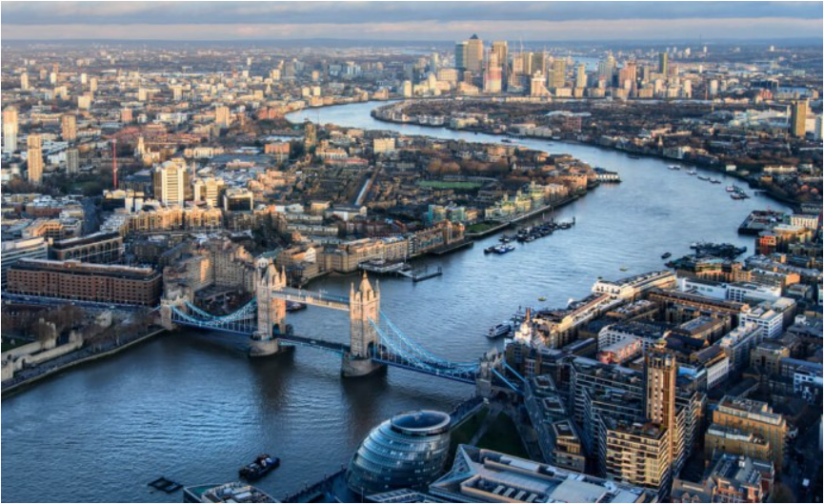
Rivers
Lesson 2

Slide 2
LO: To understand why rivers are important
Task 1 – What can you remember about rivers?
Can you name 5 features that a river has. Can you think of a feature that you think know one else will remember!
Extension task – How is a river different from a stream?

Slide 3
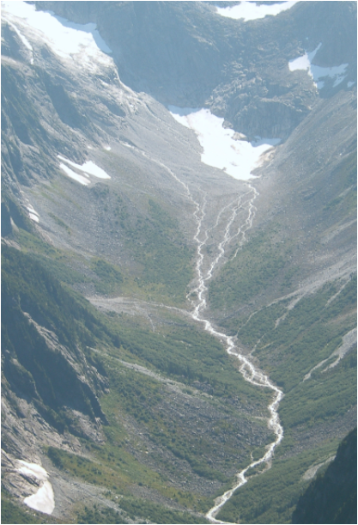
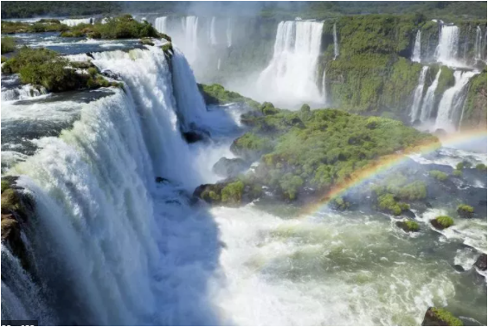
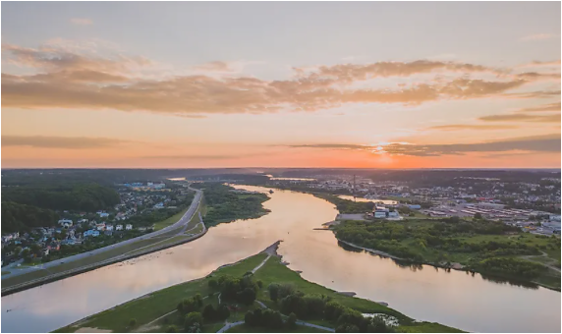
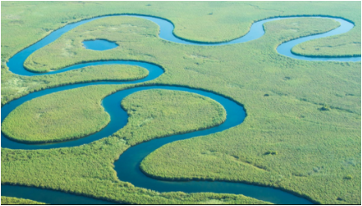
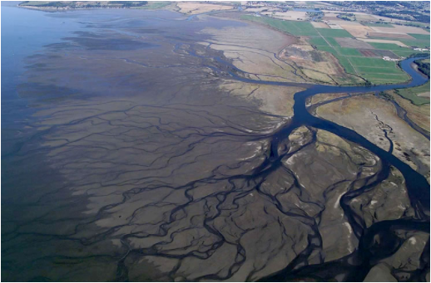
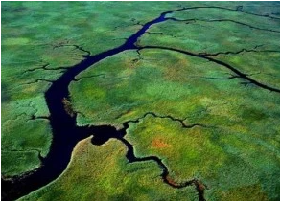
Match these features to their name…
Task 2
a.
b.
c.
d.
e.
Tributary
f.
Waterfall
Source
Delta
Meander
Confluence
Extension task – Write a definition for each feature

Slide 4
Match these features to their name…ANSWERS
a.
b.
c.
d.
e.
Confluence
Meander
Delta
Waterfall
Source
Source - The source is where a river starts its journey and is usually found in the hills or mountains. Some rivers begin at springs where water naturally seeps or gushes from the ground, others are formed when rain or melted snow runs as surface water into streams. A river can have more than one source.
Waterfall - a cascade of water falling from a height, formed when a river or stream flows over a precipice or steep incline.
Confluence - Where two rivers meet
Meander - A river that follows a winding course
Delta – land form created by sediment in a river as it enters the sea
Tributary – Rivers and streams that join a larger river
f.
Tributary

Slide 5
LO: To understand why rivers are important
Task 3 – Create a mind map or write a list of all the ways that river are used.
(Top tip - think about wildlife, transport, farming, energy, drinking and washing and how they are used by people for fun or sports)

Slide 6
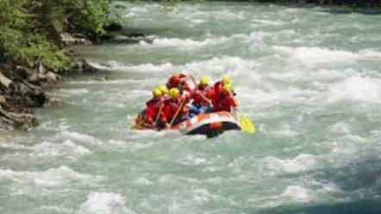
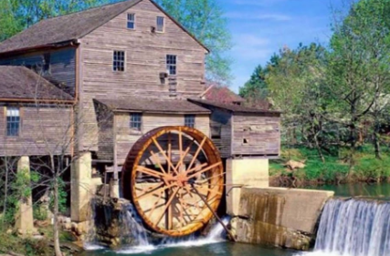
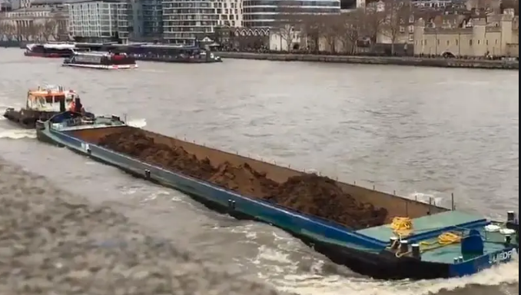
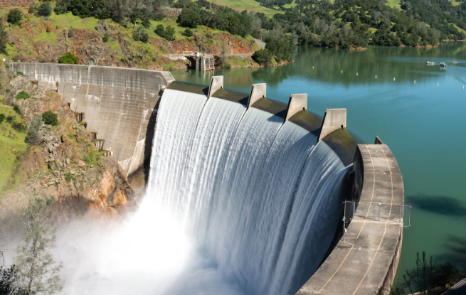
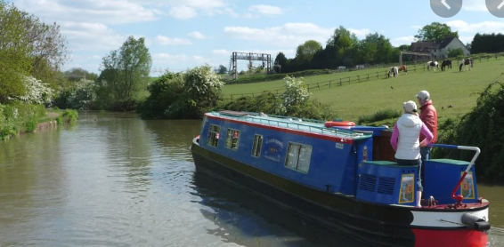
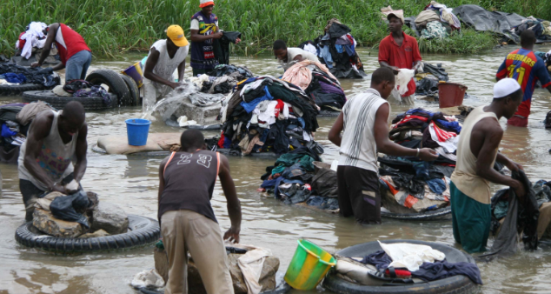
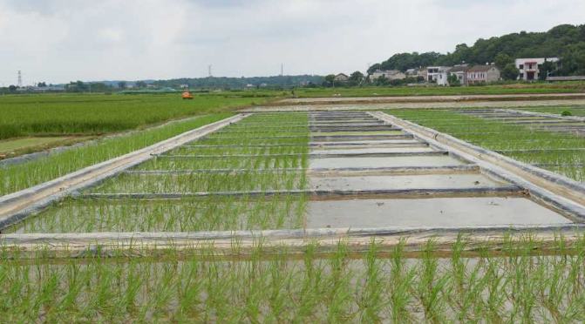
Look at these images and describe how the rivers are being used, think of as many uses as you can.
Task 4
1
2
3
4
6
5
7

Slide 7
Now we are going to compare two rivers, The Thames and The Test.

Slide 8
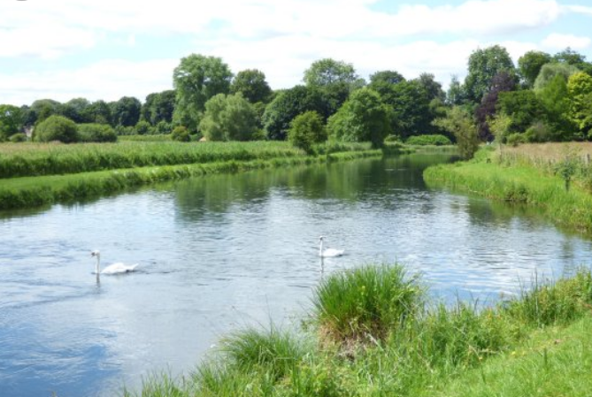
Compare the two rivers and write down how you think they might be used
Task 5
River Thames
River Test
Extension: Why do you think different rivers have different uses?

Slide 9
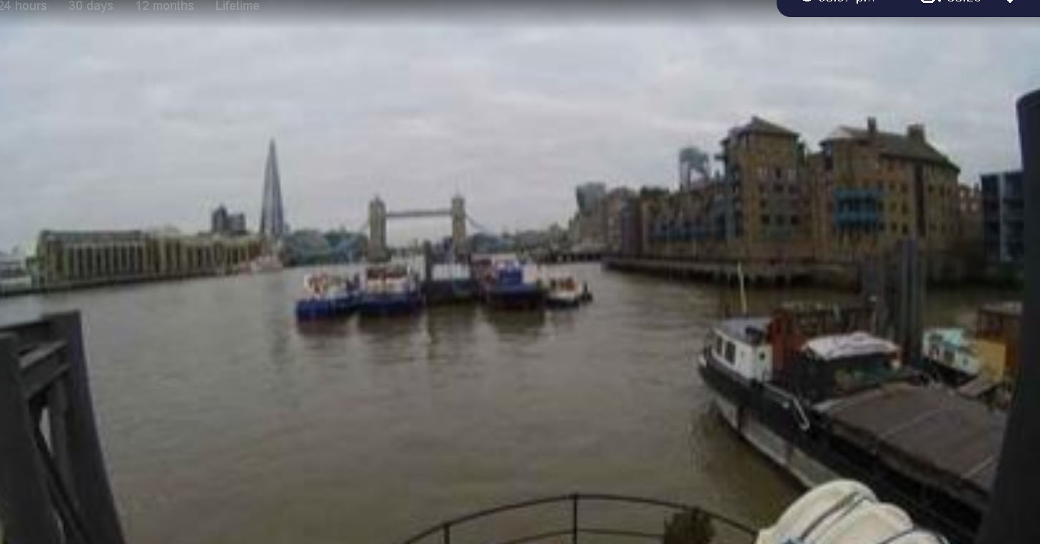
Task 6
Play the time-lapse video
https://www.see.cam/gb/eng/london/london-thames
Write 5 things that you see
Write 1 think that you wonder?

Slide 10
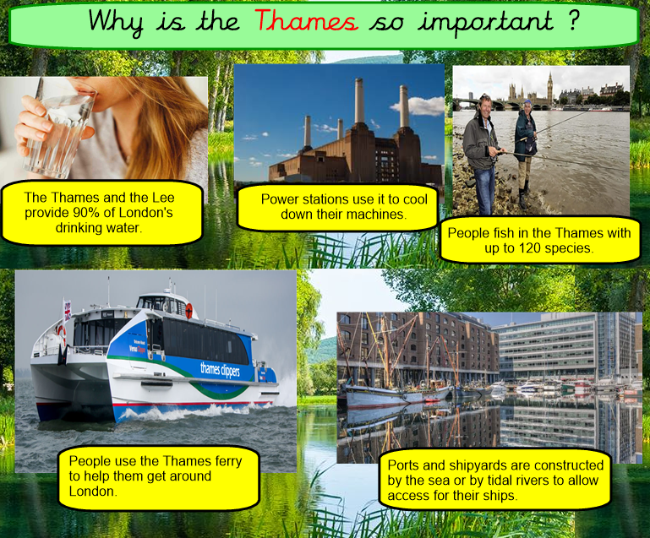
Task 7
Order your pictures to show
which picture you think is
the most important to the least
important.

Slide 11
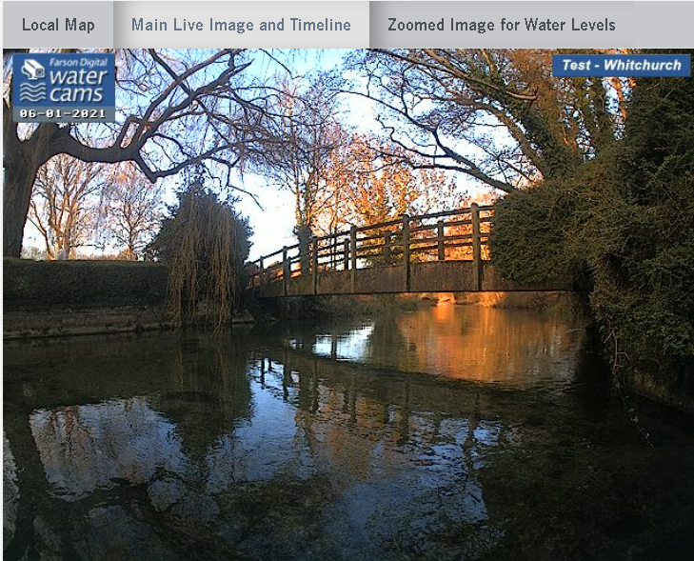
Task 8
Play the time-lapse video
https://www.farsondigitalwatercams.com/locations/whitchurch
Write 5 things that you see
Write 1 think that you wonder?

Slide 12
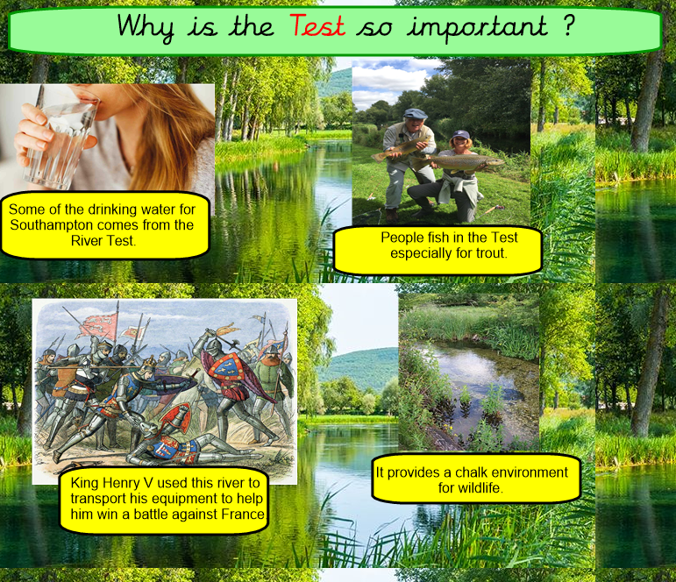
Task 9
Order your pictures to show
which picture you think is
the most important to the least
important.

Slide 13


