Slide 1
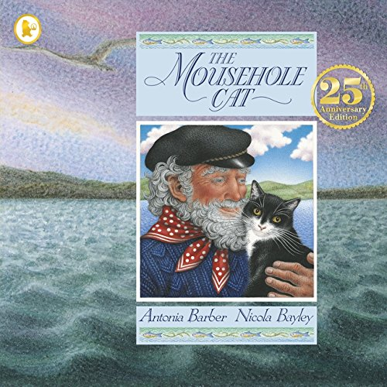
Reading
Mousehole Cat
Don’t read the story yet!

Slide 2
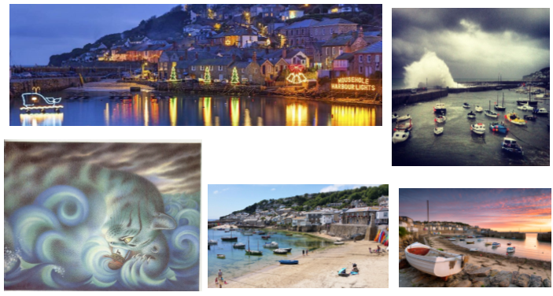
Look at the images
Write 10 things that you see
Write 3 things that it makes you think
Write 1 thing that makes your wonder

Slide 3
You will be reading and learning about a new book called Mousehole Cat!
Before you get started there is some vocabulary that you will need to know because it appears in the book.
Having a look at the vocabulary will help you understand what you have read.

Slide 4
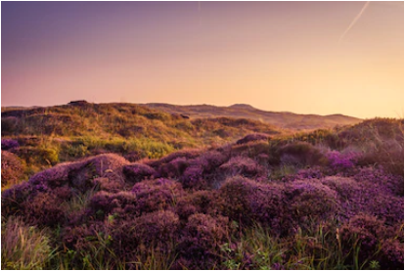
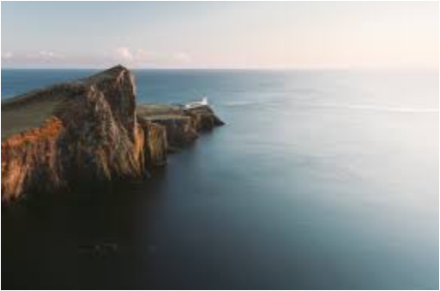
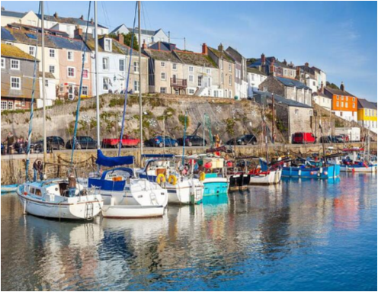
New Vocabulary
Moorland
Open land, often overgrown with heather (a purple flowering bush) and found in places high above ground where its gets a lot of rain.
Headland
A narrow piece of land that comes from a coastline into the sea. Usually high above the ground level.
Harbour
A sheltered area of water where boats can be anchored.

Slide 5
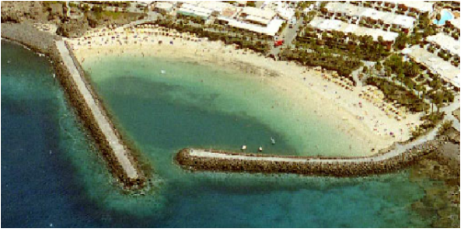
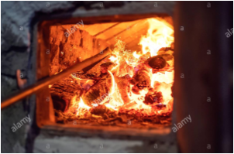
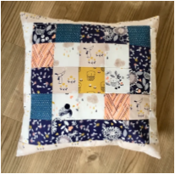
Vocabulary
breakwaters
A barrier built out into the sea to protect a coast or harbour from the force of wave
Stoke the range
To poke the fire in an oven which has a fire inside to cook the food
Made by sewing together small pieces of material of different colours or patterns.
Patchwork

Slide 6
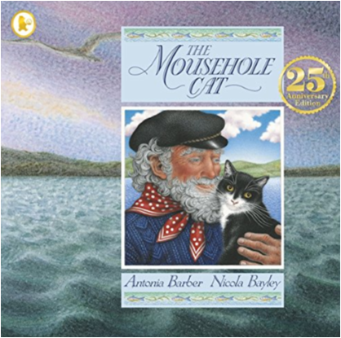
LO: I am learning to respond to a text
Read up to page 9
As you are reading think carefully about what is happening in the book.
Write down any new words that look interesting or you’re unsure about and try to predict what’s going to happen next!

Slide 7
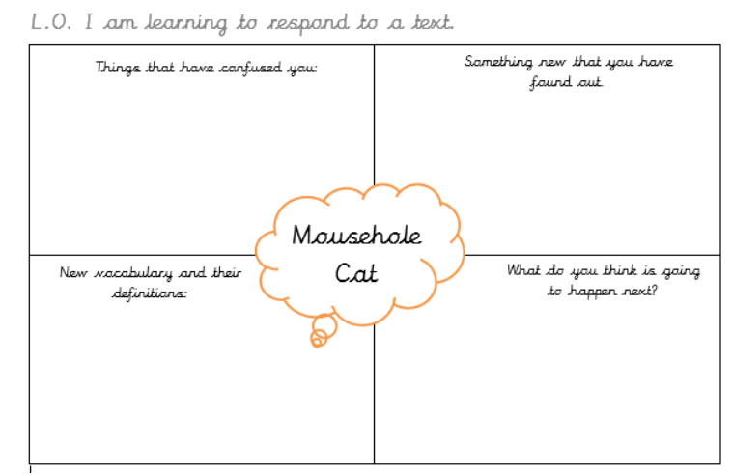
Now complete the sheet, or write your answers directly in your books.
Write at least 3 things that you’re unsure about.
Write at least 1 thing you've found out.
Use a (online) dictionary to help you find the definitions for words you are unsure about. Make sure the definition makes sense when you re-read the sentence it’s in!
Use the stem sentences to explain your prediction.
I predict that….
I think this because…

