Slide 1

FRENCH

Slide 2





REVISIT
Click clock to open timer
1 minute to write down any French words you know.
1 minute to magpie words from your talking partner.
1 minute to say the words out loud to each other.

Slide 3
Part 1
LO: I am learning classroom
Instructions in French.

Slide 4

Class work
On the next slide you will see and hear some French spoken.
Listen carefully.
Repeat after each word.

Slide 5
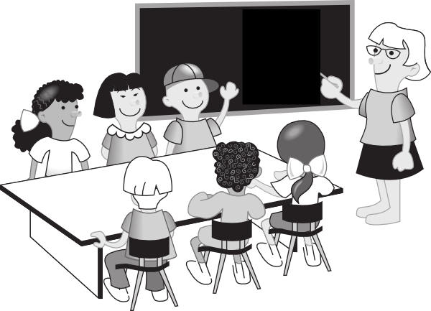

les instructions
Bonjour la classe, sortez vos affaires
Bonjour la classe, sortez vos affaires
Regardez, écoutez
Regardez, écoutez
Bonjour la classe, sortez vos affaires
Alors, la classe, levez la main
Alors, la classe, levez la main
Écoutez, répondez
Écoutez, répondez
Alors, la classe, levez la main
Silence! la classe, rangez vos affaires
Silence! la classe, rangez vos affaires
Regardez, écoutez
Regardez, écoutez
Silence! la classe, silence, et au revoir!
Notes:
Re-cap the song from the autumn term. Use the actions to keep pupils thinking of the meaning of the words.
Song – to the tune of She’ll be coming round the mountain…
Listen to the audio just to get the scansion …
Bonjour la classe, sortez vos affaires
Bonjour la classe, sortez vos affaires
Regardez, Écoutez
Regardez, Écoutez
Bonjour la classe, sortez vos affaires
Alors, la classe levez la main
Alors, la classe levez la main
Écoutez, répondez
Écoutez, répondez
Alors, la classe levez la main
Silence! la classe, rangez vos affaires
Silence! la classe, rangez vos affaires
Regardez, Écoutez
Regardez, Écoutez
Silence! la classe, silence, et au revoir!

Slide 6
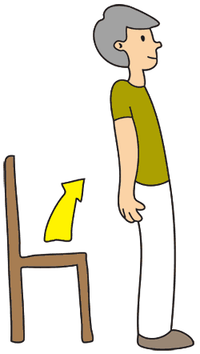
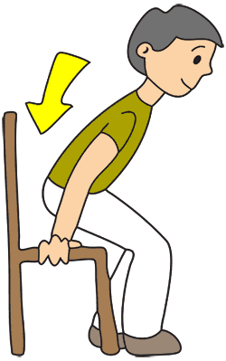









Levez-vous!
Asseyez-vous!
Écoutez!
Regardez!
Écrivez!
Parlez!
Travaillez
en paires!
Sortez vos affaires!
Dessinez!
Notes:
This is a re-cap from lesson 6, half-way through the Autumn Term of Y3. It is necessary to re-visit language and re-learn it often.
Do actions to practise and embed. Pupils can suggest the actions and you can agree them together.
AUDIO is heard automatically when you click and the text for each instruction appears.
You may want to repeat this slide 2-3 times.
Meanings as follows:
Levez-vous – Stand up
Asseyez-vous – Sit down
Écoutez – Listen
Regardez – Look
Écrivez – Write
Parlez – Speak
Travaillez en paires – Work in pairs
Sortez vos affaires – Get your things out
Dessinez - Draw
NB: I have put accents on the capital letters
There is some dispute about this, mainly due to when people did their education!
This is an interesting thread on the subject:
https://forum.wordreference.com/threads/capital-letters-in-french-and-accented-characters.2733412/

Slide 7
1
2
3
Levez-vous!
Asseyez-vous!
Écoutez!
4
5
6
Regardez!
Écrivez!
Parlez!
7
8
9
Travaillez
en pairs!
Sortez vos affaires!
Dessinez!
Notes:
2) Say numbers and they read the instruction aloud
If desired, you can then click on the text to hear the audio again.

Slide 8
Well done!
You have learnt all about classroom instructions.

