Slide 2
Where do you think we should use capital
letters in our writing?

Slide 3
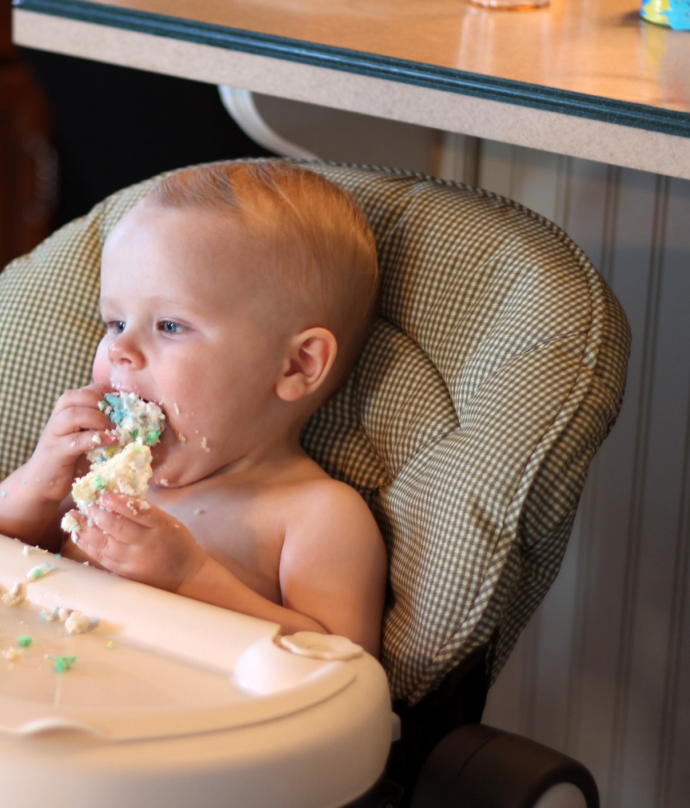
Starting Sentences
Capital letters are always
used to start sentences
He loves to eat cake!
Photo courtesy of viviannguyen(@flickr.com) - granted under creative commons licence – attribution

Slide 4
Proper Nouns
Nouns are naming words.
Proper nouns are naming words for individual people, places, days of the week and months of the year.
Proper nouns all need capital letters.
Common Nouns | Proper Nouns
girl | Helen
country | England
city | Sheffield
football team | Nottingham Forest
day/month | Monday/September

Slide 5
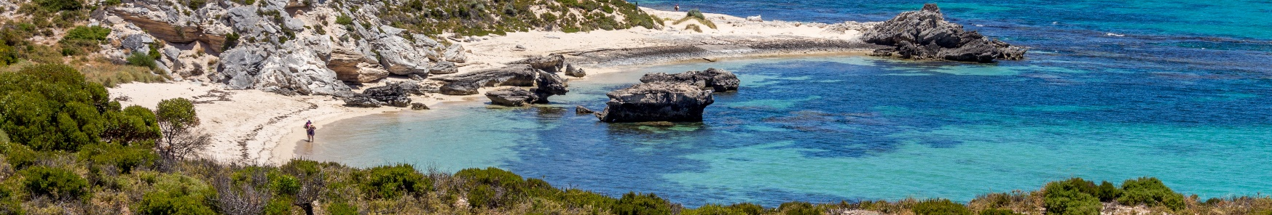
Activity
Can you spot the proper nouns in these sentences and add
capital letters to the beginning of them?
Have a go on your whiteboard.
ben and susan went to australia for their holidays.
owen supports hull city fc.

Slide 6
ben and susan went to australia for their holidays.
Ben and Susan went to Australia for their holidays.
owen supports hull city fc.
Owen supports Hull City FC.

Slide 7
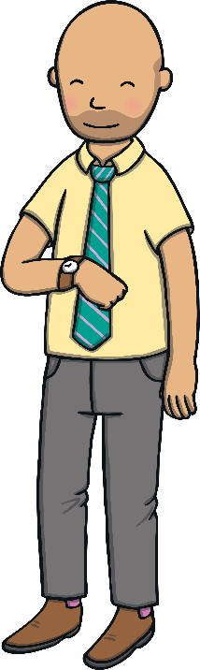
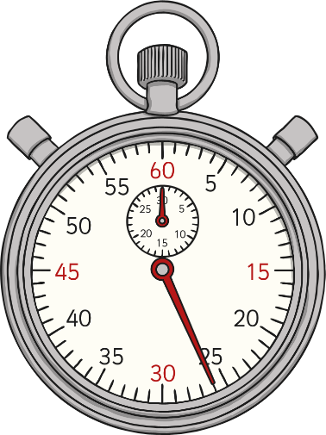
The Personal Pronoun ‘I’
When we are writing about ourselves we use the
personal pronoun ‘I’
I can tell the time.
The personal pronoun ‘I’ always needs a capital letter.

Slide 9
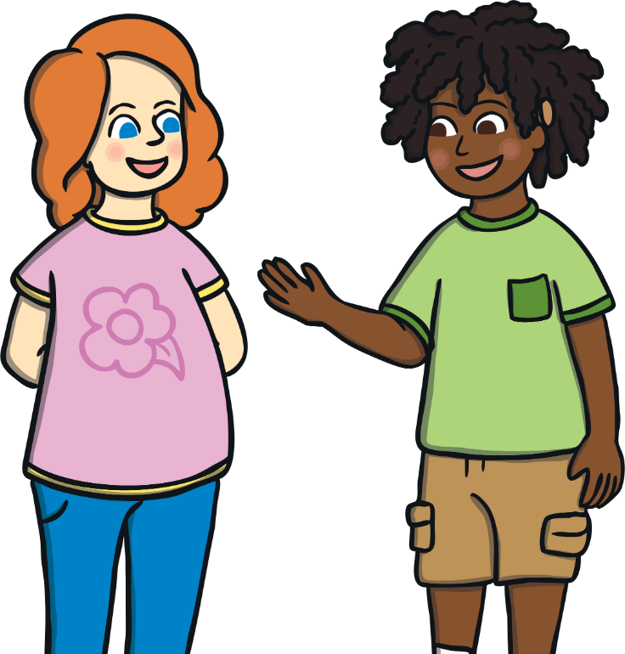
Where should we use full stops in our writing?

Slide 10
Ending Sentences
Full stops are always used to show where a sentence has ended.
I love to eat cake
.

Slide 11
Now it’s your turn…
Add full stops in the right places in these sentences.
Remember - the end of a sentence.
The dog sat on a mat
The dog sat on a mat
A man went to the moon
A man went to the moon
My dog is brown
My dog is brown
Tom has a black cat
Tom has a black cat

Slide 12
Did you get the full stops in the correct place?
The dog sat on a mat
The dog sat on a mat.
A man went to the moon
A man went to the moon.
My dog is brown
My dog is brown.
Tom has a black cat
Tom has a black cat.

Slide 13
Now it’s your turn …

