Slide 2
Aim
To understand seasonality and know where and how a variety of ingredients are grown, reared, caught and processed.

Slide 3
What is Seasonality?
Climate conditions affect when food is produced in the UK. Seasonality is the time of year when a food type is at its best in terms of flavour or harvest. Have a look at the seasonality timetable below and work out which of the foods are at their best now.
 | Jan | Feb | Ma | Apr | May | Jun | July | Aug | Sept | Oct | Nov | Dec
cherries |  |  |  |  |  |  | *
strawberries |  |  |  |  |  | * | * | * | *
new potatoes |  |  |  | * | * | * | *
turnip | * | * |  |  |  |  |  |  |  | * | * | *
duck |  |  |  |  |  |  |  |  |  | * | * | *
tuna |  |  |  |  | * | * | * | * | *

Slide 4
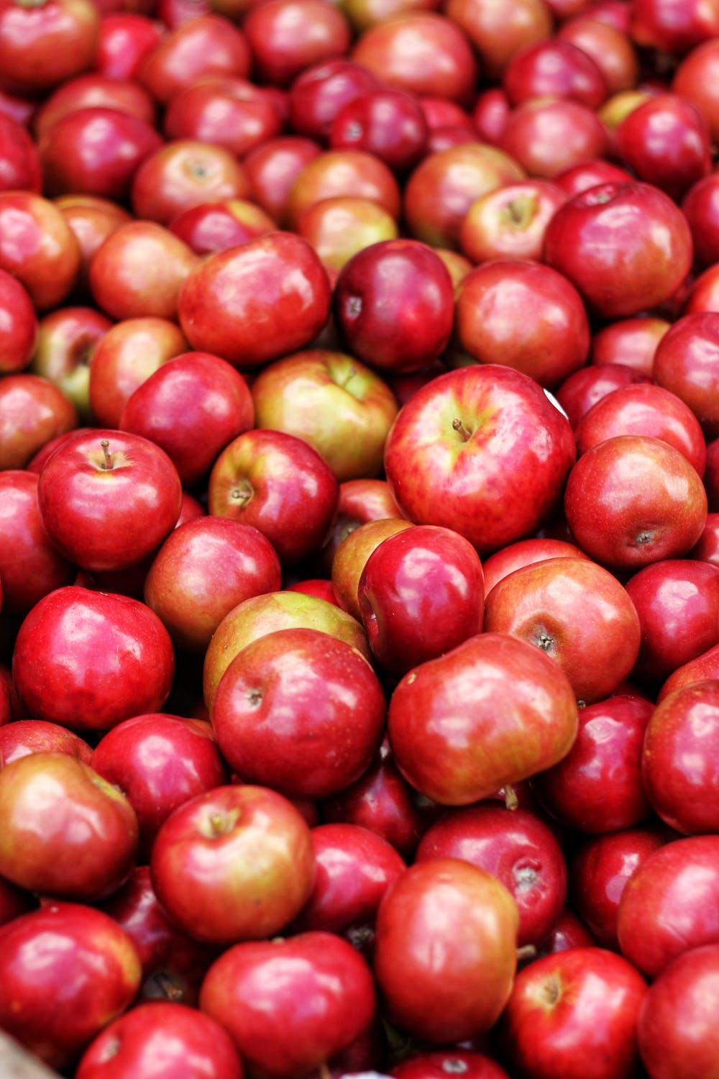
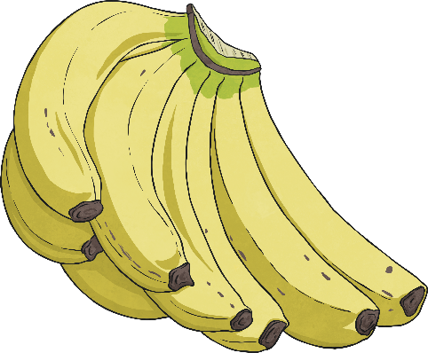
Where Food Comes From
Some foods are required when they are out of season so producers grow them in hot houses/green houses in the UK. Alternatively, the food is produced abroad and sent to the UK.
Climate and soil conditions mean that not all food types can be produced here.
The following foods come into the UK: rice, feta cheese, mangoes, oranges, lemons, bananas and coconuts.

Slide 5


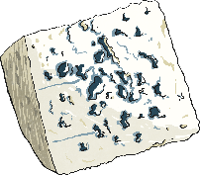
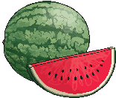
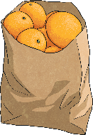


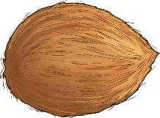
Where Food Comes From
China
Greece
Rice and
Watermelons
Feta Cheese
Brazil
India
Indonesia
Oranges
Mangos and Bananas
Coconuts

Slide 6
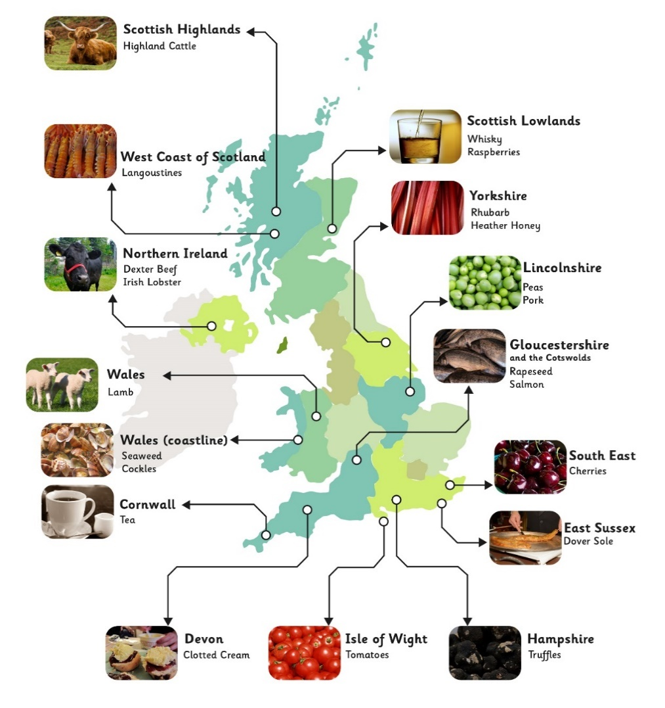
Where Food Comes From

Slide 7
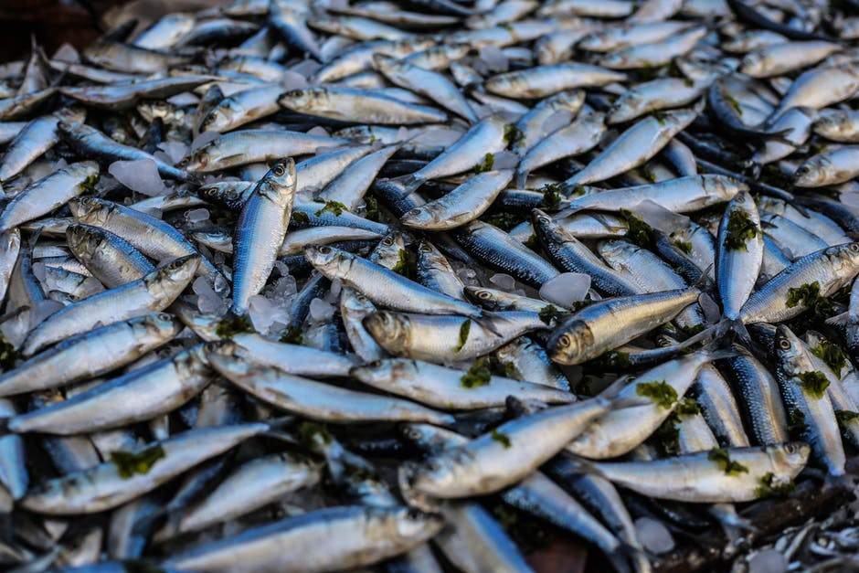
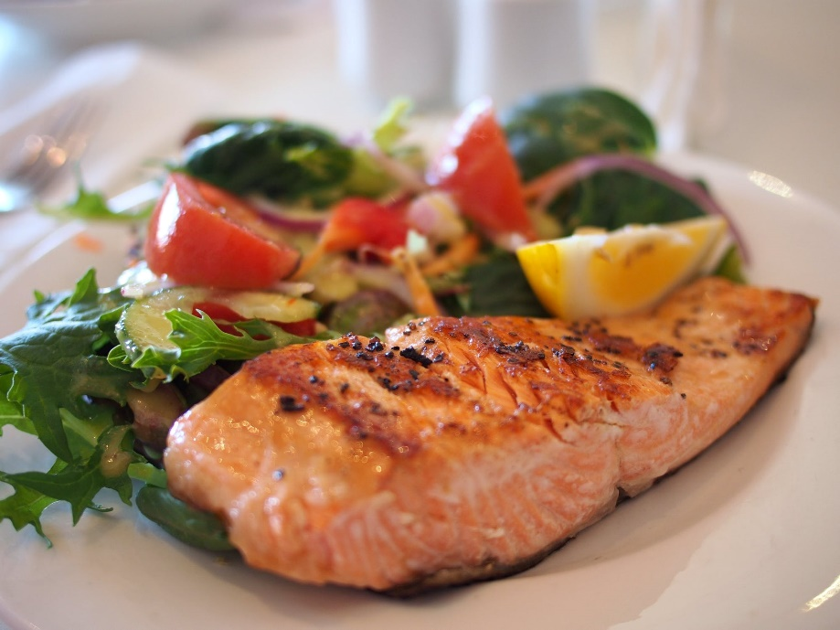
East Sussex – Dover Sole
Dover sole swim in shallow water with muddy sea beds making East Sussex the ideal place for them to thrive.
Soles are nocturnal so they are easier to catch at night.

Slide 8
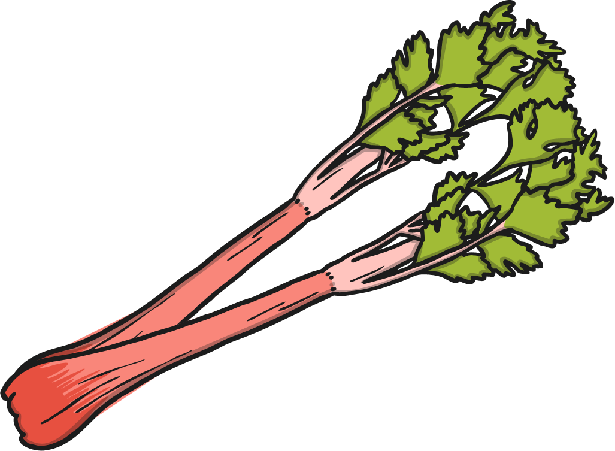
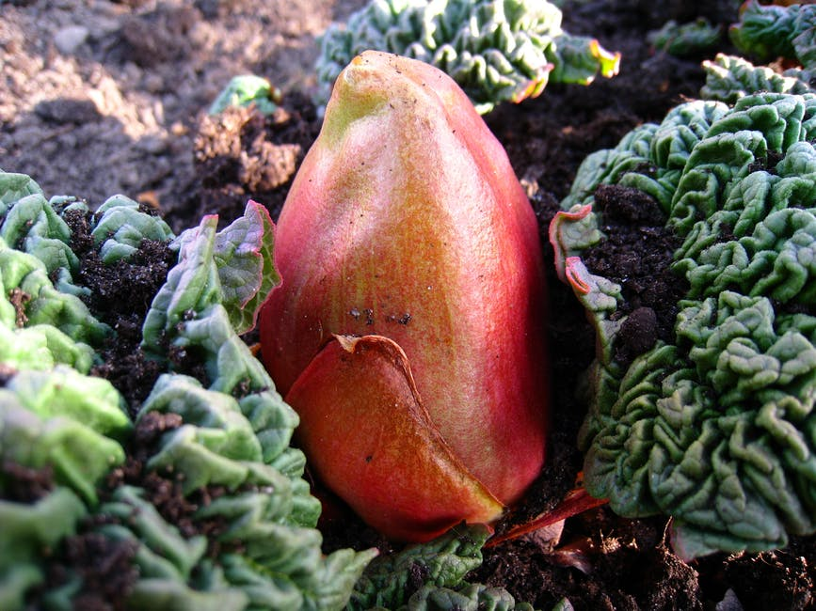
Yorkshire – Rhubarb
The Rhubarb Triangle is situated near to the Pennines.
This location gives the rhubarb the perfect climate it needs.
Rhubarb needs a low temperature with plenty of rain.

Slide 9
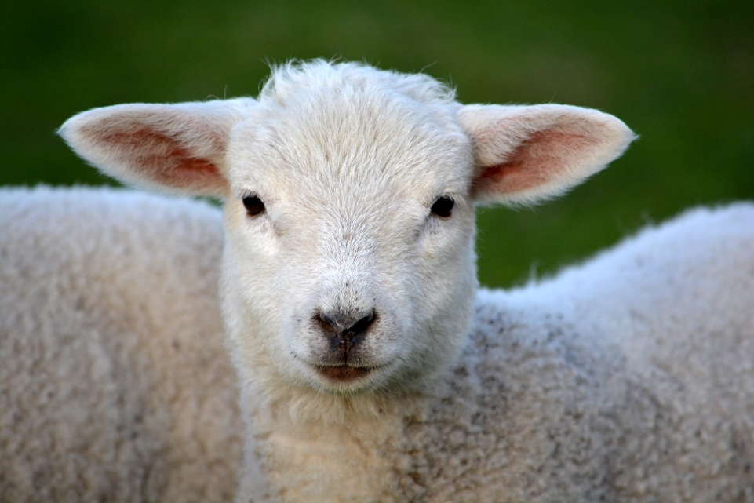
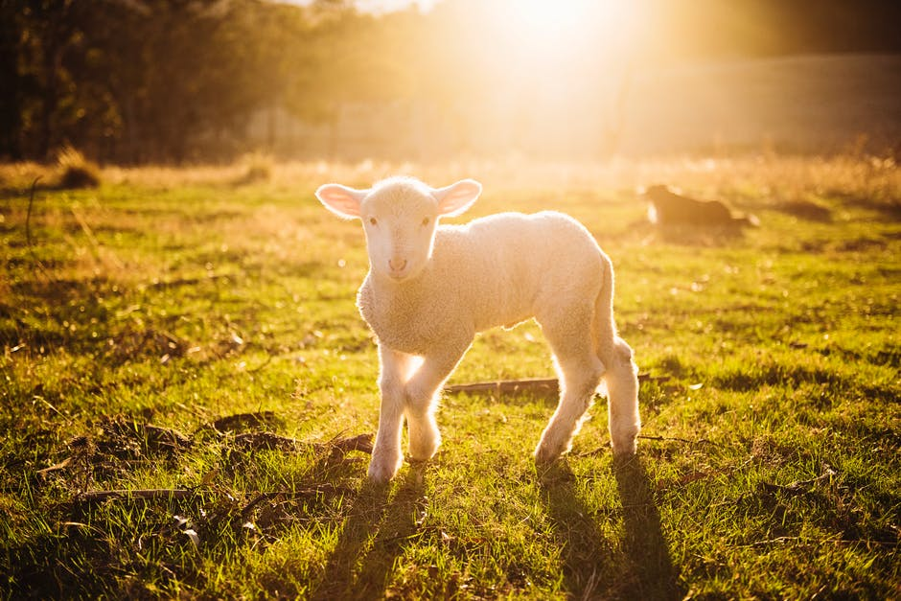
Wales – Welsh Lamb
Wales is well suited to beef and sheep farming because the rich soil produces good grass.
Up in the Welsh mountains there is lots of heavy rainfall and cold conditions in which tough mountain breeds can survive.

Slide 10
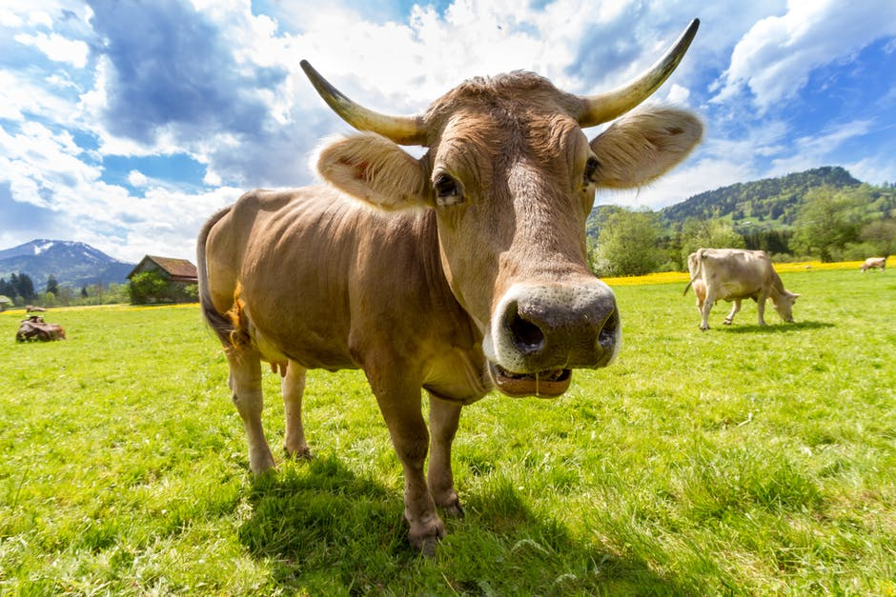
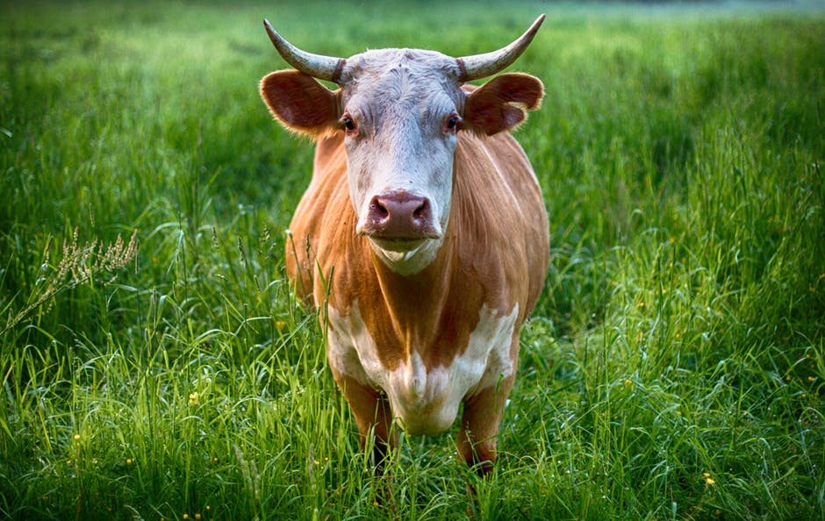
Scotland – Highland Cattle
Highland cattle have lots of hair to keep them warm. The soil in the Scottish Highlands is not very fertile so the cattle are good at foraging for food on mountainous slopes (flowers, grass and leaves). Grazing on this type of greenery means they grow slowly and are very lean (little fat).

Slide 11
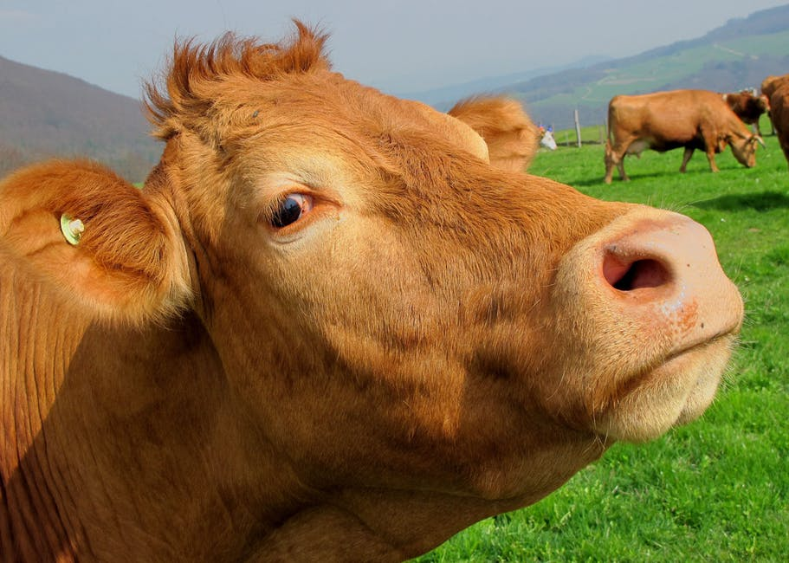
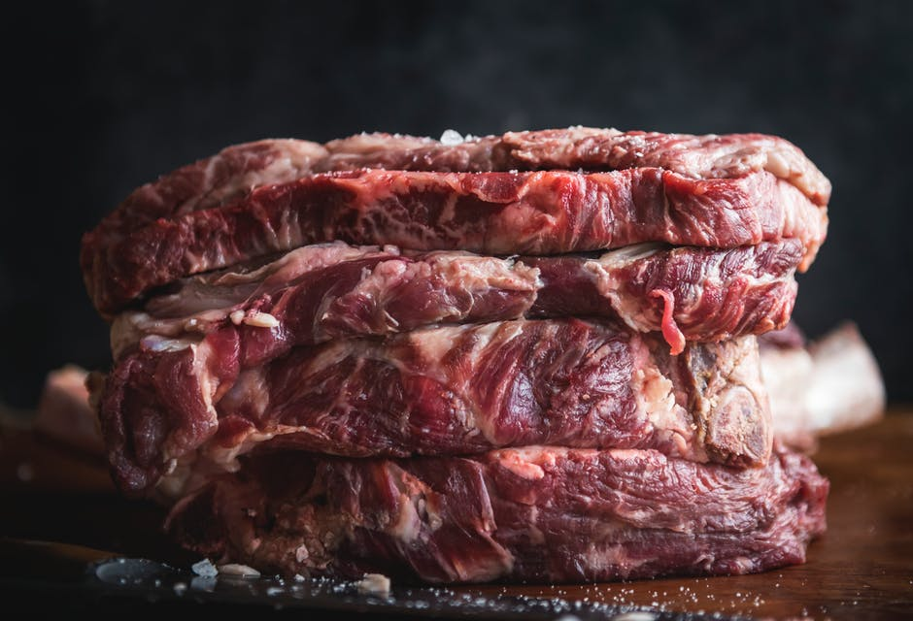
Northern Ireland – Dexter Beef
This breed of cattle can survive tough conditions making the meat lean.
They eat a range of grasses which contains good fats, alongside wild herbs which naturally flavours their meat.

Slide 12
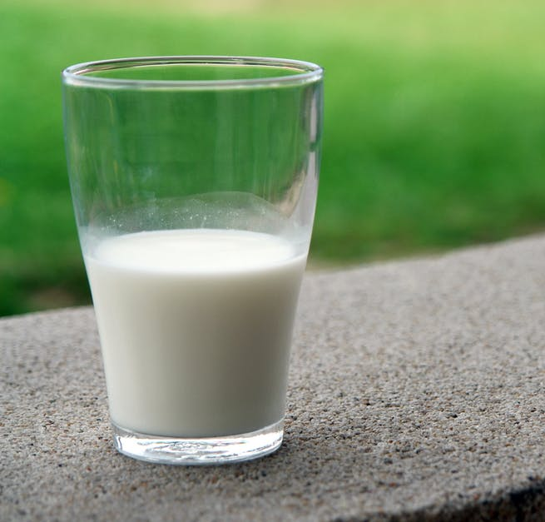
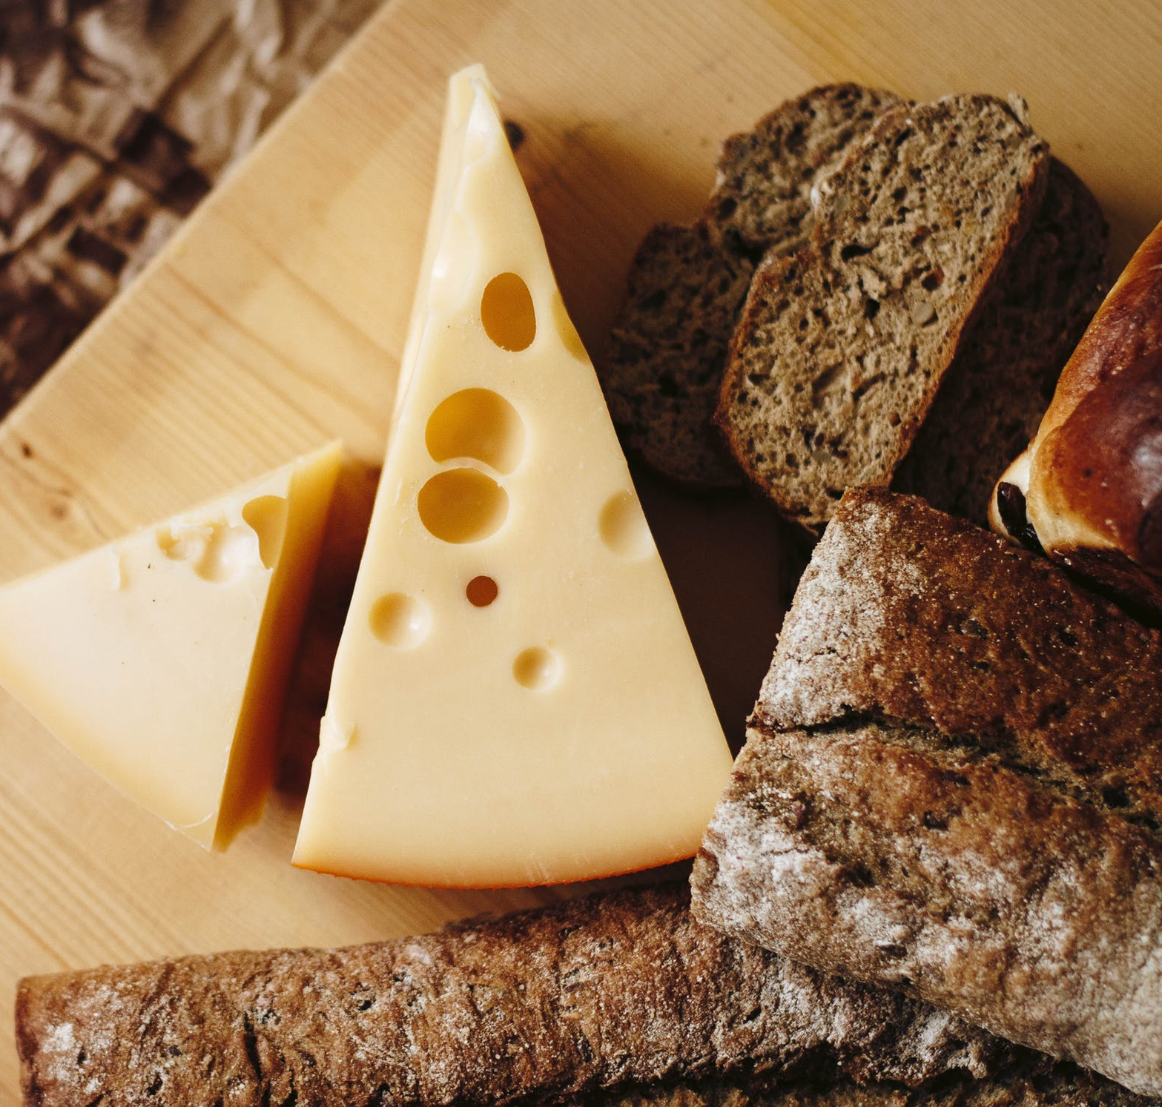
Processing Food
Which processes have they been through before we eat/drink them?

Slide 13
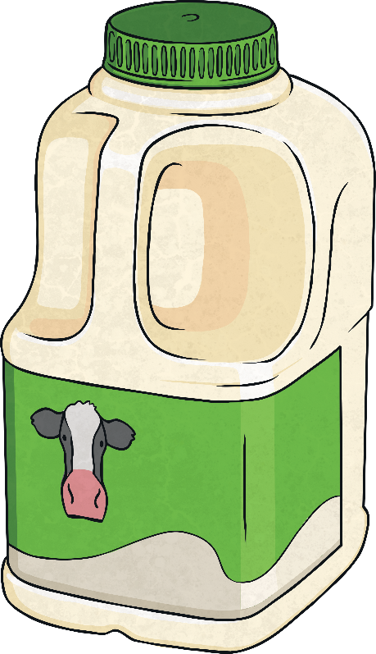
Milk
Drinking cow’s milk helps us to have calcium in our diets as well as helpful fats, proteins and a wide range of other vitamins and nutrients. Some people may choose to drink milk alternatives due to an intolerance of the lactose that can be found in cow’s milk.
What journey does cow’s milk go on to get to us?
Firstly, the cows are led into the stalls of the milking parlour to be milked.
The milking machine gently begins to suck the milk from the cow’s teats.
The amount of milk produced by the cows is measured.
The milk then travels to the farm vat where it is cooled and stored until the dairy arrives to collect it.
The milk is transferred into the tanker every day then travels to the dairy.
Once the milk arrives at the dairy, it is heat treated and then cooled very quickly to kill off harmful bacteria.
Finally, the milk is packaged and sold.

Slide 14
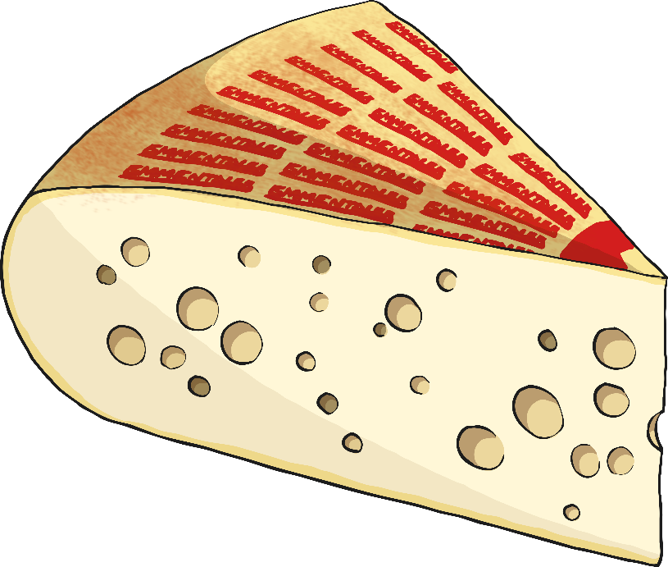
Cheese
Cheese, like milk, is a great source of vitamins,
calcium, fats and protein.
In order to become cheese, the milk it is
made from has to go through a
specific process:
The milk is ripened by adding a special bacteria to thicken it up.
Next, rennet is added to help the milk separate into curds and whey.
The whey is then separated from the curds.
Now the curds are cut to release any whey, which is then drained off.
When making cheddar, the curds are cut into blocks and stored on
top of each other.
The curd is milled into crumbs and salt is added.
This helps the cheese to have a longer life and gives it a nice flavour.
Next, the curd is pressed into moulds in order to force out more whey.
This process forms it into its final shape.
Now the cheese has to be ripened to help develop the flavour.
It is placed in a storage room for anything up to 2 years.

Slide 15
Plenary
Write down 3 things that you have learned.

