Slide 1

Comparing Places
The Caribbean and the UK

Slide 2
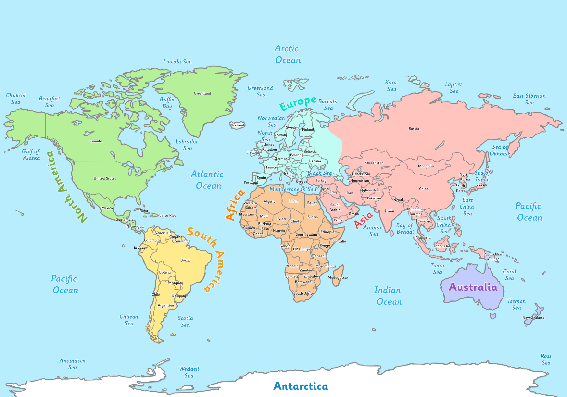
Where in the World?
United Kingdom
The United Kingdom is made up of England, Scotland, Wales and Northern Ireland. It is in the Atlantic Ocean.
The Caribbean
The Caribbean is a group of islands and reefs in the Caribbean Sea.

Slide 3

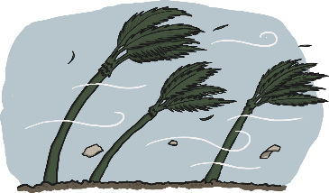
Weather in the Caribbean
The weather in the Caribbean changes over the year. The Caribbean has different seasons of weather.
In the winter (December, January and February), there is very little rainfall. On average, there is between 5cm to 8cm of rain each month. The average temperature is around 25 degrees Celsius.
The spring months of March, April and May start to get hotter, with average temperatures of 30 degrees Celsius. There is also more rainfall, with many islands having an average 13cm of rain per month.
In summer (June, July and August), both the temperature and the rainfall continue to increase. Average temperatures go up to around 35 degrees Celsius, and the average rainfall is around 25cm per month.
The autumn sees some of the most unpredictable weather in the Caribbean. The hurricane season runs from June until November, but September and October are the peak months for hurricane activity. The temperature and rainfall is the same as it is in the spring.

Slide 4



Weather in the UK
The weather in the UK also follows a seasonal pattern, but it is different to the weather pattern in the Caribbean.
The winter usually sees the coldest weather. It is cold, wet and windy, and it sometimes snows. The average winter temperature is around 3 degrees Celsius, and the average rainfall is about 5cm.
In spring, the weather turns milder. It can still be wet and windy, especially in April. The average temperature is 11 degrees Celsius and the average rainfall is 5cm.
In summer (June, July and August), the weather gets warmer. Average temperatures go up to around 19 degrees Celsius and the average rainfall is around 4.5 cm.
The autumn sees the weather turn colder and wetter. The average temperature is 13 degrees Celsius and the average rainfall is about 6cm.

Slide 5
Caribbean Fruit

Slide 6
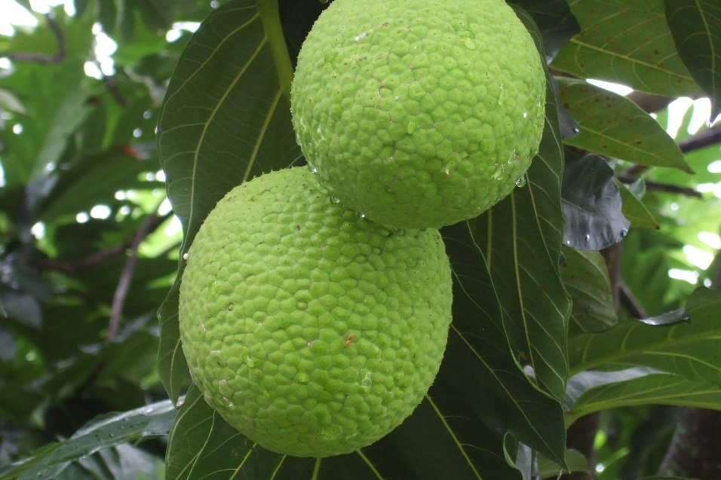
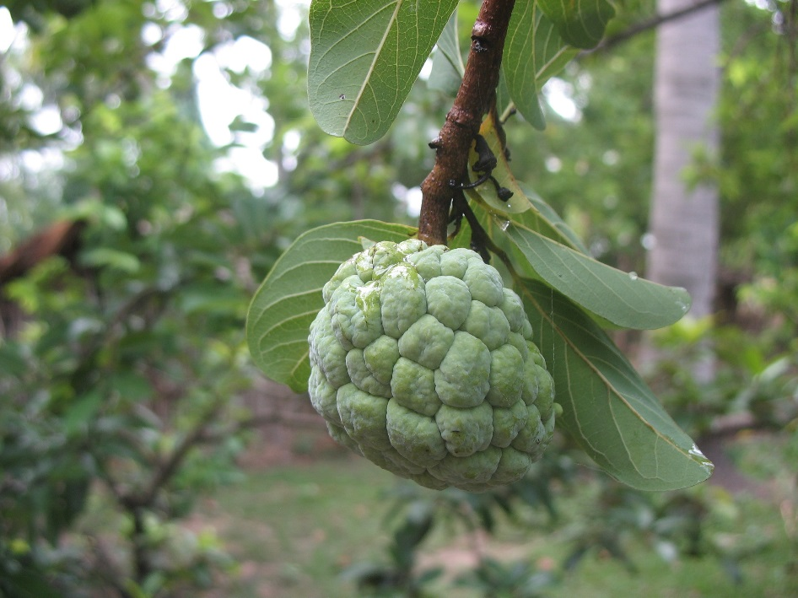
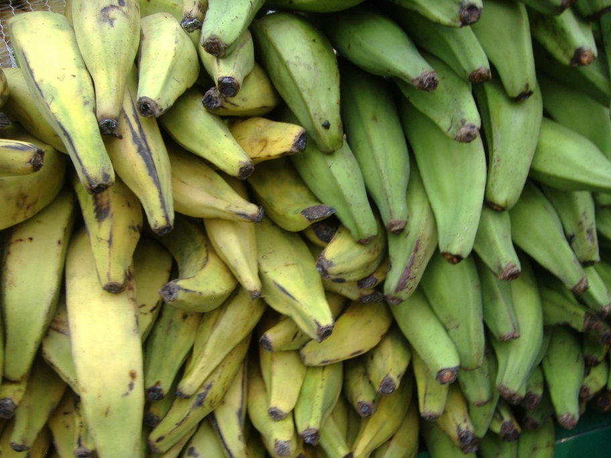
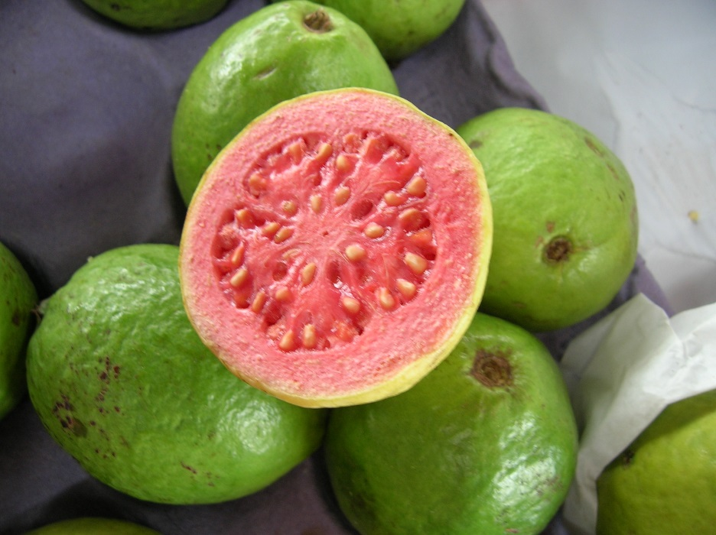
breadfruit
custard apple
plantain
guava
Photo courtesy of luigig, Virginia McMillan and Narith5 (@flickr.com) - granted under creative commons licence - attribution

Slide 7
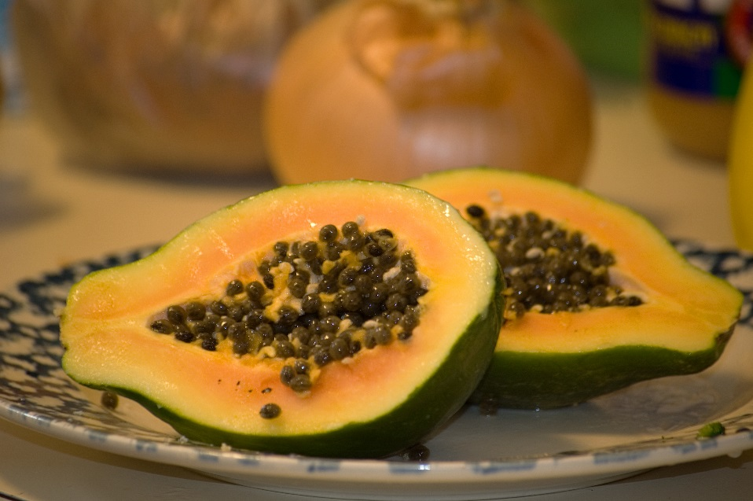
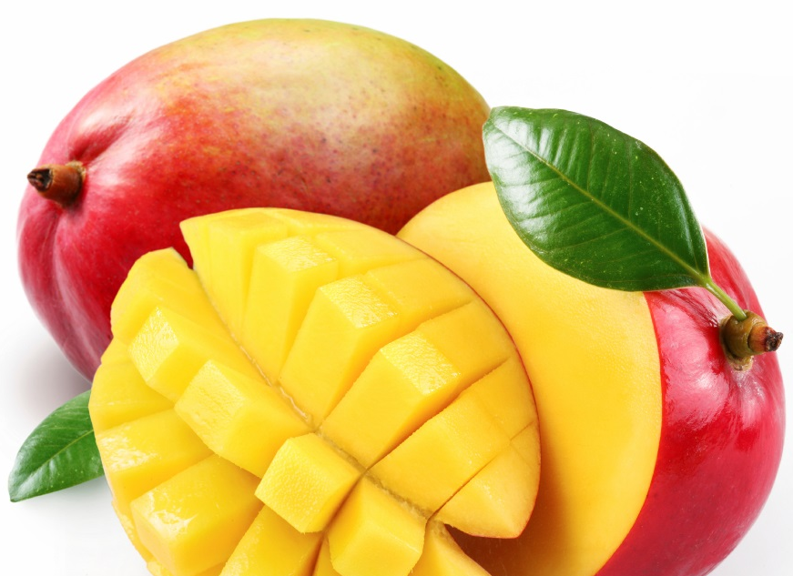
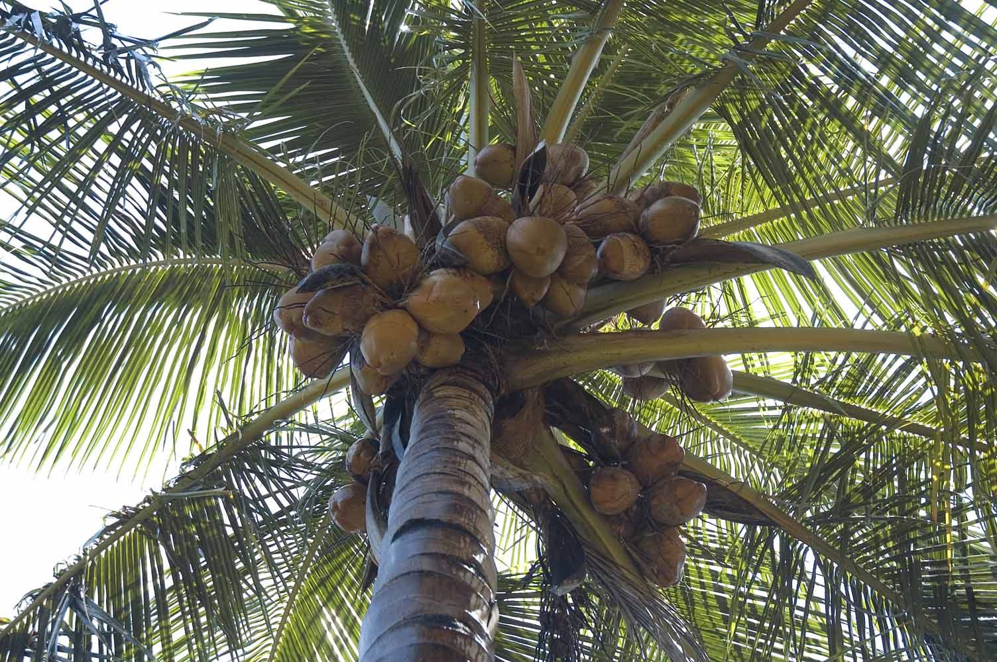
mango
papaya
coconuts
Photo courtesy of sneakerdog, Koshyk and bangdoll (@flickr.com) - granted under creative commons licence - attribution

Slide 8
UK Fruit

Slide 9
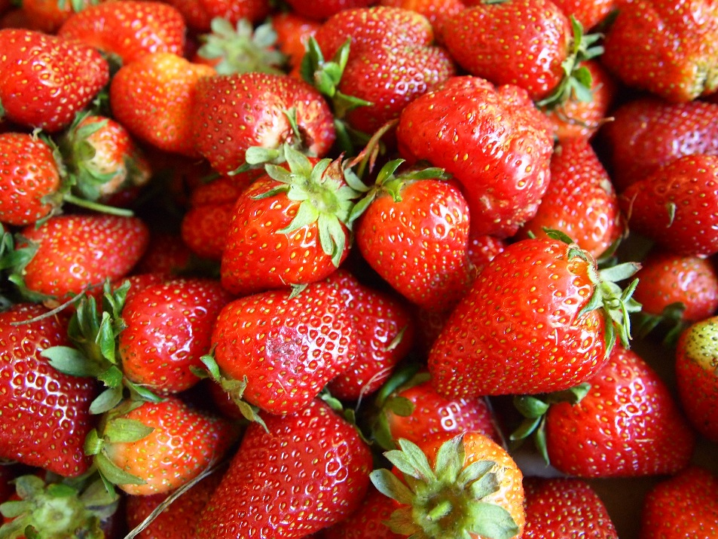
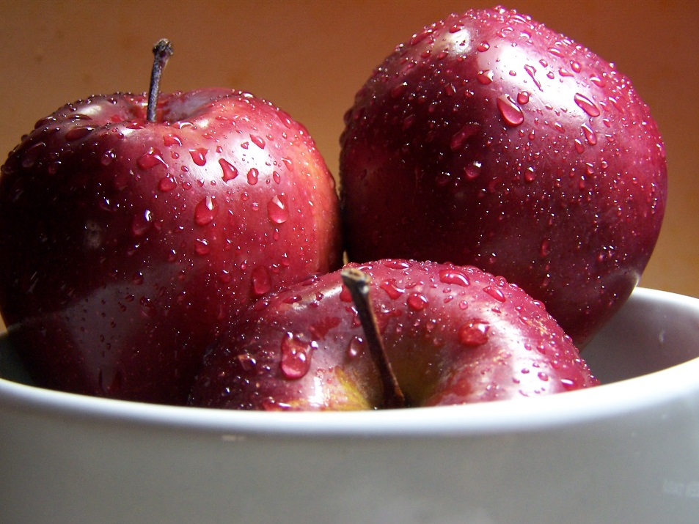
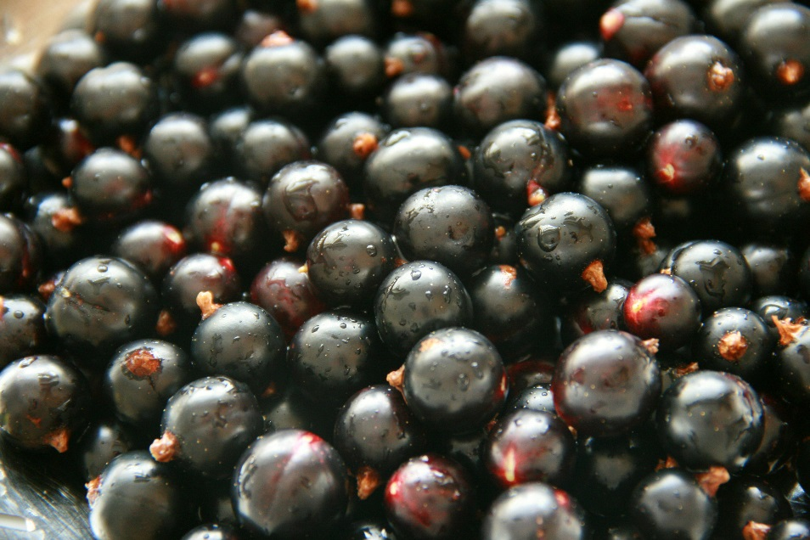
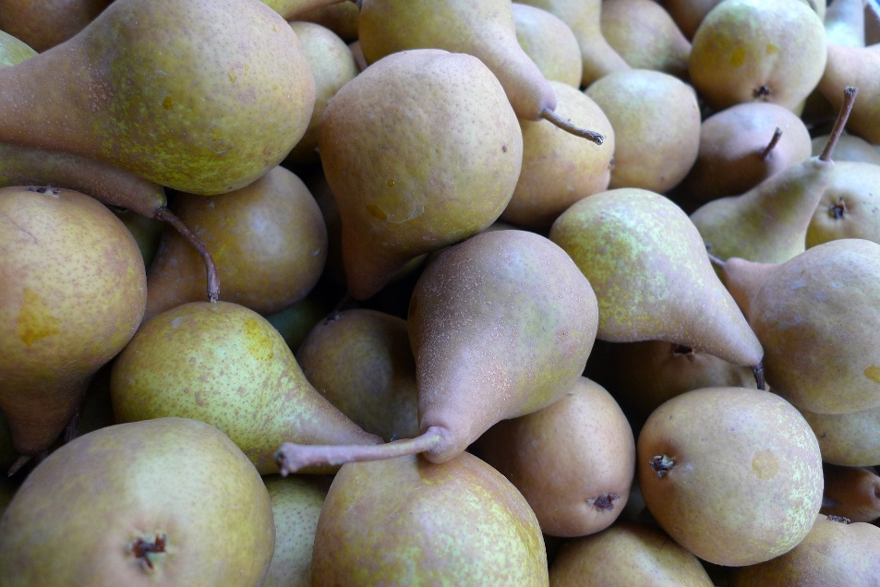
strawberries
apples
blackcurrants
pears
Photo courtesy of Fried Dough , katerha, The Garden Smallholder and cuttlefish (@flickr.com) - granted under creative commons licence - attribution

Slide 10
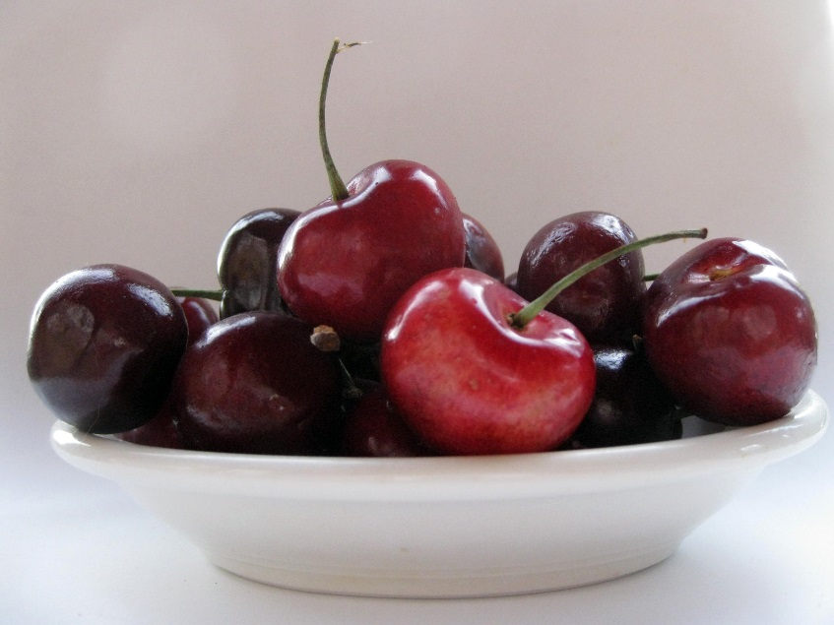
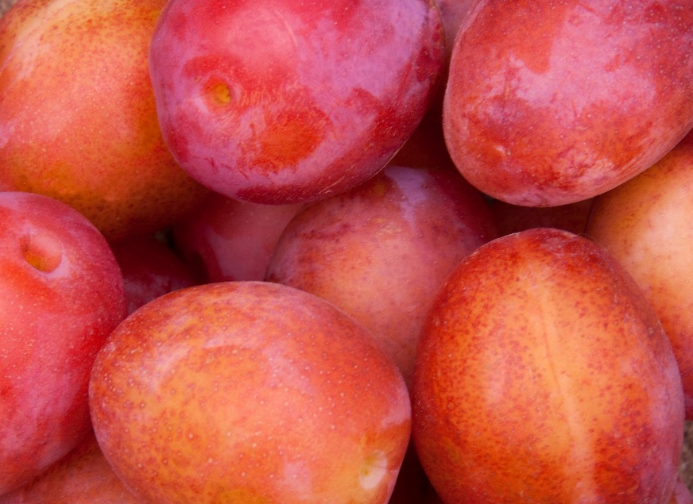
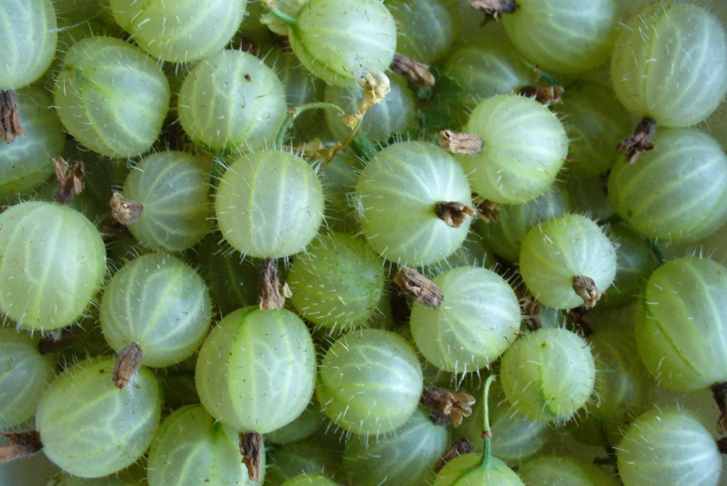
cherries
plums
gooseberries
Photo courtesy of katerha, fsse8info and ahisgett (@flickr.com) - granted under creative commons licence - attribution

Slide 11
Caribbean Houses

Slide 12
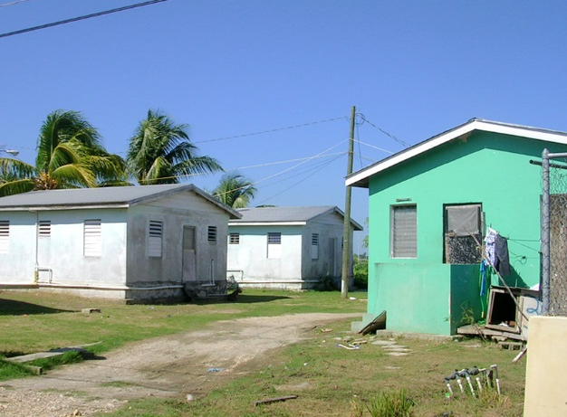
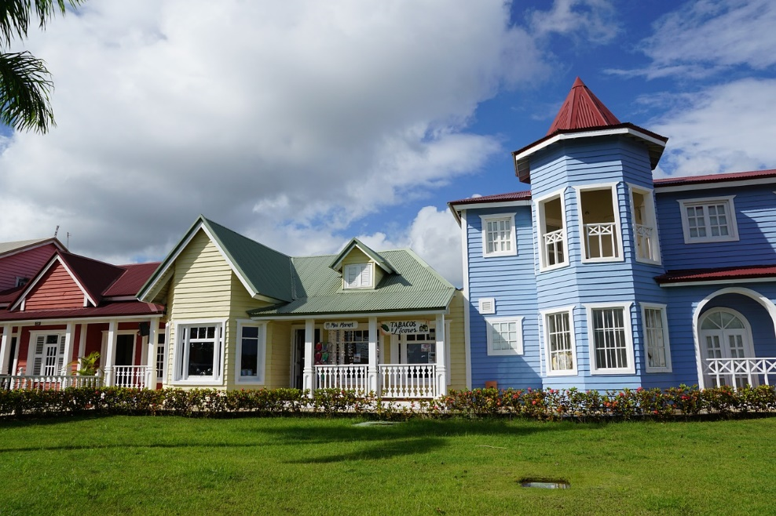
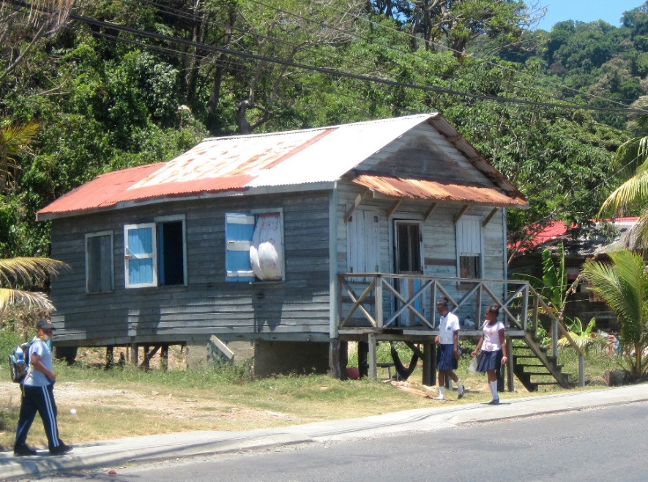
Photo courtesy of roger4336 (@flickr.com) - granted under creative commons licence - attribution

Slide 13
UK Houses

Slide 14
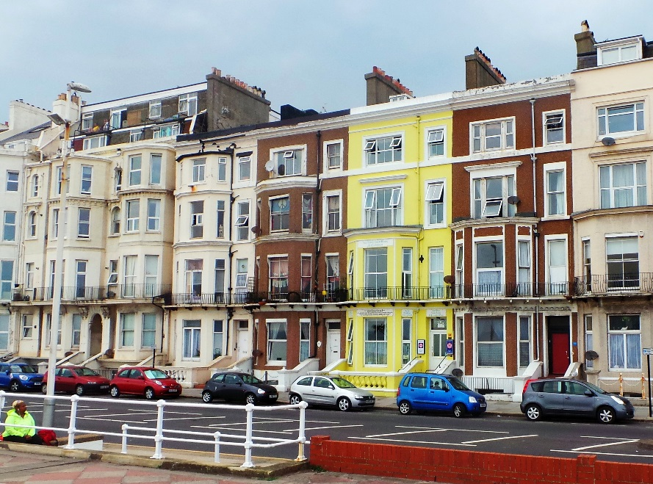
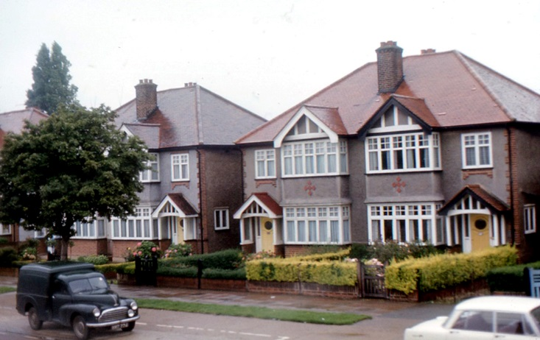
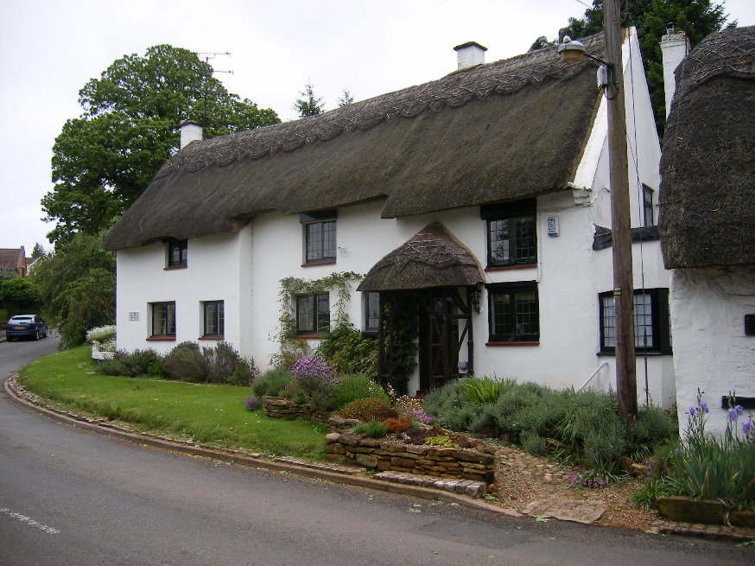
Photo courtesy of roger4336 and ell brown (@flickr.com) - granted under creative commons licence - attribution

Slide 15
Caribbean Beaches

Slide 16
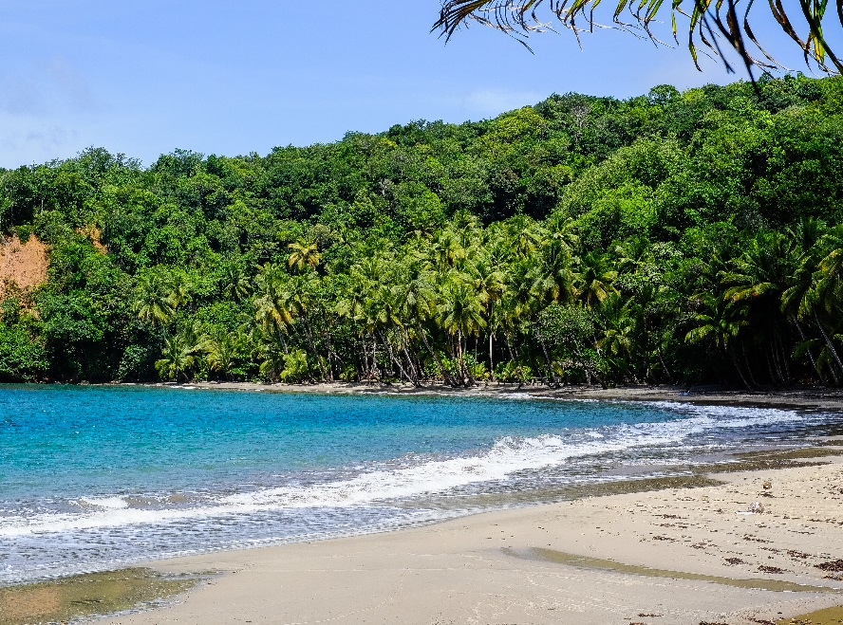
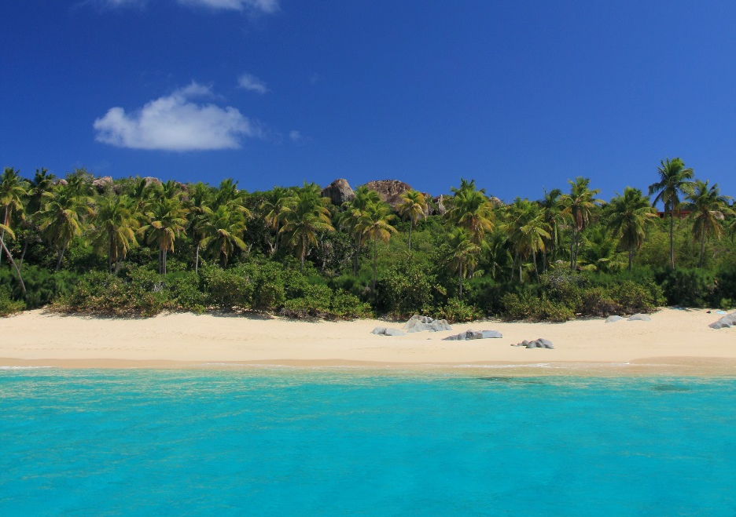
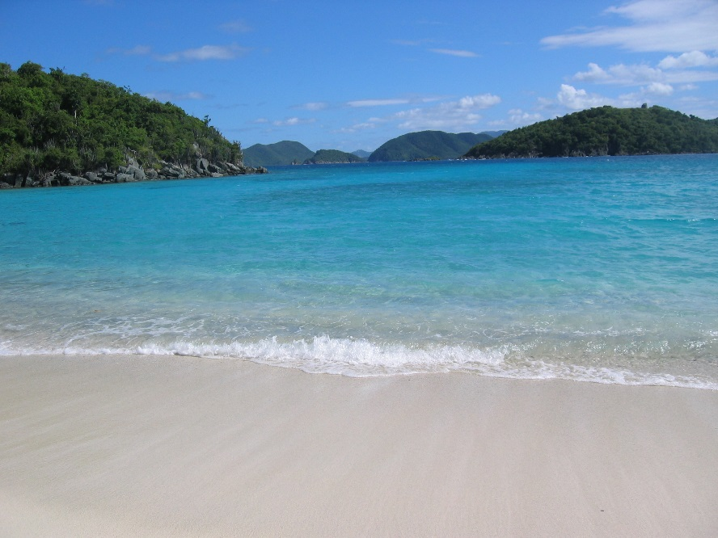
Photo courtesy of mripp, Tkrueger and Mike's Birds (@flickr.com) - granted under creative commons licence - attribution

Slide 17
UK Beaches

Slide 18
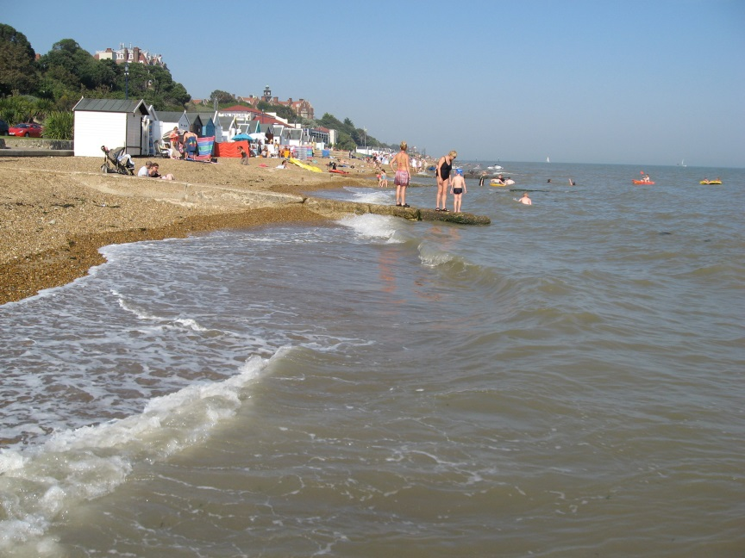
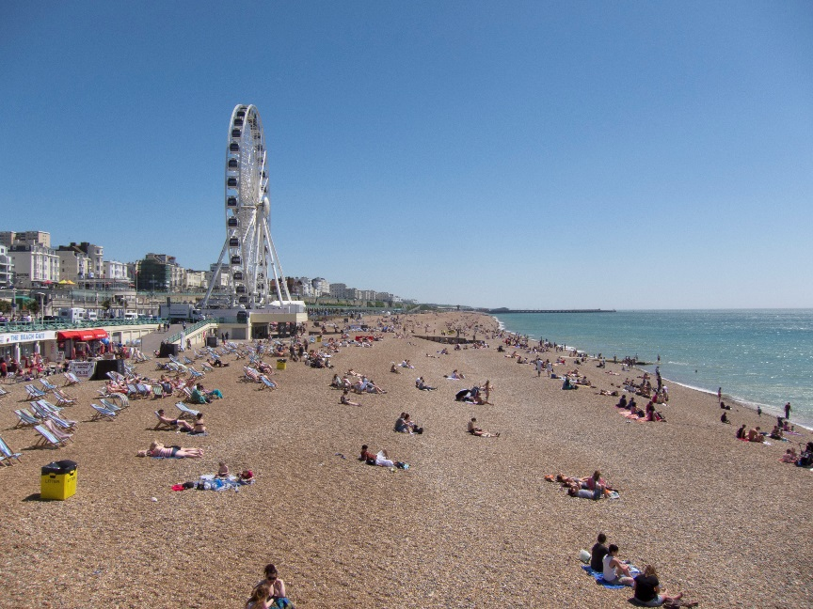
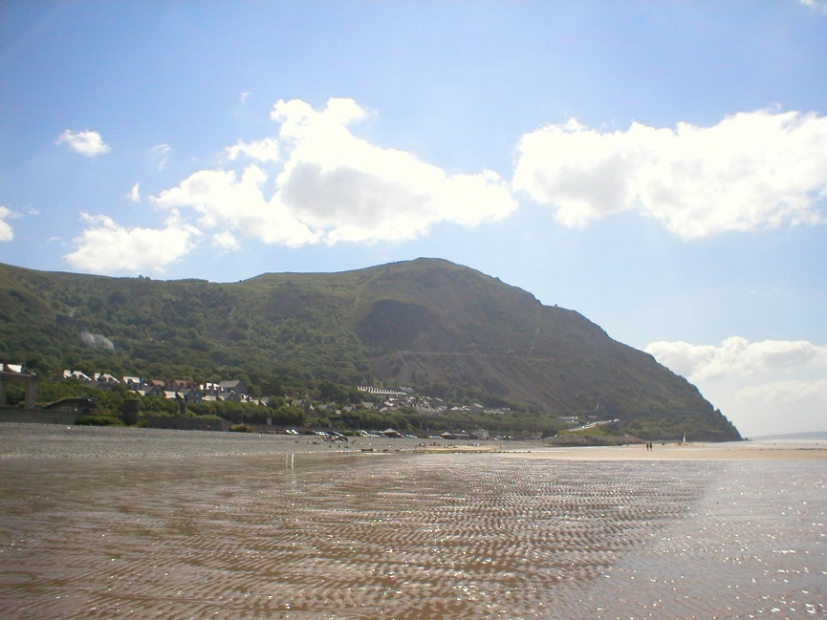
Photo courtesy of avail, andy liang and Haversack (@flickr.com) - granted under creative commons licence - attribution

